Slide 1
Epidemiology of Hepatitis B and C in Florida, 2018
Department of Health

Slide 2

Epidemiology of Hepatitis B and C in Florida, 2018
Florida Department of Health
Bureau of Communicable Diseases
Viral Hepatitis Surveillance

Slide 3
Technical Notes
Acute cases require clinical criteria (discrete symptom onset with jaundice or elevated liver enzymes) in addition to laboratory criteria. Cases with documented test conversion, where a negative lab result is followed by a positive lab result, do not require clinical criteria to be classified as an acute case.
Chronic cases do not require clinical criteria for case classification.

Slide 4
Technical Notes, Continued
Detailed case definitions for acute and chronic hepatitis B and C and perinatal hepatitis C can be found on the Department of Health’s website: floridahealth.gov/diseases-and-conditions/disease-reporting-and-management/disease-reporting-and-surveillance/surveillance-and-investigation-guidance/index.html
Data are pulled based on Morbidity and Mortality Weekly Report weeks, as outlined by the Centers for Disease Control and Prevention, and do not necessarily align with calendar years. This is referred to as “report year.”

Slide 5
Technical Notes, Continued
Cases by year represent cases reported during that report year, regardless of event date. Someone could be reported with an acute and chronic infection in the same year or across multiple report years.
Only acute cases are required to be investigated and interviewed in Florida; therefore, chronic cases may be missing demographic and risk factor information.
In 2014, Florida Administrative Code (F.A.C.), Chapter 64D–3, reporting requirements for hepatitis, changed requiring the reporting of all positive and negative hepatitis results, including screening tests. Other requirements also include all serum aminotransferase levels.

Slide 6
Technical Notes, Continued
Chronic cases do not include perinatal hepatitis cases and may not match data in FL CHARTS or data slides from previous years.
Perinatal hepatitis C is defined as hepatitis C among children less than or equal to 36 months of age who are not known to be exposed to the virus other than perinatally (i.e., mother-to-child transmission).
Data slides represent cases of all ages unless otherwise specified.
Data are pulled from Merlin, Florida’s reportable disease surveillance system. All data are as of 9/19/2019.

Slide 7
Number of Reported Chronic Hepatitis Cases in Florida, 2011–2018
Number
of Cases
¹
¹ Change to F.A.C. 64D–3 Reporting requirements for hepatitis.
Note: Chronic cases do not include perinatal hepatitis cases and may not match data in FL CHARTS or data slides from previous years. See technical notes on slide 6.
Data as of 9/19/2019.

Slide 8
Rates of Chronic Hepatitis in Florida, 2011–2018
Rate per
100,000
¹
¹ Change to F.A.C. 64D–3 Reporting requirements for hepatitis.
Note: Chronic cases do not include perinatal hepatitis cases and may not match data in FL CHARTS or data slides from previous years. See technical notes on slide 6.
Data as of 9/19/2019.

Slide 9
Chronic Hepatitis B by Age Group¹
Percentage
of Cases
N=4,927
N=4,763
¹ Age was missing for 14 cases in 2017 and 9 cases in 2018.
Bar heights may vary due to rounding.
See technical notes on slide 6. Data as of 9/19/2019.

Slide 10
Chronic Hepatitis B by Sex¹
¹ Sex was unknown for 12 cases in 2017 and 18 cases in 2018.
Bar lengths may vary due to rounding.
See technical notes on slide 6. Data as of 9/19/2019.

Slide 11
Chronic Hepatitis B by Race/Ethnicity
Bar lengths may vary due to rounding.
See technical notes on slide 6. Data as of 9/19/2019.

Slide 12
Chronic Hepatitis C by Age Group¹
Percentage
of Cases
N=26,389
¹ Age was missing for 33 cases in 2017 and 61 cases in 2018.
Bar heights may vary due to rounding.
See technical notes on slide 6. Data as of 9/19/2019.

Slide 13
Chronic Hepatitis C by Sex¹
¹ Sex was unknown for 46 cases in 2017 and 74 cases in 2018.
Bar lengths may vary due to rounding.
See technical notes on slide 6.Data as of 9/19/2019.

Slide 14
Chronic Hepatitis C by Race/Ethnicity
Bar lengths may vary due to rounding.
See technical notes on slide 6. Data as of 9/19/2019.

Slide 15
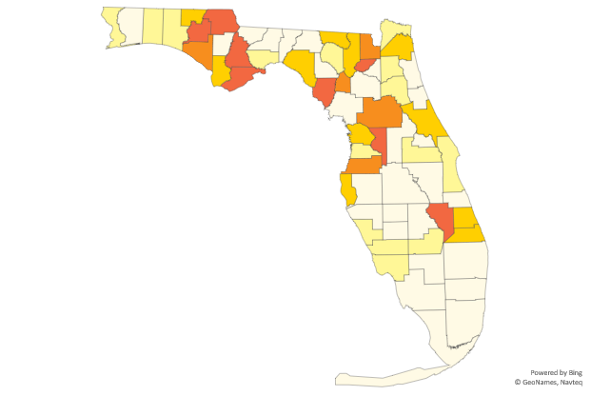
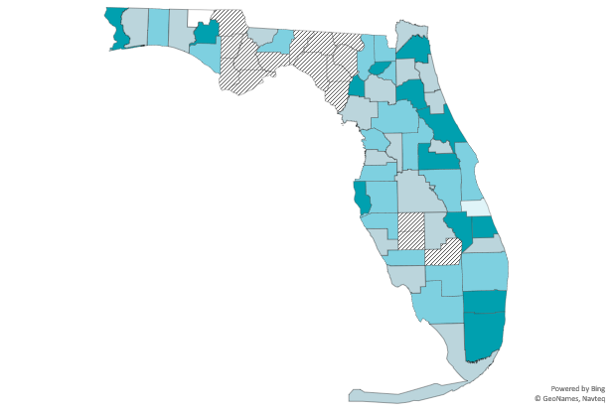
Rates¹ of Chronic Hepatitis by County, 2018
Chronic hepatitis B
N=4,763
Chronic hepatitis C
N=22,175
Rate suppressed, <5 cases
0.0
>10.0
10.0–15.0
15.1–24.0
>24.0
28.0–100.0
100.0–130.0
131.1–160.0
160.1–190.0
>190.0
¹ Per 100,000 population.
See technical notes on slide 6. Data as of 9/19/2019.

Slide 16
Acute Hepatitis in Florida

Slide 17
Number of Reported Acute Hepatitis Cases in Florida, 2011–2018
Number
of Cases
1
¹ Change to F.A.C. 64D–3 Reporting requirements for hepatitis. See technical notes on slide 6. Data as of 9/19/2019.

Slide 18
Rates of Acute Hepatitis in Florida, 2011–2018
Rate per
100,000
1
¹ Change to F.A.C. 64D–3 Reporting requirements for hepatitis. See technical notes on slide 6. Data as of 9/19/2019.

Slide 19
Acute Hepatitis B by Age Group
Percentage
of Cases
Bar heights may vary due to rounding.
See technical notes on slide 6. Data as of 9/19/2019.

Slide 20
Acute Hepatitis B by Sex
Bar lengths may vary due to rounding.
See technical notes on slide 6. Data as of 9/19/2019.

Slide 21
Acute Hepatitis B by Race/Ethnicity
N=745
N=783
Bar lengths may vary due to rounding.
See technical notes on slide 6. Data as of 9/19/2019.

Slide 22
Acute Hepatitis C by Age Group¹
Percentage
of Cases
¹ Age was missing for 1 case in 2018.
Bar heights may vary due to rounding.
See technical notes on slide 6. Data as of 9/19/2019.

Slide 23
Acute Hepatitis C by Sex
Bar lengths may vary due to rounding.
See technical notes on slide 6. Data as of 9/19/2019.

Slide 24
Acute Hepatitis C by Race/Ethnicity
Bar lengths may vary due to rounding.
See technical notes on slide 6. Data as of 9/19/2019.

Slide 25
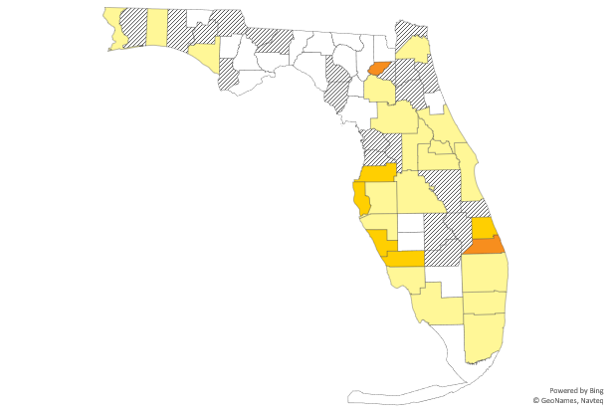
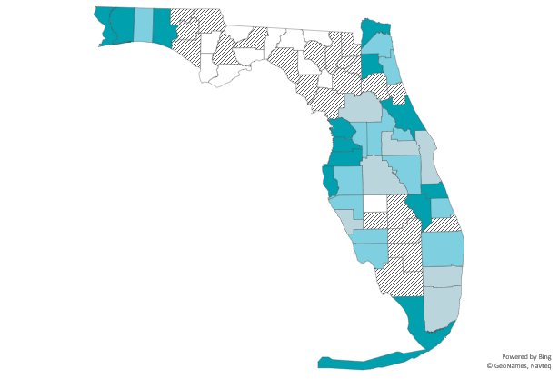
Rates¹ of Acute Hepatitis by County, 2018
Acute hepatitis B
N=783
Acute hepatitis C
N=485
Rate suppressed, <5 cases
0.0
0.1–3.0
3.1–5.0
>5.0
Rate suppressed, <5 cases
0.0
0.1–3.0
3.1–5.0
>5.0
¹ Per 100,000 population.
See technical notes on slide 6. Data as of 9/19/2019.

Slide 26
Drug use was the most commonly reported risk factor for acute hepatitis cases in 2018.
Range of missing/unknown risk factors is 37–52% for acute hepatitis B and 66–76% for acute hepatitis C.
See technical notes on slide 6. Data as of 9/19/2019.

Slide 27
Perinatal Hepatitis C in Florida,
2016–2018
Number
of Cases
¹
¹ Perinatal hepatitis C became reportable in Florida in 2016.
² Perinatal hepatitis C case definition was updated to include a suspect case classification and age was increased from 2 years to 3 years. In 2018, there were 5 suspect cases reported.
See technical notes on slide 6. Data as of 9/19/2019.

Slide 28
Perinatal Hepatitis C by Age and Sex
Percentage
of Cases
N=22 N=45
In 2018, there were 5 suspect perinatal hepatitis C cases reported. See technical notes on slide 6. Data as of 9/19/2019.

Slide 29
Perinatal Hepatitis C by Race/Ethnicity
In 2018, there were 5 suspect perinatal hepatitis C cases reported. See technical notes on slide 6. Data as of 9/19/2019.

Slide 30
The number of women of childbearing age with acute or chronic hepatitis C increased by 57% from 2011 to 2018.
Note: These charts represent persons with any reported hepatitis C infection and may not match data in FL CHARTS or data slides from previous years. FL CHARTS data represent counts of cases and not counts of persons.
See technical notes on slide 6. Data as of 9/19/2019.

Slide 31
Hepatitis Surveillance Resources
Florida CHARTS: flhealthcharts.com
Case Definitions: cdc.gov/nndss/conditions/search/hepatitis/
Serology Training: cdc.gov/hepatitis/resources/professionals/training/serology/training.htm

Slide 32
Hepatitis Prevention Resources
Treatment Map: floridahealth.gov/diseases-and-conditions/hepatitis/Hepatitis_Treatment_Map_8_20_19.xlsx
Hepatitis Resource Guide: floridahealth.gov/diseases-and-conditions/hepatitis/_documents/docs-for-hepatitis-resource-page/_documents/hepatitis-resource-guide-general-resources.pdf

Slide 33
Hepatitis Prevention Resources
Hepatitis Fact Sheets
  English: floridahealth.gov/diseases-and-conditions/hepatitis/_documents/docs-for-hepatitis-resource-page/hep-abc-chart-english.pdf
  Spanish: floridahealth.gov/diseases-and-conditions/hepatitis/_documents/educational-materials/_documents/hep-abc-chart-spanish.pdf
  Creole: floridahealth.gov/diseases-and-conditions/hepatitis/_documents/docs-for-hepatitis-resource-page/_documents/abc-chart-creole.pdf
For more prevention resources, visit flahepatitis.org

Slide 34
Viral Hepatitis Surveillance Data Contacts
Kati Touchstone Shana Geary
Viral Hepatitis Epidemiologist Supplementary Surveillance Program Mgr.
Kati.Touchstone@flhealth.gov Shana.Geary@flhealth.gov
850-901-6982 850-901-6615
Emma Spencer Tom Bendle
HIV/Hepatitis Surv. Program Mgr. Hepatitis Program Manager
Emma.Spencer@flhealth.gov Thomas.Bendle@flhealth.gov
850-245-4432 850-245-4426
Hepatitis data are also available on Florida CHARTS
floridacharts.com/charts/CommunicableDiseases/default.aspx

