Slide 1

CORAL SPRINGS / PARKLAND FIRE DEPARTMENT
COMMUNITY PARAMEDICINE / MOBILE INTEGRATED HEALTHCARE PROGRAM
FIRE CHIEF FRANK BABINEC
EMS DIVISION CHIEF JUAN CARDONA

Slide 2
The Coral Springs Fire Department
400 members including:
147 Shift Personnel
26 Administrative/Community Risk Reduction/Training Personnel
Approximately 100 Part-Time Academy Instructors
5 Fire Stations in Coral Springs (43, 64, 71, 80, 95)
3 Fire Stations in Parkland (42, 97, 109)
14,000 calls per year
11,000 EMS calls

Slide 3
CSFD Responds to Approximately 14,000 Calls Per Year
Source: Coral Springs Dispatch Center

Slide 4
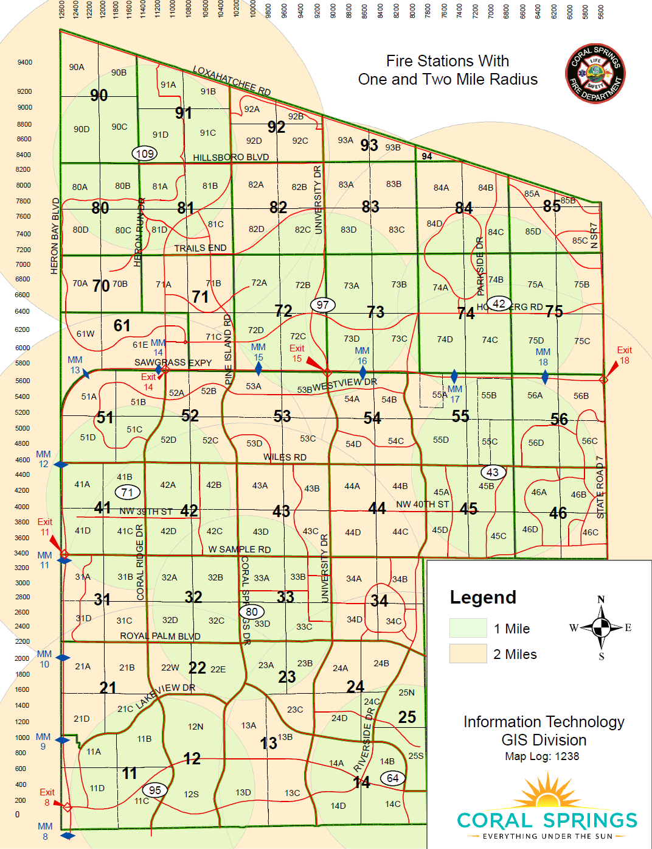

109
97
42
43
71
80
95
64

Slide 5
Community
Paramedicine

Slide 6
Community Paramedicine
The aim of Community Paramedicine Programs (CP) is to:
Increase access to primary and preventive care,
Provide wellness interventions within the medical home model,
Decrease emergency department utilization,
Save healthcare dollars, and
Improve patient outcomes using emergency medical services (EMS) providers in an expanded role. (NRHA)

Slide 7
Key Components
Patient-Centered – Must have the goal of improving patient outcomes.
Consistent with Institute for Healthcare Improvement’s “Triple Aim Initiative” – 1. Improve the patient experience; 2. Improve the health of the population; 3. Reduce the per capita cost of healthcare.
Fully Integrated – Bi-directional sharing of patient information aimed at improving care.
Collaboration – Must meet the predefined needs of the community. Must involve stakeholders, partners and providers.

Slide 8
Key Components, Continued
Supplemental – Enhances the current healthcare system, while filling gaps in resources.
Data Driven – Data is being collected and analyzed to develop evidence based performance measures.
Improves access to healthcare.
Is recognized as a multidisciplinary practice of medicine.
CP/MIH must be overseen by engaged physicians and practitioners, as well as the patient’s primary care network.
The use of telemedicine should be deployed and used whenever possible.

Slide 9
Best Practice Models
Pittsburgh PA Elderly/”EMS loyal” patients
San Diego CA Homeless/Mental health
Dallas/Fort Worth TX Hospital readmissions
Reno NV Mental health
Mesa, AZ Mobile Integrated Healthcare
Each agency has looked at their community and tailored their CP program to their specific needs.
Community needs Assessment
What are our particular needs?

Slide 10

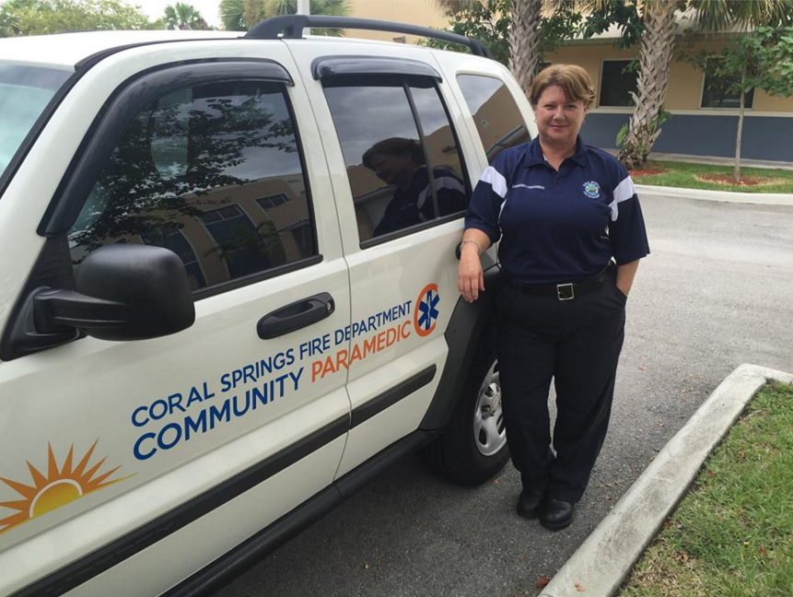
Coral Springs Fire Department
Community Paramedic Program
Community Paramedic
Sue Toolan – 17 year veteran

Slide 11
The Key person for a successful CP Program
  Motivated individual with 10 years Paramedic experience
  Community Paramedic Certificate/Training
  Excellent communication and interpersonal skills
  Ability to think “outside the box”
  Good with nurturing people
  Ability to network with many stakeholders

Slide 12
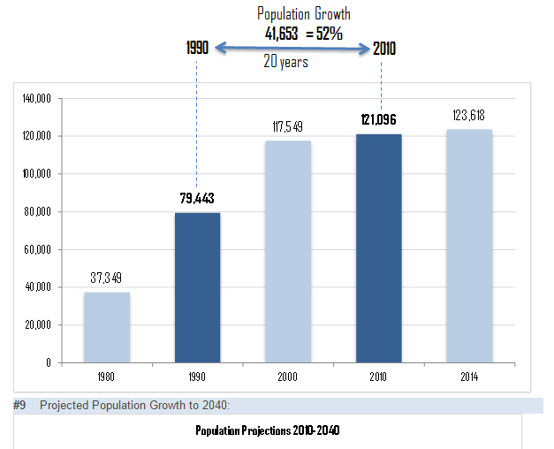


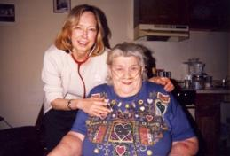
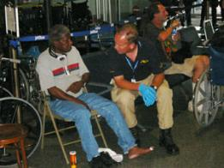
The City of Coral Springs
Target population
Frequent Callers
Frequent Fall patients
Elderly Population
Special Medical Needs
Less Privileged

Slide 13

THE COMMUNITY PARAMEDIC PROGRAM
Expand the role of paramedics, not scope
Assess and identify gaps between community needs and service
Reduce hospital readmissions and emergency department utilization
Add value to quality of life

Slide 14
Referral sources
PATIENT
CREWS
DISPATCH
FRIENDS & FAMILY
DATA
Hospital

Slide 15
Adding Value to the Lives of Our Customers
Referrals for Hospice care
Referrals to Home Health Care Agencies
Acquiring medical equipment for those in need
Home safety assessments
Medication reconciliation
Utilization of appropriate County/State agencies to facilitate care

Slide 16
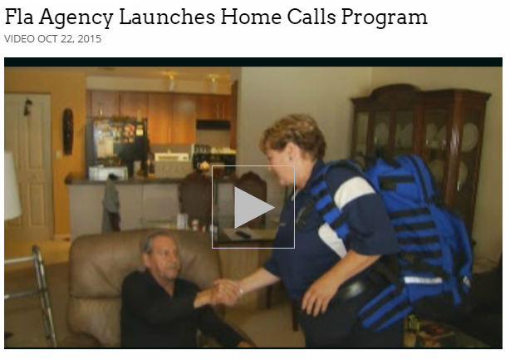

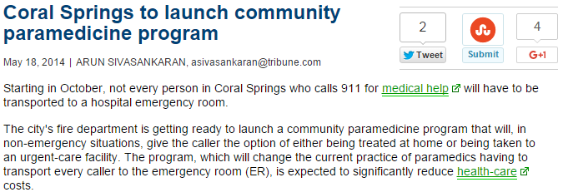

Outcomes
Some of our immediate outcomes
To date 80 cases with 15 active
Reduction in frequent callers
Increase unit availability
Fall prevention education
Provide assistance to special medical needs patients
Utilization of non-emergency contact number vs. 911 (954-346-HELP)

Slide 17
Short-term Outcomes (7 Months)
12% Reduction in calls from patients admitted to our CP Program
22.5 Hours of capacity added to our emergency fleet
More customized issue resolution from CP Vs Rescue Unit (with follow up)
Sustainable Reduction- Resolving the root cause of the issue

Slide 18
REDUCTION IN CALL VOLUME FROM CP POPULATON

Slide 19
CP Success Stories
SOME OF OUR SUCCESS STORIES TO DATE
“Bob” – Lives alone, COPD getting worse. “I was ready to pull the plug”
“Jane” “I was a Prisoner in my own home”
“Sue is now my guardian angel”
“I had no means of transportation to seek care”
Installation of wheel chair ramps for Patient
New hospital bed for a patient unable to sit upright

Slide 20
Mobile
Integrated
Healthcare

Slide 21
Coral Springs Fire Department
Mobile Integrated Healthcare
CSFD is designing a new and innovative healthcare initiative by bringing care to patients’ home for non-emergent issues
Utilization of Mid-level providers ARNP
In partnership with Cleveland Clinic
Will be the first of its kind in our state as well as the Southeast region of the country

Slide 22
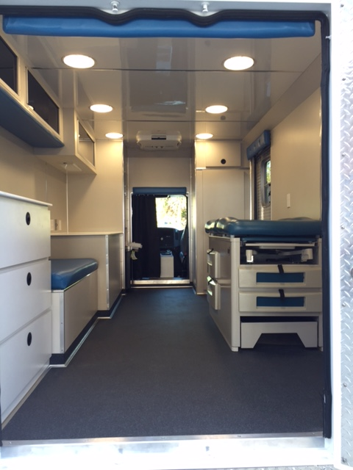
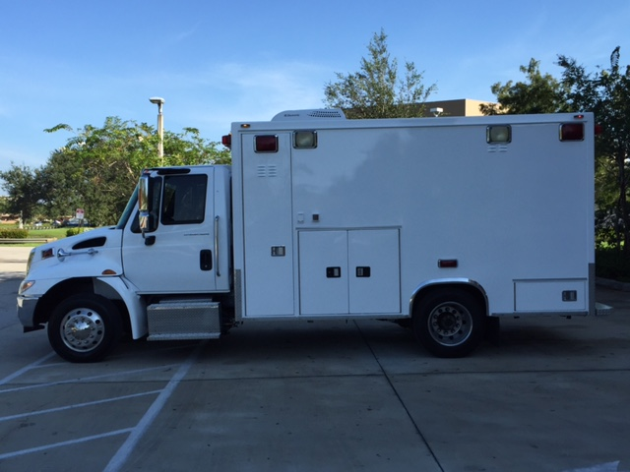
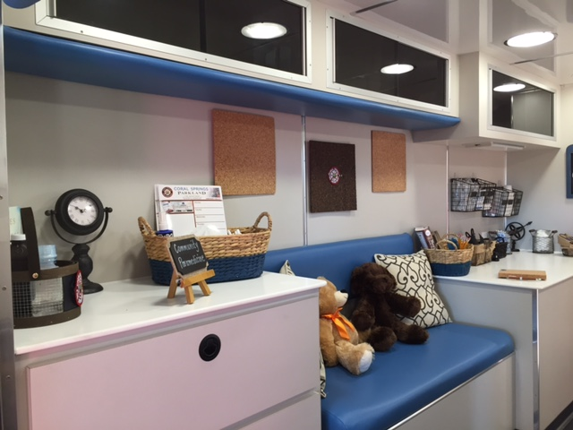
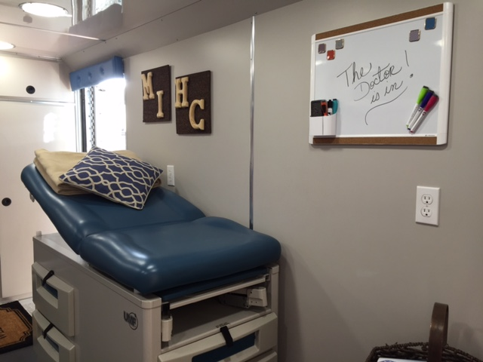
The MIH Unit

Slide 23
Community Needs Assessment
Target Population
Unscheduled mid-level care evaluation and treatment.
Model of “assess, treat and refer”
Primary, secondary and tertiary prevention strategies.
Patient advocacy and education.
A range of treatment/transport options.
Chronic Disease Management.
Most importantly this program will remain patient-centered with an emphasis on ease of access to care, developing non-traditional portals of entry, continuity of care and transparency.

Slide 24
Delivery of Services
Deploy a well equipped Mobile Integrated Health Care Unit.
Level of care to be determined by CSFD Officer on scene or the MIH unit ANRP.
Mobile unit is dispatched to scene via CSFD dispatch.
Mobile unit will provide the patient with mid-level care, referral, documentation, and follow up instructions.
If required, the patient will be transported by an ALS transport unit to the most appropriate facility.

Slide 25
Delivery of Services, Continued
During Times of Decreased Activity:
Functions similar to community paramedic
Discharge Follow up
  Vital signs, Pulse Ox, Glucose, etc.
Health System Navigation Assistance
Prevention of hospital readmissions: CHF, asthma, pneumonia, diabetics, etc.
Patient home safety inspections (fall prevention)
Evaluation of patient’s overall needs
  Food, utilities, relatives transportation, etc.
  Medication reconciliation
  Mental Health

Slide 26
Examples of Additional Functions
Assessment: Vital signs, Blood pressure/glucose screening and monitoring, Routine follow up of patient’s EKG, Prescription drug compliance monitoring, Patient safety risks (e.g., risk for falling)
Treatment/Intervention of low acuity calls: Breathing treatments, wound care, stapling, suture removal, tetanus shots, closed fractures, soft casting, pain management, changing dressings, pediatric fever, Foley catheter, Intravenous medication monitoring, patient not feeling well, the flu, patient education, etc.
Referrals: Mental health and substance use disorder referrals, Social service referrals
Prevention and Public Health: Immunizations, Flu shots, Well Baby checks, Asthma management (nebulization therapy), Fluoride varnishing and oral health activities, Disease investigation, School/sports physicals

Slide 27
Quality Assurance/Quality Improvement
Performance Measures are being put in place and will be reviewed on a regular basis
Each member of this specialized unit will be continuously trained to the standard of care
The success on this program relies heavily on solid partnerships with our medical community and support services
  Local hospital system, primary care physicians, Specialists, Hospice, Home health, etc.

Slide 28

Questions?

