Slide 1
Epidemiology of Hepatitis B and C in Florida, 2019
Department of Health
Data as of 1/21/2021

Slide 2

Epidemiology of Hepatitis B and C in Florida, 2019
Florida Department of Health
Bureau of Communicable Diseases
Viral Hepatitis Surveillance

Slide 3
Technical Notes
Acute cases require clinical criteria (discrete symptom onset with jaundice or elevated liver enzymes) in addition to laboratory criteria. Cases with documented test conversion, where a negative hepatitis B virus or hepatitis C virus lab result is followed by a positive lab result, do not require clinical criteria to be classified as acute.
Chronic cases do not require clinical criteria for case classification.

Slide 4
Technical Notes, continued
Detailed case definitions for acute and chronic hepatitis B and C and perinatal hepatitis C can be found on the Department of Health’s website: floridahealth.gov/diseases-and-conditions/disease-reporting-and-management/disease-reporting-and-surveillance/surveillance-and-investigation-guidance/index.html.
Data are pulled based on Morbidity and Mortality Weekly Report weeks, as outlined by the Centers for Disease Control and Prevention, and do not necessarily align with calendar years. This is referred to as “report year.”

Slide 5
Technical Notes, continued
Cases by year represent cases reported during that report year, regardless of event date. Someone could be reported with an acute and chronic infection in the same year or across multiple report years.
Only acute cases are required to be investigated and interviewed in Florida; therefore, chronic cases may be missing demographic and risk factor information.
In 2014, Florida Administrative Code (F.A.C.) Chapter 64D-3, Reporting requirements for hepatitis, changed, requiring the reporting of all positive and negative hepatitis results, including screening tests. Other requirements include all serum aminotransferase levels.

Slide 6
Technical Notes, continued
In 2020, national case definition changes were implemented for acute and chronic hepatitis C. “Discrete onset of symptoms” was removed from acute clinical criteria, and jaundice, peak elevated total bilirubin levels ≥ 3.0 mg/dL or peak elevated serum alanine aminotransferase levels > 200 IU/L are sufficient to meet acute clinical criteria for the 2020 case definition. Additionally, the “negative nucleic acid test followed by positive antibody to hepatitis C (anti-HCV)” test conversion scenario was removed.

Slide 7
Technical Notes, continued
Chronic cases do not include perinatal hepatitis cases and may not match data in FLHealthCHARTS.com or data slides from previous years.
Perinatal hepatitis C is defined as hepatitis C among children less than or equal to 36 months of age who are not known to be exposed to the virus other than perinatally (i.e., mother-to-child transmission).
Data slides represent cases of all ages unless otherwise specified.
Bar heights may vary due to rounding.
Data are pulled from Merlin, Florida’s reportable disease surveillance system. All data are as of 1/21/2021.

Slide 8
Number of Reported Chronic Hepatitis Cases in Florida, 2012–2019
Number
of Cases
¹
¹ Change to F.A.C. 64D-3, Reporting requirements for hepatitis.

Slide 9
Rates of Chronic Hepatitis in Florida, 2012–2019
Rate per
100,000
¹
¹ Change to F.A.C. 64D-3, Reporting requirements for hepatitis.

Slide 10
Chronic Hepatitis B by Age Group¹
Percentage
of Cases
N=4,763
¹ Age was missing for 9 cases in 2018 and 13 cases in 2019.

Slide 11
Chronic Hepatitis B by Sex¹
¹ Sex was unknown for 15 cases in 2018 and 7 cases in 2019.

Slide 12
Chronic Hepatitis B by Race/Ethnicity

Slide 13
Chronic Hepatitis C by Age Group¹
Percentage
of Cases
N=19,917
¹ Age was missing for 61 cases in 2018 and 44 cases in 2019.

Slide 14
Chronic Hepatitis C by Sex¹
¹ Sex was unknown for 58 cases in 2018 and 33 cases in 2019.

Slide 15
Chronic Hepatitis C by Race/Ethnicity
N=22,175
N=19,917

Slide 16
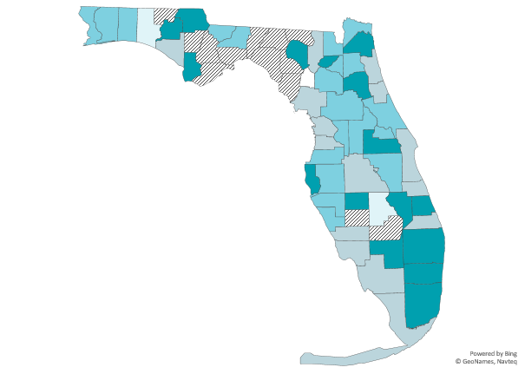
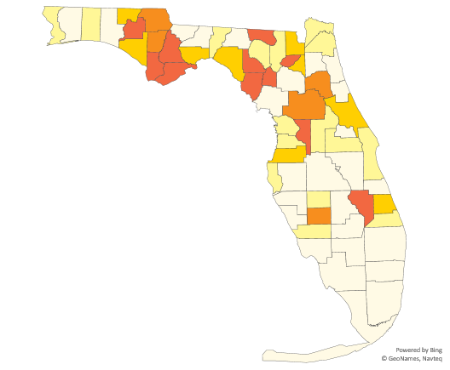
Rates¹ of Chronic Hepatitis by County, 2019
Chronic hepatitis B
N=4,812
Chronic hepatitis C
N=19,917
Rate suppressed, <5 cases
0.0
<10.0
10.0–15.0
15.1–24.0
>24.0
28.0–100.0
100.0–130.0
131.1–160.0
160.1–190.0
>190.0
¹ Per 100,000 population.

Slide 17
Acute Hepatitis in Florida

Slide 18
Number of Reported Acute Hepatitis Cases in Florida, 2012–2019
Number
of Cases
1
¹ Change to F.A.C. 64D-3, Reporting requirements for hepatitis.

Slide 19
Rates of Acute Hepatitis in Florida, 2012–2019
Rate per
100,000
1
¹ Change to F.A.C. 64D-3, Reporting requirements for hepatitis.

Slide 20
Acute Hepatitis B by Age Group
Percentage
of Cases

Slide 21
Acute Hepatitis B by Sex

Slide 22
Acute Hepatitis B by Race/Ethnicity
N=783
N=759

Slide 23
Acute Hepatitis C by Age Group
Percentage
of Cases

Slide 24
Acute Hepatitis C by Sex

Slide 25
Acute Hepatitis C by Race/Ethnicity

Slide 26
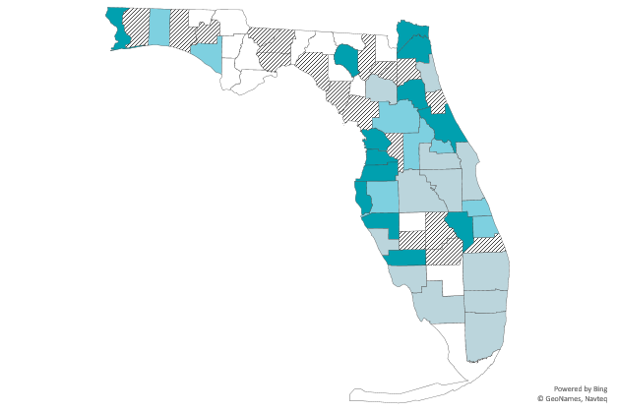
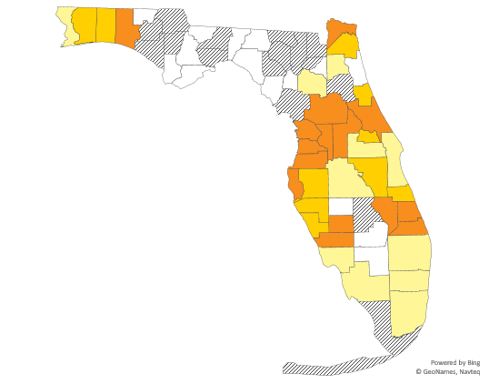
Rates¹ of Acute Hepatitis by County, 2019
Acute hepatitis B
N=759
Acute hepatitis C
N=806
Rate suppressed, <5 cases
0.0
0.1–3.0
3.1–5.0
>5.0
Rate suppressed, <5 cases
0.0
0.1–3.0
3.1–5.0
>5.0
¹ Per 100,000 population.

Slide 27
Drug Use was the Most Commonly Reported Risk Factor for Acute Hepatitis Cases in 2019.
Range of missing/unknown risk factors is 31–57% for acute hepatitis B and 35–69% for acute hepatitis C.

Slide 28
Perinatal Hepatitis C in Florida,
2016–2019
Number
of Cases
¹
¹ Perinatal hepatitis C became reportable in Florida.
² Perinatal hepatitis C case definition was updated to include a suspect case classification and age was increased
from 2 years to 3 years. In 2019, there were 2 suspect cases reported.

Slide 29
Perinatal Hepatitis C by Age and Sex
Percentage
of Cases
N=45 N=24
In 2019, there were 2 suspect perinatal hepatitis C cases reported.

Slide 30
Perinatal Hepatitis C by Race/Ethnicity
In 2019, there were 2 suspect perinatal hepatitis C cases reported.

Slide 31
The Number of Women of Childbearing Age with Acute or Chronic Hepatitis C Increased by 16% from 2012 to 2019.
These charts represent persons with any reported hepatitis C infection and may not match data in FLHealthCHARTS.com or data slides from previous years. FLHealthCHARTS.com data represent counts of cases and not counts of persons.

Slide 32
Hepatitis Surveillance Resources
FLHealthCHARTS: flhealthcharts.com
Case Definitions: cdc.gov/nndss/conditions/search/hepatitis/
Serology Training: cdc.gov/hepatitis/resources/professionals/training/serology/training.htm

Slide 33
Hepatitis Prevention Resources
Hepatitis Resource Guide: floridahealth.gov/diseases-and-conditions/hepatitis/_documents/docs-for-hepatitis-resource-page/_documents/hepatitis-resource-guide-general-resources.pdf
Hepatitis General Information: floridahealth.gov/diseases-and-conditions/hepatitis/hepatitis-general-information.html
Hepatitis Education Materials: floridahealth.gov/diseases-and-conditions/hepatitis/education-materials.html

Slide 34
Hepatitis Prevention Resources, continued
Hepatitis Fact Sheets
  English: floridahealth.gov/diseases-and-conditions/hepatitis/_documents/docs-for-hepatitis-resource-page/hep-abc-chart-english.pdf
  Spanish: floridahealth.gov/diseases-and-conditions/hepatitis/_documents/educational-materials/_documents/hep-abc-chart-spanish.pdf
  Haitian Creole: floridahealth.gov/diseases-and-conditions/hepatitis/_documents/docs-for-hepatitis-resource-page/_documents/abc-chart-creole.pdf
For more prevention resources, visit flahepatitis.org

Slide 35
Viral Hepatitis Surveillance Data Contacts
Kati Touchstone Tom Bendle
Hepatitis Surveillance Epidemiologist Hepatitis Program Manager Kati.Touchstone@flhealth.gov Thomas.Bendle@flhealth.gov
850-901-6982 850-245-4426
Hepatitis data are also available on FLHealthCHARTS
flhealthcharts.com/charts/CommunicableDiseases/default.aspx

