Slide 1
Influenza and ILI Update
Florida Department of Health
Division of Disease Control & Health Protection
Bureau of Epidemiology
To protect, promote, and improve the health of all people in Florida through integrated state, county, and community efforts.

Slide 2
Percent of Emergency Department and Urgent Care Center Visits for Influenza-Like Illness by Flu Season

Slide 3
Percent of Emergency Department and Urgent Care Center Visits for Influenza-Like Illness in People 65 Years and Older by Flu Season

Slide 4
Where are outbreaks occurring?
As of January 25, 2018: 202 outbreaks of influenza and influenza-like illness (ILI) have been reported
  127 (63%) in facilities serving the elderly (skilled nursing facilities, assisted living facilities, long-term care facilities)
  34 (17%) in schools
  27 (13%) in daycares
  8 (4%) in correctional facilities
  4 (2%) in health care facilities
  2 (1%) in other facilities

Slide 5
Outbreaks in Settings Serving the Elderly
127 outbreaks of influenza and influenza-like illness (ILI) reported
  39 (31%) in skilled nursing facilities
  28 (22%) in assisted living facilities
  60 (47%) in long-term care facilities (LTCFs), not otherwise specified

Slide 6
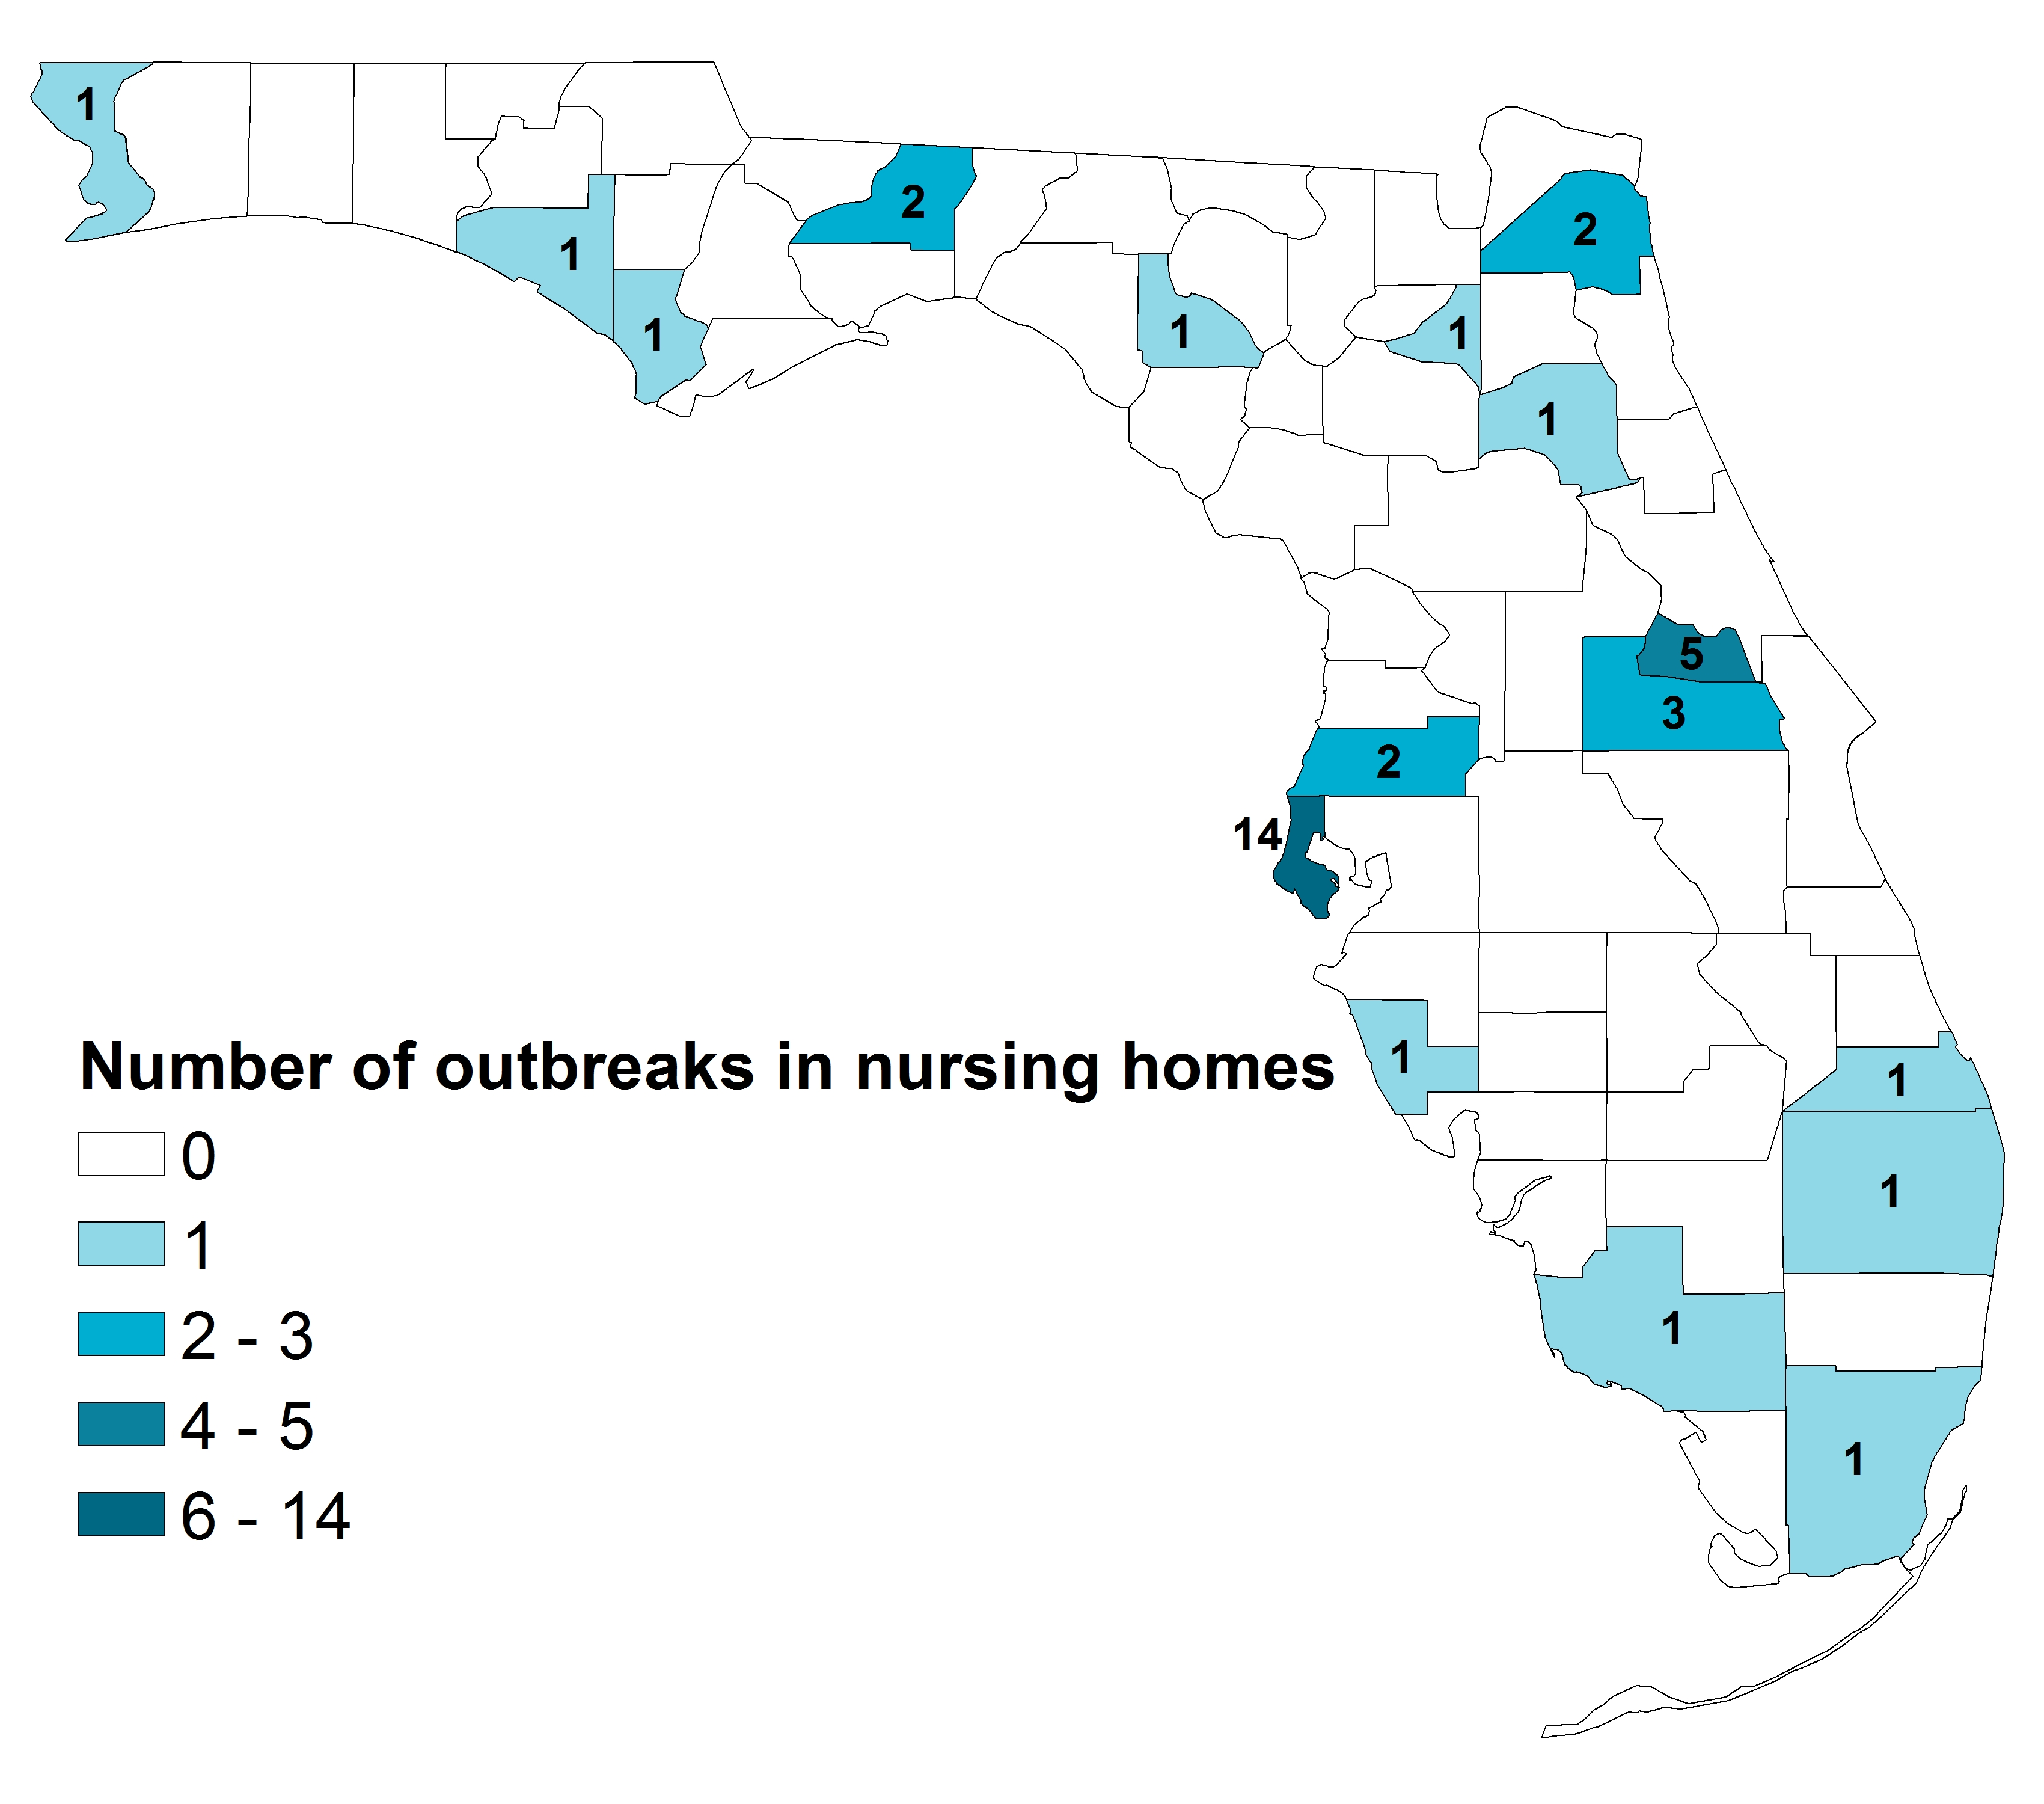
Outbreaks in Skilled Nursing Facilities – Vaccination Status
39 outbreaks of influenza and ILI reported in skilled nursing facilities
  14/39 (36%) reported to have any influenza vaccination
  12/39 (31%) reported to have both staff and residents vaccinated
  In one outbreak, only staff were reported vaccinated and in another only residents were reported vaccinated
  Many facilities unable to provide information about how many staff or residents had been vaccinated

Slide 7
Outbreaks in Skilled Nursing Facilities – Administration of Antiviral Treatment and Chemoprophylaxis
  Antiviral treatment was administered to at-risk ill individuals in 84% of the outbreaks after it was recommended by CHDs.
  Antiviral chemoprophylaxis was administered to at-risk ill individuals in 68% of the outbreaks after it was recommended by CHDs.

Slide 8
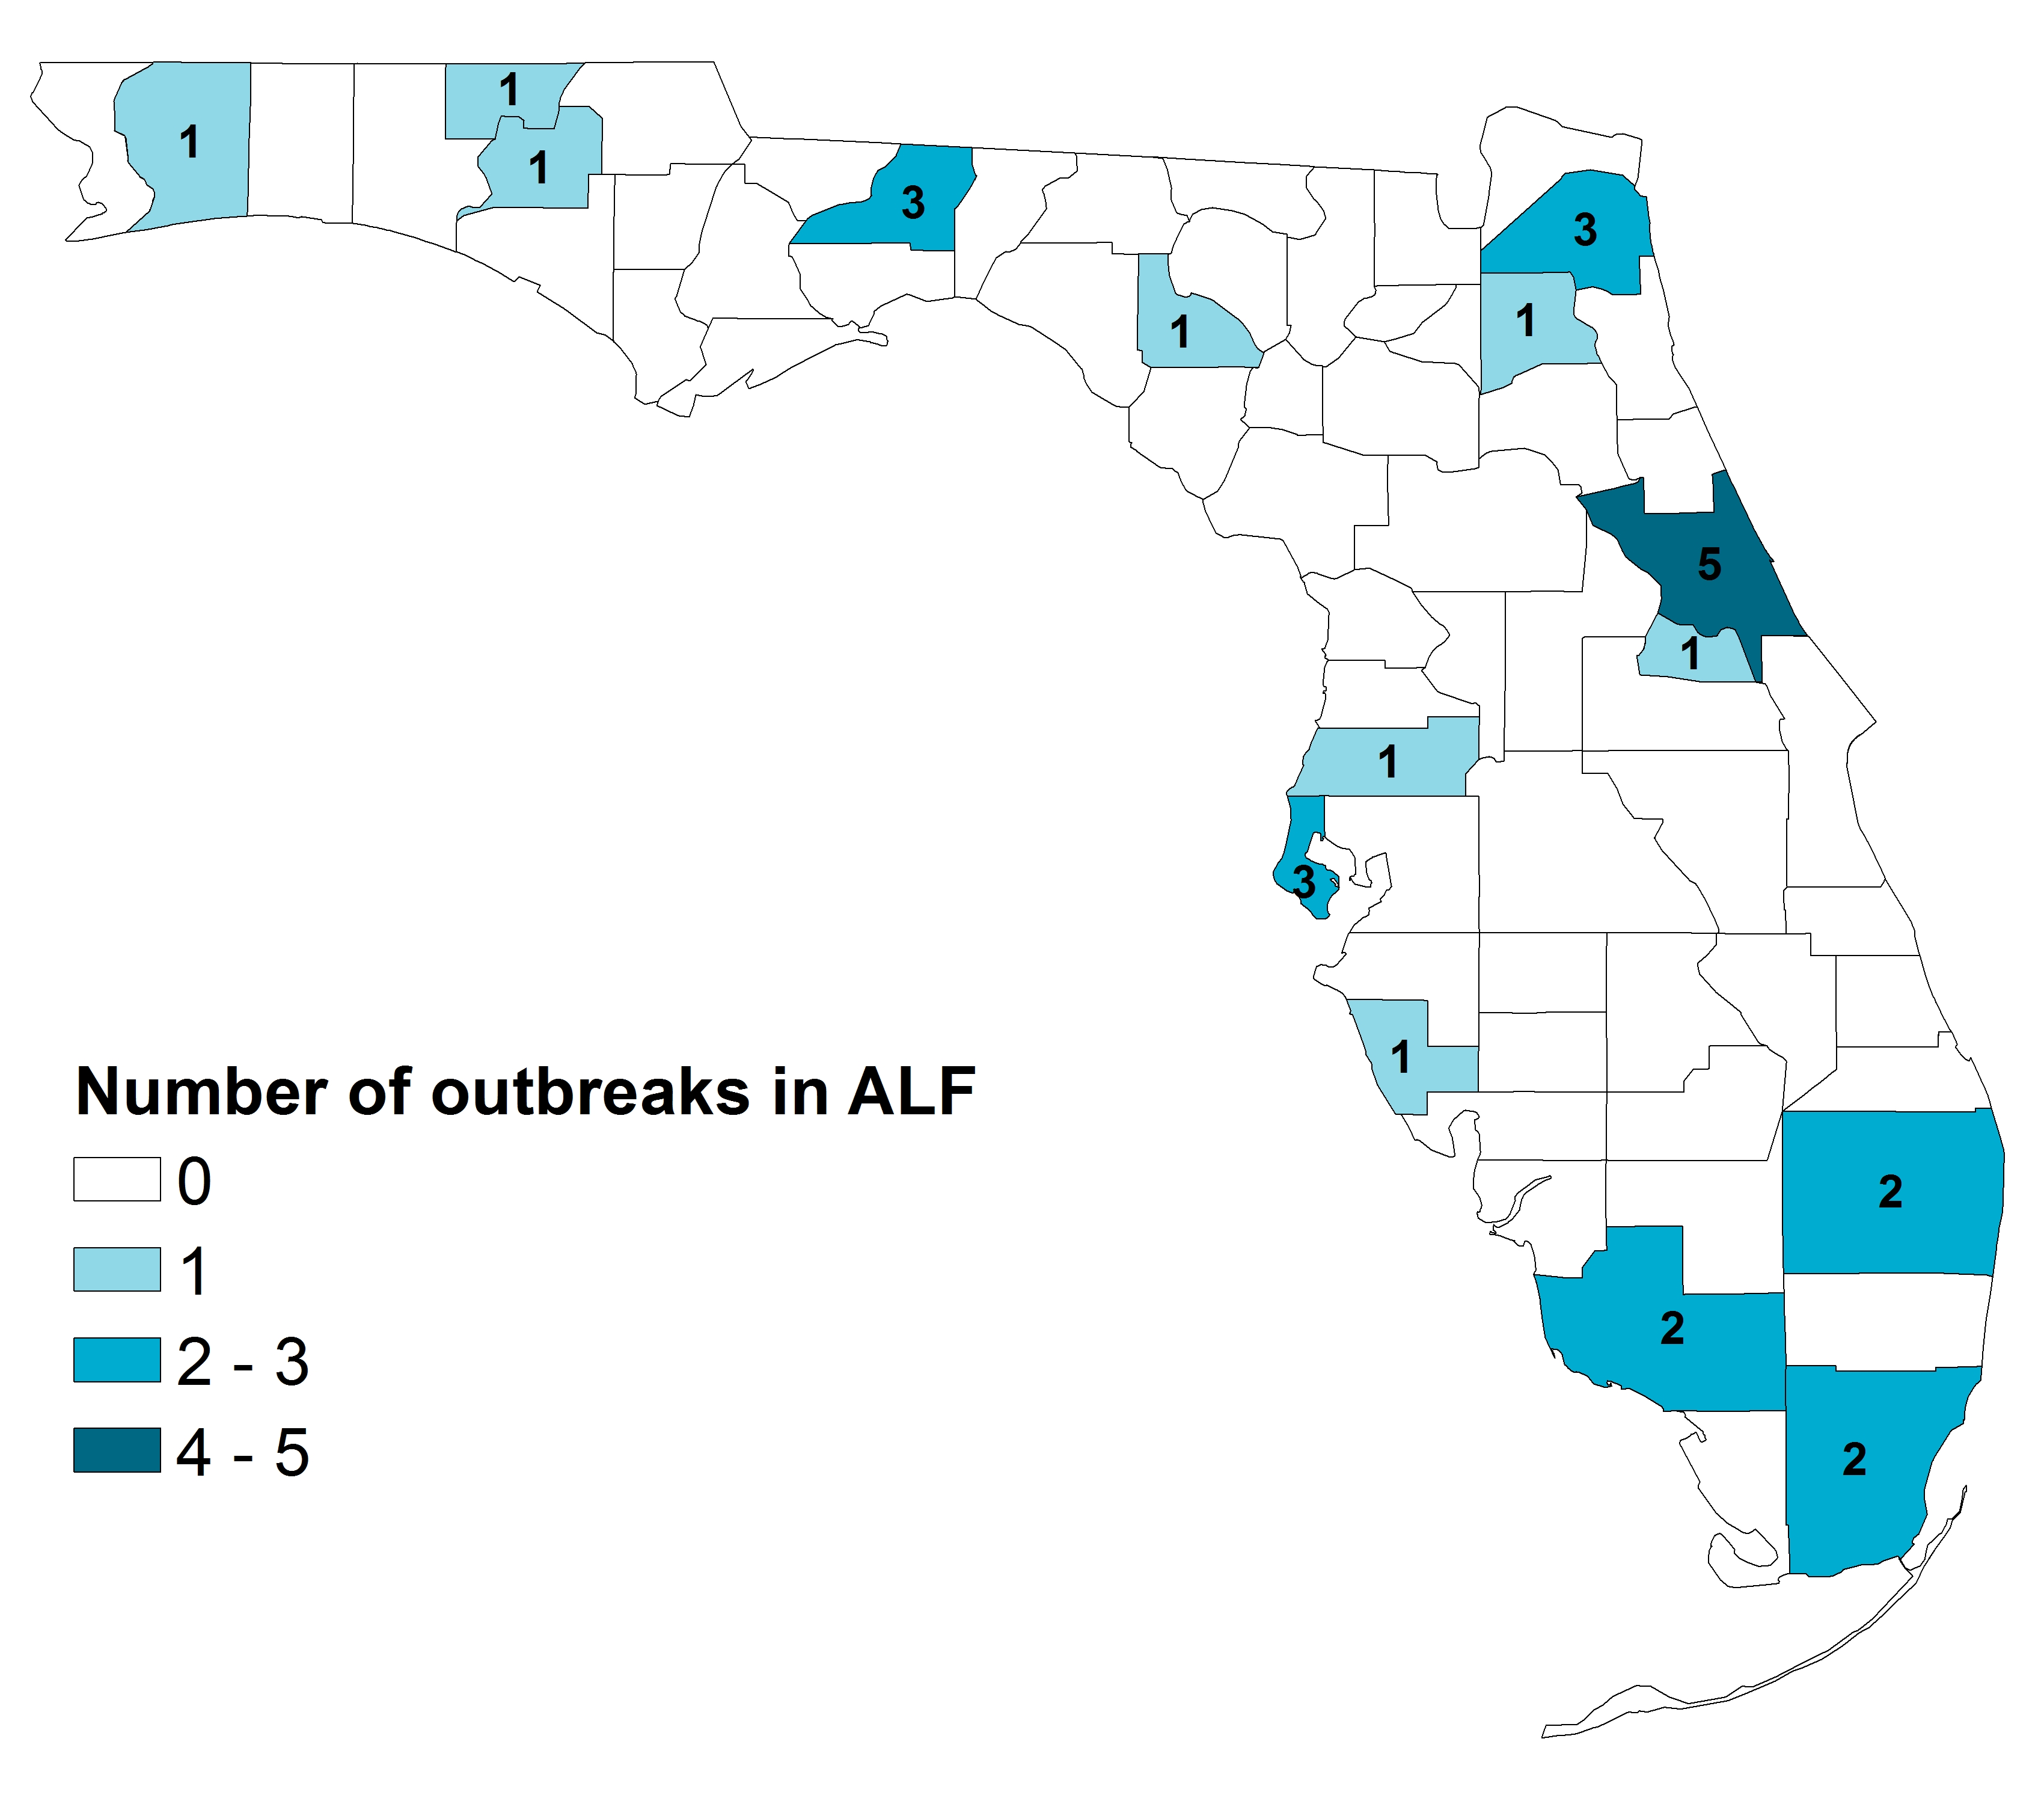
Outbreaks in Assisted Living Facilities – Vaccination Status
28 outbreaks of influenza and ILI reported in assisted living facilities
  8/28 (%) reported to have any influenza vaccination
  3/28 (11%) reported both staff and residents were vaccinated
  5/28 (18%) reported only residents vaccinated
  Many facilities unable to provide information about how many staff or residents had been vaccinated

Slide 9
Outbreaks in Assisted Living Facilities – Administration of Antiviral Treatment and Chemoprophylaxis
Antiviral treatment was administered to at-risk ill individuals in 81% of the outbreaks after it was recommended by CHDs.
Antiviral chemoprophylaxis was administered to at-risk ill individuals in 38% of the outbreaks after it was recommended by CHDs.

Slide 10
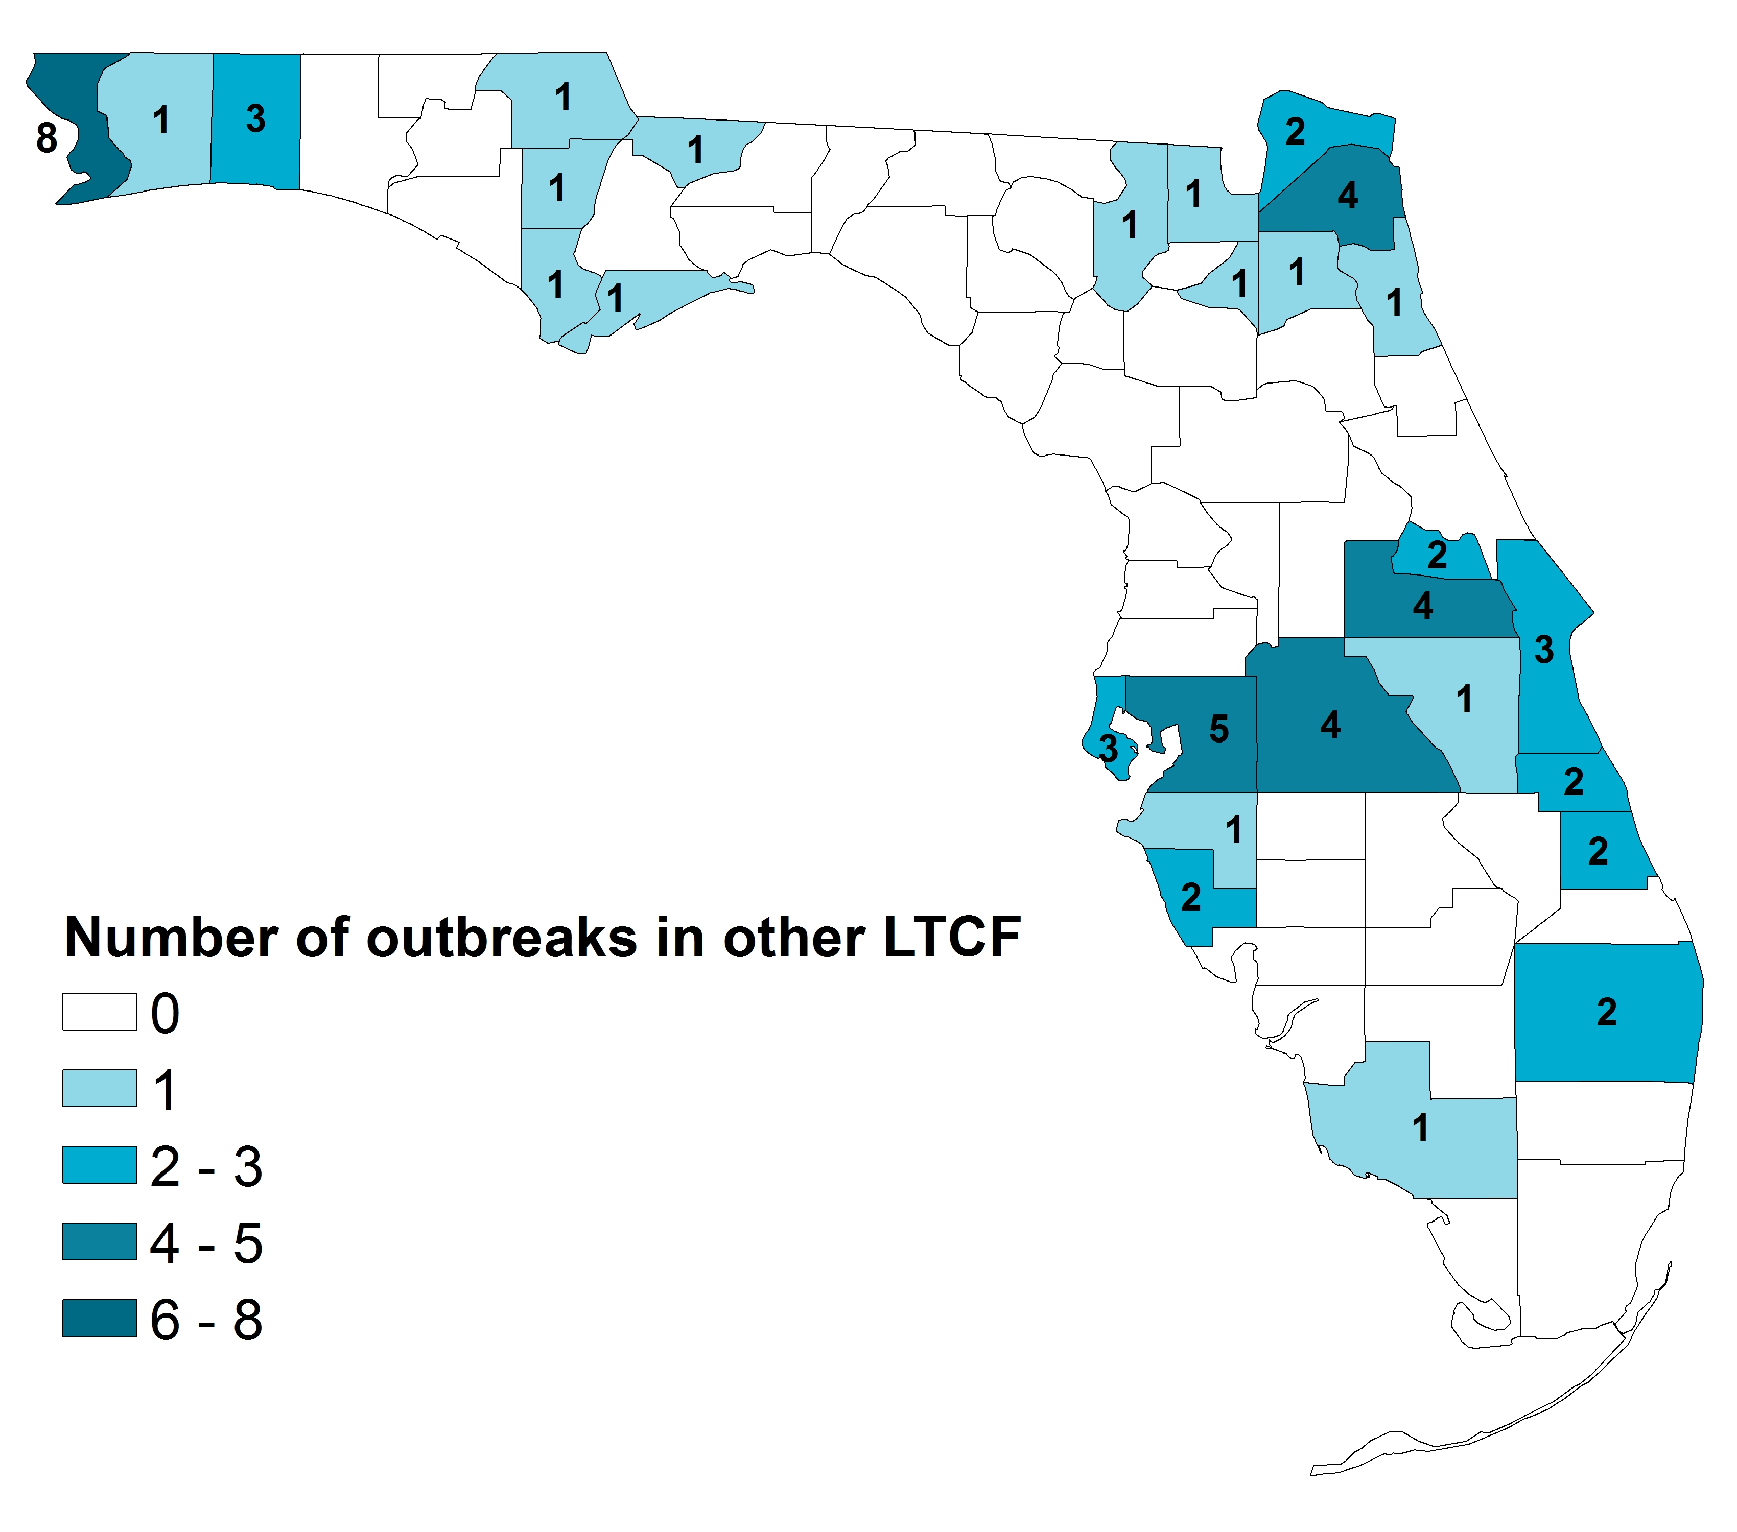
Outbreaks in LTCFs, Not Specified – Vaccination Status
60 outbreaks of influenza and ILI in LTCFs, not specified
  19/60 (32%) reported to have any influenza vaccination
  13/60 (22%) reported both staff and residents vaccinated
  4/60 (7%) reported only residents were vaccinated
  2/60 (3%) reported only staff were vaccinated
  Many facilities unable to provide information about how many staff or residents had been vaccinated

Slide 11
Outbreaks in LTCFs - Administration of Antiviral Treatment and Chemoprophylaxis
Antiviral treatment was administered to at-risk ill individuals in all of the outbreaks after it was recommended by CHDs.
Antiviral chemoprophylaxis was administered to at-risk ill individuals in 63% of the outbreaks after it was recommended by CHDs.

Slide 12
Prevention and Control of Influenza in Long-Term Care Facilities
Vaccination
Influenza testing
Infection control
Antiviral treatment
Antiviral chemoprophylaxis
Pre-planning
Centers for Disease Control and Prevention (CDC). Interim Guidance for Influenza Outbreak Management in Long-Term Care Facilities.
www.cdc.gov/flu/professionals/infectioncontrol/ltc-facility-guidance.htm

Slide 13
Influenza Vaccination
Vaccinate residents annually
  Before onset of influenza season, typically by the end of October
  For persons ≥65 years, any age-appropriate influenza vaccine formulation is acceptable
  For persons ≥65 years, high-dose or adjuvanted vaccine may provide better protection
Vaccinate staff with patient/resident contact
  Reduces transmission of influenza
  Reduces staff illness and absenteeism
  Reduces influenza-related illness and death among persons at increase risk
Advisory Committee on Immunization Practices. Prevention and Control of Seasonal Influenza with Vaccines, 2017-18.
www.cdc.gov/flu/professionals/acip/index.htm

Slide 14
Conduct Surveillance
Conduct active daily surveillance among residents, staff, and visitors for ILI.
ILI can include fever, cough, chills, headache, myalgias, sore throat, or runny nose.
Residents may have atypical signs and not have a fever.
Exclude ill residents, staff, and visitors.
Influenza testing should occur when any resident has ILI and especially when ≥2 residents develop respiratory illness within 72 hours.
Do not rely on negative rapid influenza diagnostic test results.

Slide 15
Identifying an Outbreak of Influenza
Ensure the laboratory notifies the facility of results promptly.
One laboratory-confirmed influenza case should trigger enhanced surveillance for other respiratory infections.
Two or more residents with ILI or confirmed influenza indicate an outbreak.
Immediately report all suspected outbreaks to your county health department: www.floridahealth.gov/chdepicontact

Slide 16
Implement Precautions
Standard and droplet precautions for all residents with suspected or confirmed influenza
Standard precautions
  Wear gloves if hand contact with respiratory secretions or potentially contaminated surfaces is anticipated
  Wear a gown if soiling of clothes with a resident’s respiratory secretions is anticipated
  Change gloves and gowns after each resident encounter and performing hand hygiene
  Perform hand hygiene before and after touching the resident, resident’s environment, or resident’s respiratory secretions, whether or not gloves are worn
CDC. Guideline for Isolation Precautions: Preventing Transmission of Infectious Agents in Healthcare Settings
www.cdc.gov/infectioncontrol/guidelines/isolation/index.html#a

Slide 17
Implement Precautions, Continued
Droplet precautions should be implemented for residents with suspected or confirmed influenza for 7 days after illness onset or until 24 hours after the resolution of fever and respiratory symptoms, whichever is longer.
  Place ill residents in a private room. If a private room is not available, place (cohort) residents suspected of having influenza with one another.
  Wear a facemask (e.g., surgical or procedure mask) upon entering the ill resident’s room. Remove the facemask when leaving the ill resident’s room and dispose of the facemask in a waste container.
  If resident movement or transport is necessary, have the resident wear a facemask (e.g., surgical or procedure mask), if possible.
  Communicate information about patients with suspected, probable, or confirmed influenza to appropriate personnel before transferring them to other departments/facilities.
CDC. Guideline for Isolation Precautions: Preventing Transmission of Infectious Agents in Healthcare Settings
www.cdc.gov/infectioncontrol/guidelines/isolation/index.html#a

Slide 18
Antiviral Treatment
All long-term care facility residents who have confirmed or suspected influenza should receive antiviral treatment immediately.
Treatment should not wait for laboratory confirmation of influenza.
Antiviral treatment works best when started within the first 2 days of symptoms. May still have a benefit after 2 days.
Three recommended antivirals :
  Oral oseltamivir (generic or Tamiflu®)
  Inhaled zanamivir (Relenza®)
  Intravenous peramivir (Rapivab®)
CDC. Influenza Antiviral Medications: Summary for Clinicians
www.cdc.gov/flu/professionals/antivirals/summary-clinicians.htm

Slide 19
Antiviral Chemoprophylaxis
All eligible residents in the entire long-term care facility (not just currently impacted wards) should receive antiviral chemoprophylaxis as soon as an influenza outbreak is determined.
Threshold: A single positive influenza test along with other residents with ILI.
Antiviral chemoprophylaxis is recommended for all non-ill residents, regardless of their influenza vaccination status, in long-term care facilities that are experiencing outbreaks.
Antiviral chemoprophylaxis can be offered to personnel.
Duration: minimum of 2 weeks, and continuing for at least 7 days after the last known case was identified.
CDC. Influenza Antiviral Medications: Summary for Clinicians
www.cdc.gov/flu/professionals/antivirals/summary-clinicians.htm

Slide 20
Consider Additional Measures
Isolate symptomatic residents in rooms as much as possible, restricting from common activities, and group meals
Limit number of large group activities, serve all meals in rooms
Avoid new admissions or transfers to wards with ill residents
Limit visitation and exclude ill persons by posting notices
Consider restricting visitation from children during community outbreaks
Restrict personnel movement from areas of the facility having illness to areas not affected

Slide 21
Communication With the Department of Health During Outbreaks
Immediately report all suspected outbreaks to your county health department: www.floridahealth.gov/chdepicontact
    Provide detailed information about ill residents and staff
    Provide information about staff and residents: total number, flu vaccine status, and the use of antivirals for treatment and chemoprophylaxis
    Provide regular updates
  Implement and monitor control measures
  Conduct enhanced surveillance for additional illnesses
  Potential site visit to provide guidance
  Arrange specimen collection (3-5 ill persons) for enhanced testing at the public health laboratory – collection kits will be provided

Slide 22
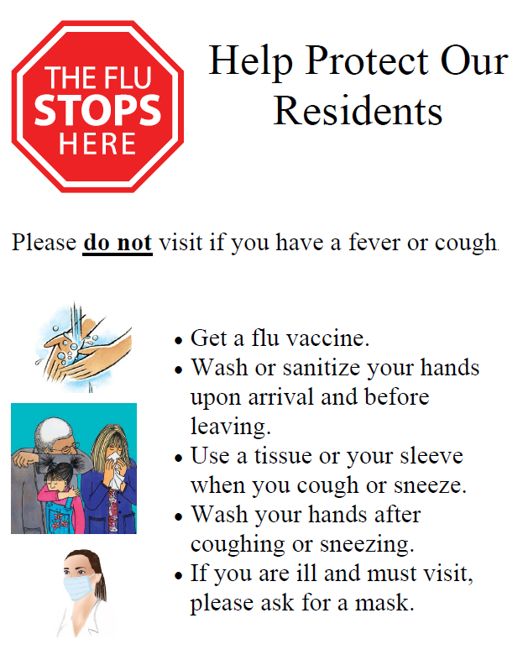
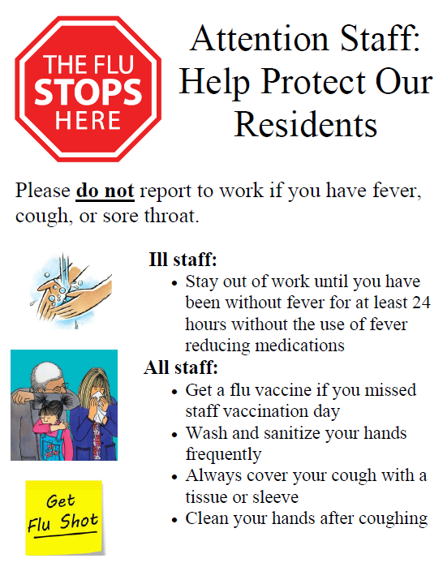
Take Action:
Prevent Outbreaks
Vaccinate residents
Provide and require staff vaccination
Encourage families to get vaccinated
Notify staff, residents, families, and activity/event visitors about increased precautions to prevent illness
Encourage hand washing among visitors and easy access to hand sanitizer at entrance
Post signs about flu season precautions

Slide 23
Plan Now: Antiviral and Chemoprophylaxis Administration
Having preapproved orders from physicians or plans to obtain orders for antiviral medications on short notice can substantially expedite administration of antiviral medications.
Develop a plan on how to obtain antivirals for all residents simultaneously for chemoprophylaxis.

Slide 24
For More Information
Local county health departments: www.floridahealth.gov/chdepicontact
Bureau of Epidemiology 24/7/365: (850) 245-4401

Slide 25
Q & A
Questions?
Potential Barriers?

