Slide 1
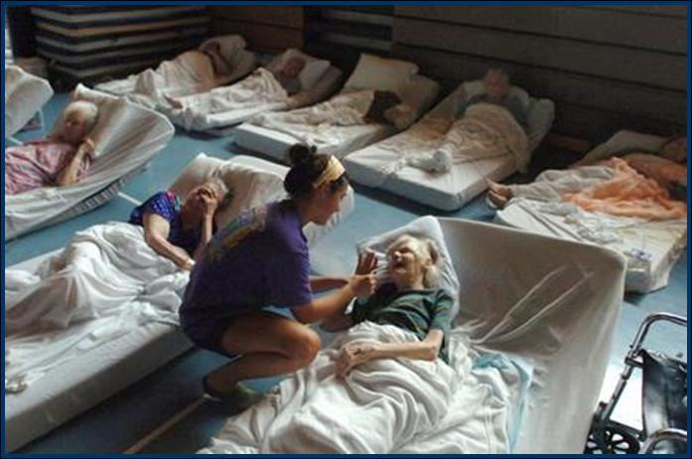
EXAMPLE
Community-Based Workshop
“Caring for Elders During Disasters”
Photo courtesy of The Baton Rouge Advocate / 2005.

Slide 2
Welcome & Introductions
Lead Team:
Theresa Isaac, Director
Office of Emergency Preparedness
Duval County Health Department
Captain J. Stephen Grant
Health & Medical Coordinator
Jacksonville Fire & Rescue Department
Linda Levin, Executive Director
ElderSource / Aging & Disability Resource Center

Slide 3
Project Team:
  Ray Runo, MPA, Project Director
  Disaster, Strategies, & Ideas Group
  Shirley Hunziker, RN, LHRM
  Clinical Risk Specialist, RB Health Partners
  April Henkel, Project Manager
  Florida Health Care Association
  Virginia Walker, Project Assistant
  RB Health Partners

Slide 4
Elder Care Stakeholders
Introductions Around the Table
  Your Name & Organization
  In a couple of sentences, what does your organization do to support/serve seniors in Duval County?

Slide 5
Workshop Purpose
Identify elder care stakeholder roles & responsibilities in providing healthcare for elders during disasters
Describe stakeholder dependencies & interdependencies
Provide planning resources and tools to community stakeholders
Support the integration of elder healthcare and support stakeholders into local emergency management communities
Provide a tool for developing a local continuum of elder care (examples, directions)

Slide 6
Project Purpose
& Overview
“Healthcare Systems
Needs Analysis for
Elders During Disasters”
A project funded by the Fla. Dept. of Health

Slide 7
Project Origin and Purpose
Our History and Experience
    Project Rationale & Need for the Project
Vision… During disasters, the complex health and medical needs of Florida’s elder population will be met.
Mission… To develop and implement a comprehensive methodology for identifying and codifying disaster roles and responsibilities for the many stakeholders comprising the continuum of healthcare for Florida’s elder population during disasters.

Slide 8
Three Year Project
Identification of Elder Care Stakeholders
  Established a Core Planning Team
  Conducted regional stakeholder workshops
  Analyzed stakeholder roles & responsibilities
Developed Continuum of Healthcare for Elders During Disasters & Planning Considerations
(and tested the model)
Preparing Communities to Care for Elders During Disasters – the Community-Based Process

Slide 9
Elder Care Continuum Stakeholders
County Emergency Management (EM) & Health Department (ESF8)
Area Agency on Aging (AAA)
2-1-1 agencies (information and referral network)
Alzheimer’s caregiver support organizations
Behavioral Health Providers
COAD / VOAD (when active in a community), including Red Cross
Councils on Aging / Senior Centers / Other aging network provider organizations
Emergency Response Agencies (e.g., EMS, fire, law enforcement)
Energy providers
Home health agencies & geriatric care managers
Hospitals & other healthcare providers (e.g., clinics, medical equipment, VA)
HUD housing (for seniors)
Nursing homes, assisted living facilities & continuing care retirement communities
Pharmacies
Renal dialysis centers
Selected Govt. partners (Dept. of Elder Affairs; Co. Health Dept.; Agency for Health Care Admin.; Adult Protective Serv./Dept. of Children & Families; Veterans’ Affairs)
Transportation providers
OTHER groups important in the healthcare continuum for elders in the local community

Slide 10
The
Community-Based Planning Process & Continuum Framework

Slide 11
The Community-Based
Planning Process…
Identifies, engages and integrates
all key stakeholders involved in
elder care during disasters
Results in specific solutions to improve the community’s capability to care for elders during disasters

Slide 12
Why is this approach needed?
Emergency planners often lack awareness of the vulnerability and complex care requirements of many elders
The scope of healthcare stakeholders for elders is broad and complex with many dependent and interdependent roles and responsibilities to coordinate and integrate
Communities (& stakeholders) have varied levels of preparedness, planning & response capabilities/capacities
Elder care stakeholders may not be actively integrated into the community’s emergency management planning

Slide 13
Planning for the care of elders during disasters begins with
an understanding
of the community’s
Healthcare and Support Continuum for Elders

Slide 14
Continuum of Care - Assumptions
Individuals are unique - common care & support services.
Condition and needs will change over the term of the disaster (decompensation).
In a disaster environment, healthcare, services and support will be limited, temporarily unavailable, or absent.
Expect negative outcomes when the continuum is disrupted or broken.
A community’s resiliency depends largely upon its augmentation and/or replacement strategies.

Slide 15
Continuum of Healthcare & Support for Elders
~~ A Complex System ~~

Slide 16
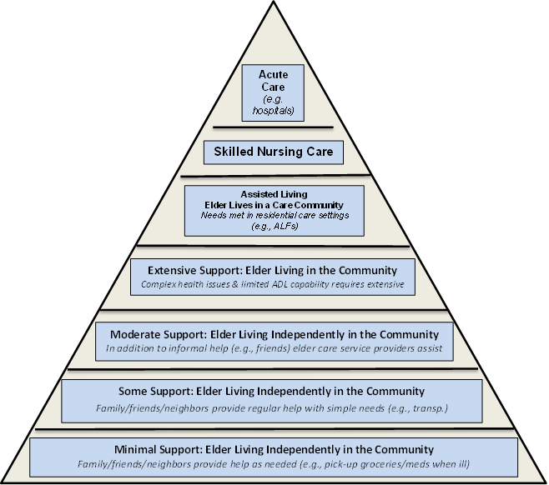
On a Sunny Day… in a Typical Community:
Proportional Use of Healthcare Systems & Supports by Elders

Slide 17
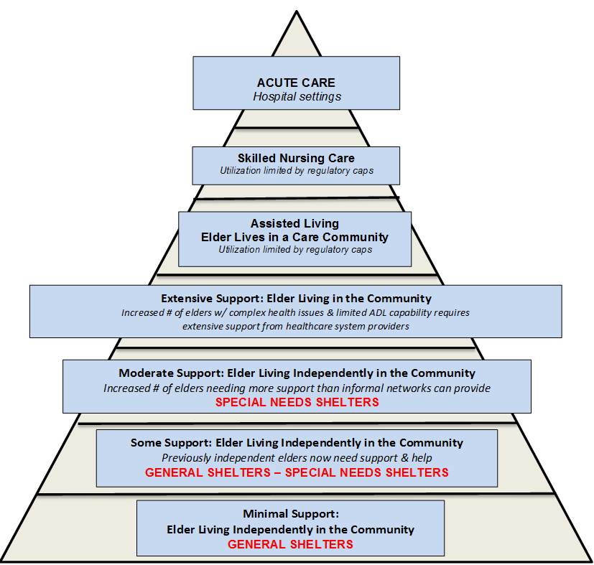
On a Rainy Day… in a Typical Community:
Shifts in Proportional Use of Healthcare Systems & Supports by Elders

Slide 18
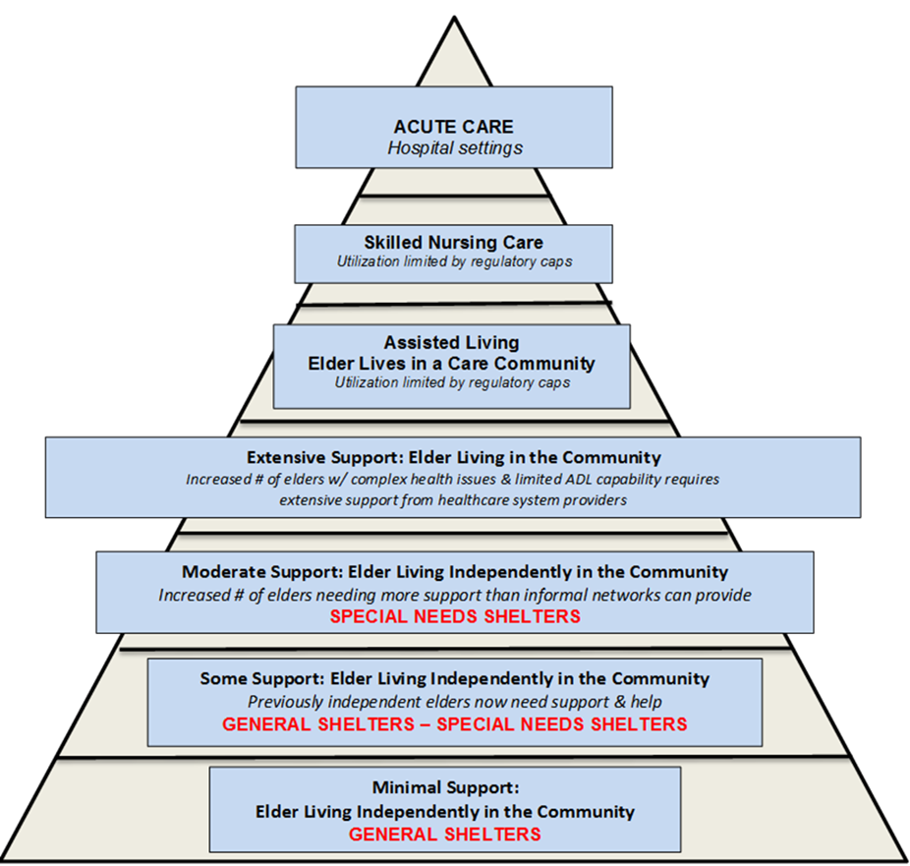
Proportional Shifts in Care & Support
Event Duration, Scope, and Severity

Slide 19
Elder-Focused Planning Considerations
Elders require a comprehensive approach to disaster-based planning considerations:
#1 Elder community profile – what are the characteristics of your elder population and who are the community stakeholders that serve them?
#2 Risk identification and management
– how vulnerable are your elders?
#3 Continuum of healthcare and support systems for elders – who are your stakeholders and what are their dependencies, and interdependencies?
#4 Community preparedness & response planning
for elder populations – how integrated and comprehensive are your stakeholders’ emergency plans (your continuum’s stakeholders)?

Slide 20
Planning Consideration
#1 Characterizing the Elder Population
Elder demographics and locations
  Residential Areas/Mapping
  Service Providers (stakeholder groups)
  Elders living “independently”
Elder Behavior during Disasters
  Evacuation behavior (“Don’t move my cheese!”)
  Use of healthcare services & supports
Elder healthcare system demands versus community capabilities

Slide 21
Planning Consideration
#2 Risk Identification and Management
Community hazards and vulnerabilities
Specific hazard impacts on elders
Clinical risk factors for elders
  Morbidity and mortality issues
  Decompensation
Strategies for managing elder risk factors
Notes:
SHIRLEY – Bullets 3 and 4

Slide 22
Planning Consideration
#3 Continuum of Healthcare Systems for
Elders During Disasters
Similar to the “continuum of care” concept in aging services – there are many stakeholders in the continuum of healthcare & support services
Reflects functional roles and responsibilities, relationships, dependencies, and interdependencies that link stakeholders together on behalf of elders during disasters
Supports the identification of gaps in the healthcare continuum for elders during disasters

Slide 23
Continuum of Healthcare
~~ Normal (Sunny) Day ~~
“Mrs. Brown”
Family
Support
Home & Comm.-based Services
Medical Support Services
Transp. Services
Food and Water
Social Supports (e.g. friends; neighbors; senior center)
Faith Based Support
Utilities
Medications
Medical Equipment & Supplies
Green = OK
Yellow = Reduced
Red = Off-line

Slide 24
Continuum of Healthcare
~~ Disaster (Rainy Day) ~~
Time Progression
Decompensation
“Mrs. Brown”
Family Support
Home- & Comm.-based Services
Medical Support Services
Transp. Services
Food & Water
Social Support Services
Faith Based Support
Utilities
Medications
Medical Equip. & Supplies
Green = OK
Yellow = Reduced
Red = Off-line

Slide 25
Continuum of Healthcare
~~ Disaster (Rainy Day) ~~
“Mrs. Brown”
Family Support
Home & Comm.-based Serv.
Medical Support Services
Transp. Services
Food &
Water
Social Support Services
Faith Based Support
Utilities
Medica-
tions
Shelter?
Hospital?
Medical Equip. & Supplies
Time Progression
Continuum disrupted
Advanced decompensation
What next?
  Family/friends?
  Shelter?
  Hospital?
What are the community’s planning contingencies?
Green = OK
Yellow = Reduced
Red = Off-line

Slide 26
A Stakeholder Example
Area
Agency on
Aging
“Continuum”
Off-Site Facilities
(other AAA offices)
Electricity - Utilities
Phones
Physical Plant / Maint.
Info. & Referral Services
Senior Centers
CCE Providers
Volun-
teers
Info. Tech. (IT)
Transp.
Providers
Nutrition Providers
Admin
(payroll)
Other Contract Services /
Vendors
Green = OK
Yellow = Reduced
Red = Off-line

Slide 27
Hurricane Impacts:
Essential Systems Reduced or Off-Line
Area
Agency on
Aging
Off-Site Facilities
(other AAA offices)
Electricity - Utilities
Phones
Physical Plant / Maint.
Info. & Referral Services
Senior Centers
CCE Providers
Volun-
teers
Info. Tech. (IT)
Transp.
Providers
Nutrition Providers
Admin
(e.g.
payroll)
Green = OK
Yellow = Reduced
Red = Off-line

Slide 28
Another Stakeholder Example
Senior Center
Off-Site Facilities
(e.g. meal sites)
Utilities
Phones
Activity Staff
Care-giver Supports
Case Mgrs.
Health / Serv. Staff
Volun-
teer Services
Info. Tech. (IT)
Transp.
Services
Phys. Plant & Maint.
Admin.
(e.g.
payroll)
Other Contract Services / Vendors
Funding (e.g. govt., UW)
Green = OK
Yellow = Reduced
Red = Off-line

Slide 29
Another Stakeholder Example
Senior Center
Off-Site Facilities
(e.g. meal sites)
Utilities
Phones
Activity Staff
Care-giver Supports
Case Mgrs.
Health / Serv. Staff
Volun-
teer Services
Info. Tech. (IT)
Transp.
Services
Phys. Plant & Maint.
Admin.
(e.g.
payroll)
Other Contract Services / Vendors
Funding (e.g. govt., UW)
Green = OK
Yellow = Reduced
Red = Off-line

Slide 30
Planning Consideration
#4 Community Preparedness & Response
Planning for Elder Populations
  Planning requirements – legislative & others
  Planning guidance – tools and resources
  Response triggers and contingency plans
Identification, involvement, and integration of community partners
  What service and support systems exist?
Integration into local EM and ESF 8 planning, training, and exercise programs

Slide 31
Local Perspectives
Characterizing the Elder Population
in Duval County
Disaster Risks & Vulnerabilities
Community Preparedness
& Response Planning

Slide 32
Using the
Healthcare & Support Systems Continuum

Slide 33
Individual Stakeholder Continuums
20 minutes – Stakeholder Analysis
Individually or in Stakeholder Groups
Write your organization’s name in the center
Outer petals – who/what does your organization depend upon to deliver services?
Discussion:
  Surprises?
  What’s Missing?
  Who’s Missing?
Notes:
They get 15 minutes to work on this
Group folks if needed
Each does a blank petal (handout)
Be sure we get a special needs shelter sheet
Report out: each stakeholder shares info from their petal
Virginia captures on-screen stakeholder names
Flips – capture missing stakeholder types

Slide 34
On your own
See list of NEARBY options
LUNCH

Slide 35
Scenario-Based Discussion
Module 1
Pre-Landfall
Foreseeable Consequences and Impacts
~~~ Booklet ~~~

Slide 36
Scenario-Based Discussion
Module 2
Post-Landfall
Known Consequences and Impacts
~~~ Booklet ~~~

Slide 37
Summary
What were the today’s key findings
(gaps – issues – stakeholders)
How will Duval County sustain today’s momentum?
    Planning
    Training
    Exercising
    Evaluating

Slide 38
Where do we go from here?

Slide 39
Duval County Work Group Facilitates the Planning Process by…
Providing ongoing guidance and direction for the community-based planning process
Identifying additional key stakeholders involved in the Duval County healthcare and support continuum for elders
Developing integrated after action plans to resolve gaps
Actively facilitating the integration of stakeholders into the Duval County emergency management system

Slide 40
Workshop Evaluation
What was the value of today’s workshop?
How can we improve on the workshop format/content?
Other comments/questions?
(please complete the feedback form)

Slide 41
~ For More Information ~
  Duval County Lead Team:
  Theresa Isaac (Theresa.Isaac@flhealth.gov)
  Stephen Grant (Grant@coj.net)
  Linda Levin (Linda.Levin@myeldersource.org)
  Project Team:
  Ray Runo (RayRuno@gmail.com)
  April Henkel (Ahenkel@fhca.org)
  Robin Bleier (Robin@rbhealthpartners.com)

