Slide 1
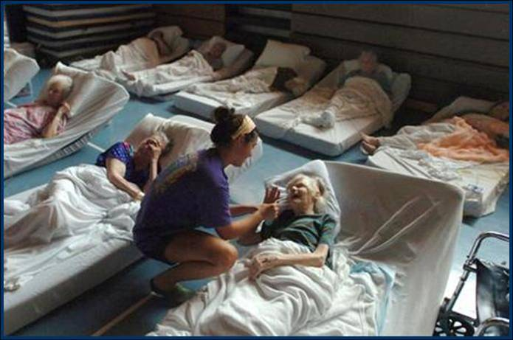
EXAMPLE
Core Planning Team (CPT)
Pre-Workshop Conference
“Caring for Elders During Disasters”
Photo courtesy of The Baton Rouge Advocate / 2005.
Notes:
Ray

Slide 2
Welcome & Introductions
Planning Partners & Hosts
  Debbie Peck, Emergency Management Coordinator
  Pinellas County Office of Emergency Management
  Jason Martino, Emergency Coordinating Officer
  Area Agency on Aging of Pinellas & Pasco
  Amber Boulding, Public Health Preparedness Manager
  Florida Department of Health - Pinellas County
Project Team
  Ray Runo, Project Director
  Disasters, Strategies, & Ideas Group (DSI)
  Robin Bleier, President
  RB Health Partners
  April Henkel, Project Manager
  Florida Health Care Association
CPT Partners
Notes:
RAY

Slide 3
Meeting Purpose
Provide an overview of the project
Define the purpose & role of the Core Planning Team
Review the Community-Based Planning Process and the continuum framework
Establish a list of workshop invitees
Review the workshop agenda & identify local SMEs to support the workshop’s goals
Confirm the workshop date and venue
Establish a CPT post-workshop meeting schedule

Slide 4
Project Overview
“Healthcare Systems
Needs Analysis for
Elders During Disasters”
A project funded by the Fla. Dept. of Health

Slide 5
Project Origin and Purpose
Our History and Experience
    Project Rationale & Need for the Project
Vision… During disasters, the complex health and medical needs of Florida’s elder population will be met.
Mission… To develop and implement a comprehensive methodology for identifying and codifying disaster roles and responsibilities for the many stakeholders comprising the continuum of healthcare for Florida’s elder population during disasters.
Notes:
RAY

Slide 6
Three Year Project
Identification of Elder Care Stakeholders
  Established a Core Planning Team
  Conducted regional stakeholder workshops
  Analyzed stakeholder roles & responsibilities
Developed Continuum of Healthcare for Elders During Disasters & Planning Considerations
(and tested the model)
Preparing Communities to Care for Elders During Disasters – the Community-Based Process

Slide 7
The
Core Planning Team
(CPT)

Slide 8
The Role the Core Planning Team
Provides guidance and direction for the community-based planning process
Identifies the key stakeholders involved in the local community’s healthcare and support continuum for elders
Supports the community’s response to gaps identified through community-based planning
Actively facilitates integration of elder healthcare and support stakeholders into a
local community’s emergency management, preparedness, response and recovery system
Notes:
Ray

Slide 9
Elder Care Continuum Stakeholders
County Emergency Management (EM) & Health Department (ESF8)
Area Agency on Aging (AAA)
2-1-1 agencies (information and referral network)
Alzheimer’s caregiver support organizations
Behavioral Health Providers
COAD / VOAD (when active in a community), including Red Cross
Councils on Aging / Senior Centers / Other aging network provider organizations
Emergency Response Agencies (e.g., EMS, fire, law enforcement)
Energy providers
Home health agencies & geriatric care managers
Hospitals & other healthcare providers (e.g., clinics, medical equipment, VA)
HUD housing (for seniors)
Nursing homes, assisted living facilities & continuing care retirement communities
Pharmacies
Renal dialysis centers
Selected Govt. partners (Dept. of Elder Affairs; Co. Health Dept.; Agency for Health Care Admin.; Adult Protective Serv./Dept. of Children & Families; Veterans’ Affairs)
Transportation providers
OTHER groups important in the healthcare continuum for elders in the local community
Notes:
Ray

Slide 10
The
Community-Based Planning Process & Continuum Framework

Slide 11
The Community-Based
Planning Process…
Identifies, engages and integrates
all key stakeholders involved in
elder care during disasters
Results in specific solutions to improve the community’s capability to care for elders during disasters
Notes:
Ray

Slide 12
Why is this approach needed?
Emergency planners often lack awareness of the vulnerability and complex care requirements of many elders
The scope of healthcare stakeholders for elders is broad and complex with many dependent and interdependent roles and responsibilities to coordinate and integrate
Communities (& stakeholders) have varied levels of preparedness, planning & response capabilities/capacities
Elder care stakeholders may not be actively integrated into the community’s emergency management planning
Notes:
RAY

Slide 13
  Expected Outcomes…
Gain knowledge and understanding of current community resources, capabilities & plans for care of elders, across the healthcare and support continuum
Identify the desired state of preparedness, response, & mitigation capabilities for elder care
Identify gaps between the current capabilities & the desired state
Develop action plans, timelines & responsibilities for filling gaps
Develop sustainment strategies for on-going planning & partnerships

Slide 14
Planning & Workshop Sequence
☑ Concept & Objectives Meeting (EM, ESF8, AAA)
  First meeting of the Lead Team (EM, ESF8, AAA); typically 75 minutes
  Goal: Brief the lead team; develop tentative timeline; identify CPT members
☑ CPT Pre-Workshop Conference
  Typically a 2 to 3 hour planning meeting of the CPT
  Goal: Invitation list, workshop date, speakers and agenda
Community-Based Workshop
  All stakeholders/partners identified by the CPT
  Structured agenda and process
  Goal: Identify gaps in the continuum of healthcare for elders during disasters, in your community & solutions
Post-Workshop Planning Session(s)
  De-briefing ~~ action plans ~~next-steps
  Additional meetings as needed
Incorporate Action Plans – Sustaining the Process
  …into EM’s preparedness & response system
  …into the plans of key partners (e.g., AAAs)
Notes:
April -- see handout

Slide 15
The Framework:
Healthcare & Support Continuum for Elders during Disasters

Slide 16
Planning for the care of elders during disasters begins with
an understanding
of the community’s
Healthcare and Support Continuum for Elders
Notes:
RAY

Slide 17
Continuum of Care - Assumptions
Individuals are unique - common care & support services.
Condition and needs will change over the term of the disaster (decompensation).
In a disaster environment, healthcare, services and support will be limited, temporarily unavailable, or absent.
Expect negative outcomes when the continuum is disrupted or broken.
Community Resiliency: Augmentation or Replacement Strategies
Notes:
ROBIN

Slide 18
Elder-Focused Planning Considerations
Elders require a comprehensive approach to disaster-based planning considerations:
#1 Elder community profile – what are the characteristics of your elder population and who are the stakeholders that serve them?
#2 Risk identification and management
– how vulnerable are your elders?
#3 Continuum of healthcare and support systems for elders – who are your stakeholders and what are their roles?
#4 Community preparedness & response planning
for elder populations – how integrated and comprehensive are your stakeholders’ emergency plans (your continuum’s stakeholders)?
Notes:
RAY

Slide 19
Planning Consideration
#1 Characterizing the Elder Population
Elder demographics and locations
  Residential Areas/Mapping
  Service Providers (stakeholder groups)
  Elders living “independently”
Elder Population Vulnerabilities
  Morbidity and mortality issues
  Behavior during disasters
  Decompensation
Notes:
RAY

Slide 20
Planning Consideration
#2 Risk Identification and Management
Community hazards and vulnerabilities
Specific hazard impacts on elders
Clinical risk factors
  Strategies for managing elder risk factors
Elder healthcare system demands versus community capabilities
Community resilience considerations
Notes:
RAY & ROBIN ON THIRD BULLET

Slide 21
Planning Consideration
#3 Continuum of Healthcare Systems for
Elders During Disasters
Population demographics (demand) and local stakeholder capabilities (supply) drive the continuum
Identify healthcare, community, and social support systems present on a “sunny day”
Building your continuum
  Visual and descriptive tools
Notes:
RAY

Slide 22
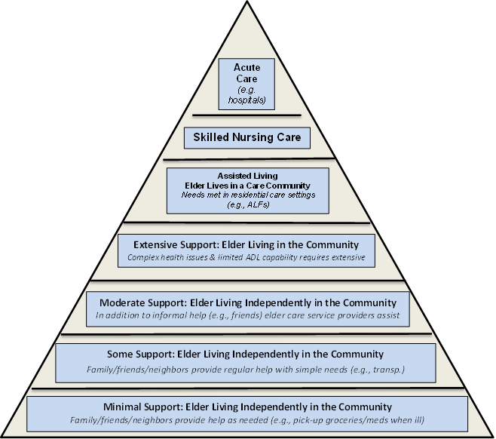
On a Sunny Day… in a Typical Community:
Proportional Use of Healthcare Systems & Supports by Elders

Slide 23
On a Rainy Day… in a Typical Community:
Shifts in Proportional Use of Healthcare Systems & Supports by Elders

Slide 24
The “Continuum” Framework
Similar to the “continuum of care” concept in aging services – there are many stakeholders in the continuum of healthcare & support services
Reflects functional roles and responsibilities, relationships, dependencies, and interdependencies that link stakeholders together on behalf of elders during disasters
Supports the identification of gaps in the healthcare continuum for elders during disasters
Notes:
Ray

Slide 25
Continuum of Healthcare & Support for Elders
~~ A Complex System ~~

Slide 26
Continuum of Healthcare
~~ Normal (Sunny) Day ~~
An Individual Elder’s Healthcare &
Support
Continuum
Family
Support
Home & Comm.-based Services
Medical Support Services
Transp. Services
Food and Water
Social Supports (e.g. friends; neighbors)
Faith Based Support
Utilities
Medications
Medical Equipment & Supplies
Green = OK
Yellow = Reduced
Red = Off-line
Notes:
ROBIN

Slide 27
Continuum of Healthcare
~~ Disaster (Rainy Day) ~~
Time Progression
Decompensation
Elder
Family Support
Home- & Comm.-based Services
Medical Support Services
Transp. Services
Food & Water
Social Support Services
Faith Based Support
Utilities
Medications
Medical Equip. & Supplies
Green = OK
Yellow = Reduced
Red = Off-line
Notes:
ROBIN

Slide 28
Continuum of Healthcare
~~ Disaster (Rainy Day) ~~
Elder
Family Support
Home & Comm.-based Serv.
Medical Support Services
Transp. Services
Food &
Water
Social Support Services
Faith Based Support
Utilities
Medica-
tions
Shelter?
Hospital?
Medical Equip. & Supplies
Time Progression
Continuum disrupted
Advanced decompensation
What next?
  Family/friends?
  Shelter?
  Hospital?
What are the community’s planning contingencies?
Green = OK
Yellow = Reduced
Red = Off-line

Slide 29
A Stakeholder Example
Area
Agency on
Aging
“Continuum”
Off-Site Facilities
(other AAA offices)
Electricity - Utilities
Phones
Physical Plant / Maint.
Info. & Referral Services
Senior Centers
CCE Providers
Volun-
teers
Info. Tech. (IT)
Transp.
Providers
Nutrition Providers
Admin
(payroll)
Other Contract Services /
Vendors
Green = OK
Yellow = Reduced
Red = Off-line
Notes:
April

Slide 30
Another Stakeholder Example
Senior Center
Off-Site Facilities
(e.g. meal sites)
Utilities
Phones
Activity Staff
Care-giver Supports
Case Mgrs.
Health / Serv. Staff
Volun-
teer Services
Info. Tech. (IT)
Transp.
Services
Phys. Plant & Maint.
Admin.
(e.g.
payroll)
Other Contract Services / Vendors
Funding (e.g. govt., UW)
Green = OK
Yellow = Reduced
Red = Off-line
Notes:
April

Slide 31
Hurricane Impacts:
Essential Systems Reduced or Off-Line
Area
Agency on
Aging
Off-Site Facilities
(other AAA offices)
Electricity - Utilities
Phones
Physical Plant / Maint.
Info. & Referral Services
Senior Centers
CCE Providers
Volun-
teers
Info. Tech. (IT)
Transp.
Providers
Nutrition Providers
Admin
(e.g.
payroll)
Green = OK
Yellow = Reduced
Red = Off-line
Notes:
April

Slide 32
Another Stakeholder Example
Senior Center
Off-Site Facilities
(e.g. meal sites)
Utilities
Phones
Activity Staff
Care-giver Supports
Case Mgrs.
Health / Serv. Staff
Volun-
teer Services
Info. Tech. (IT)
Transp.
Services
Phys. Plant & Maint.
Admin.
(e.g.
payroll)
Other Contract Services / Vendors
Funding (e.g. govt., UW)
Green = OK
Yellow = Reduced
Red = Off-line
Notes:
April

Slide 33
Planning Consideration
#4 Community Preparedness & Response
Planning for Elder Populations
  Planning requirements – legislative & others
  Planning guidance – tools and resources
  Response triggers and contingency plans
Identification, involvement, and integration of community partners
  What service and support systems exist?
Integration into local EM and ESF 8 planning, training, and exercise programs
Notes:
RAY

Slide 34
Applying the Planning Considerations:
The Community-Based Workshop

Slide 35
Pinellas County
Community-Based Workshop
“Caring for Elders During Disasters”
Tuesday, April 8, 2014 ~~ 8:30am – 4:30pm
Mid-County Health Department
Conference Center
8751 Ulmerton Road, Largo

Slide 36
Workshop Agenda
Start Time: 8:30 a.m.
End Time: 4:30 p.m.

Slide 37
Agenda – Morning Topics
Part 1: Overview
Welcome, Workshop Briefing and Stakeholder Introductions Project Purpose & Rationale Planning Considerations for Care of Elders during Disasters Community-Based Planning Outcomes
Part 2: Framework for Community-Based Planning - The Continuum Model
This is an interactive discussion. Use flipcharts to capture comments. Utilize SMEs identified by the CPT as resources for information (e.g., EM, ESF8 & AAA). Community Profile: Characterizing the Elder Population (People and Stakeholder Roles & Responsibilities) SMEs: ________________ Disaster Risks and Vulnerabilities for Elder Population SMEs: ________________ Continuum of Healthcare and Support Systems for Elders SMEs: ________________ Community Preparedness and Response Planning for Elder Populations SMEs: ________________
Part 3: Using the Continuum of Healthcare and Support Systems
Work through the sunny day perspective: each person develops petals for their respective organization, followed by the full group identifying petals for the community. Record highlights on flipcharts. Discuss & Diagram -- Individual Stakeholder Continuum (individual work – 15 min.) Discuss and Diagram - Local Community Continuum (plot on the vector diagram)
Notes:
During the April 8 workshop, we’d like representatives from your community to talk about the four planning considerations, from a Pinellas Co perspective. We’ve allotted speaker time for each of the 4 considerations. Who speaks and how many speakers are up to you as a CPT.

Slide 38
Agenda – Afternoon Topics
Part 4: Scenario-Based Group Discussion (Pre-Impact)
Facilitated discussion; capture highlights on flipcharts. Scenario Pre-Impact Conditions – utilize continuum diagrams & overview of planning considerations to discuss current state, desired state & gaps
Part 5: Scenario-Based Group Discussion (Post-Impact)
Facilitated discussion; capture highlights on flipcharts. Scenario Post-Impact Conditions - utilize continuum diagrams and overview of planning considerations to discuss: Current State, Desired State, and Gaps
Part 6: Comments/Questions/Evaluation
Review and discuss gaps identified Discuss strategies for filling gaps (prospective partners and methods) Evaluation & Final Comments
Workshop Ends: 4:30 pm

Slide 39
  Workshop Outcomes & Next Steps
Workshop Outcomes:
Knowledge of current community resources, capabilities & plans for care of elders, across the healthcare and support continuum
Description of the desired state of preparedness, response, & mitigation capabilities for elders
Identification of gaps between the current capabilities & desired state
CPT’s Next Steps:
Action plans, timelines & responsibilities for
filling gaps.
Sustainment strategies for on-going planning & partnerships

Slide 40
After the Community-Based Workshop…
Reconvene the CPT
Present/discuss key findings from the Workshop (gaps, etc.)
Develop an Integrated After Action Process and Action Plans (across stakeholder groups)
Sustain the Process:
  Plan ~~ Train ~~ Exercise ~~ Evaluate

Slide 41
Today’s Decisions:
Decide who will be invited to the workshop (stakeholders)
Select subject matter experts
Post-workshop CPT meeting (?)

Slide 42
Who should attend?
Maximum # of attendees - 40
Invitees:
  CPT Members (you!)
  Other stakeholders (Who else? )
(See next slide for ideas…)

Slide 43
Pinellas County Stakeholders
--Seniors?
--Primary Care?
--V.A.?
--Who else?

Slide 44
Elder Care Continuum Stakeholders
County Emergency Management (EM) & Health Department (ESF8)
Area Agency on Aging (AAA)
2-1-1 agencies (information and referral network)
Alzheimer’s caregiver support organizations
Behavioral Health Providers
COAD / VOAD (when active in a community), including Red Cross
Councils on Aging / Senior Centers / Other aging network provider organizations
Emergency Response Agencies (e.g., EMS, fire, law enforcement)
Energy providers
Home health agencies & geriatric care managers
Hospitals & other healthcare providers (e.g., clinics, medical equipment, VA)
HUD housing (for seniors)
Nursing homes, assisted living facilities & continuing care retirement communities
Pharmacies
Renal dialysis centers
Selected Govt. partners (Dept. of Elder Affairs; Co. Health Dept.; Agency for Health Care Admin.; Adult Protective Serv./Dept. of Children & Families; Veterans’ Affairs)
Transportation providers
OTHER groups important in the healthcare continuum for elders in the local community
Notes:
Ray

Slide 45
Subject Matter Experts (local)
Elder population profile: ______________________
Related risks & vulnerabilities: _________________
Pinellas County’s continuum: __________________
Preparedness & response planning: ____________

Slide 46
Post-workshop CPT Meeting?
Meet morning of April 9?
Meet at a later date via phone?
Other Options?

Slide 47
Comments & Questions
Notes:
RAY

Slide 48
~ For More Information ~
  Ray Runo (rayruno@gmail.com)
  April Henkel (ahenkel@fhca.org)
  Robin Bleier (robin@rbhealthpartners.com)
Notes:
RAY

