Slide 1


Thank You!
Due to a partnership with the Florida Department of Public Health we are happy to bring you FREE Count the Kicks materials and training!
Notes:
Emily share why we are having this webinar today.

Slide 2
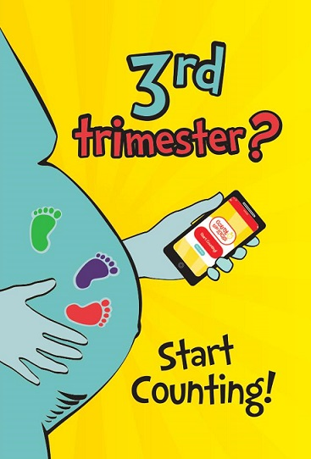
Count the Kicks
Stillbirth prevention public health campaign
Evidence-based
Mom-focused
Educates women on importance of tracking fetal movement
  Mobile app & paper charts
Empowers moms to speak up to providers if there is a concern

Slide 3
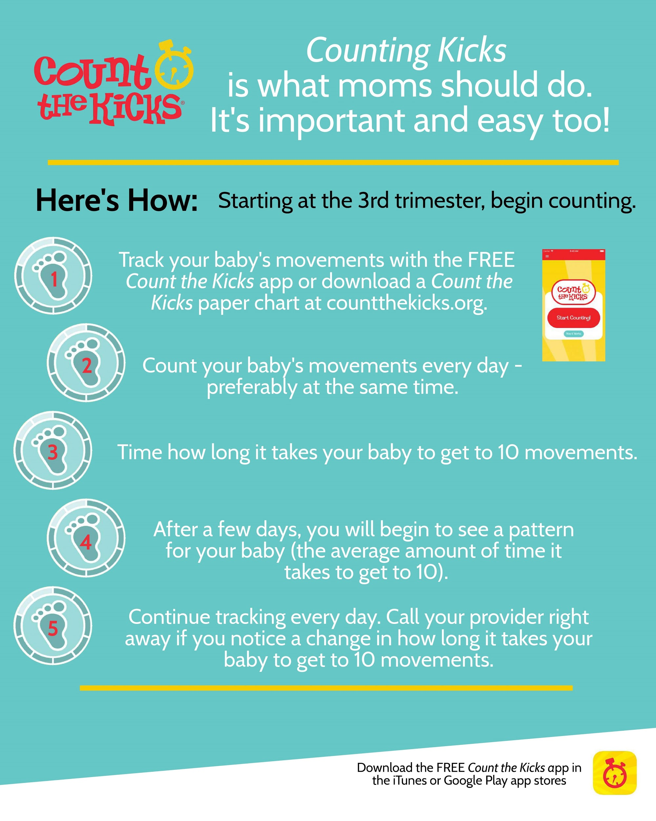
Notes:
This is the method for paying attention to babies’ movements - this is the highly effective method we teach moms. Count the Kicks teaches the method for, and importance of, tracking fetal movement during the third trimester of pregnancy. Research shows the benefits of expectant moms tracking their baby’s movements daily and learning how long it normally takes their baby to get to 10 movements. After a few days, moms will begin to see a pattern, a normal amount of time it takes their baby to get to 10 movements. If their baby’s “normal" changes during the third trimester, this could be a sign of potential problems and is an indication that the expectant mom should call her healthcare provider.

Slide 4
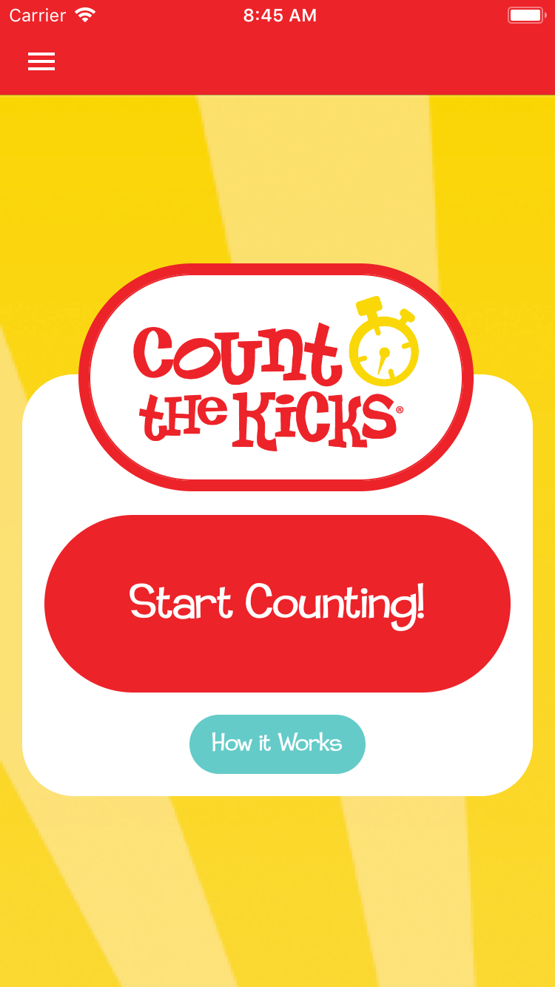
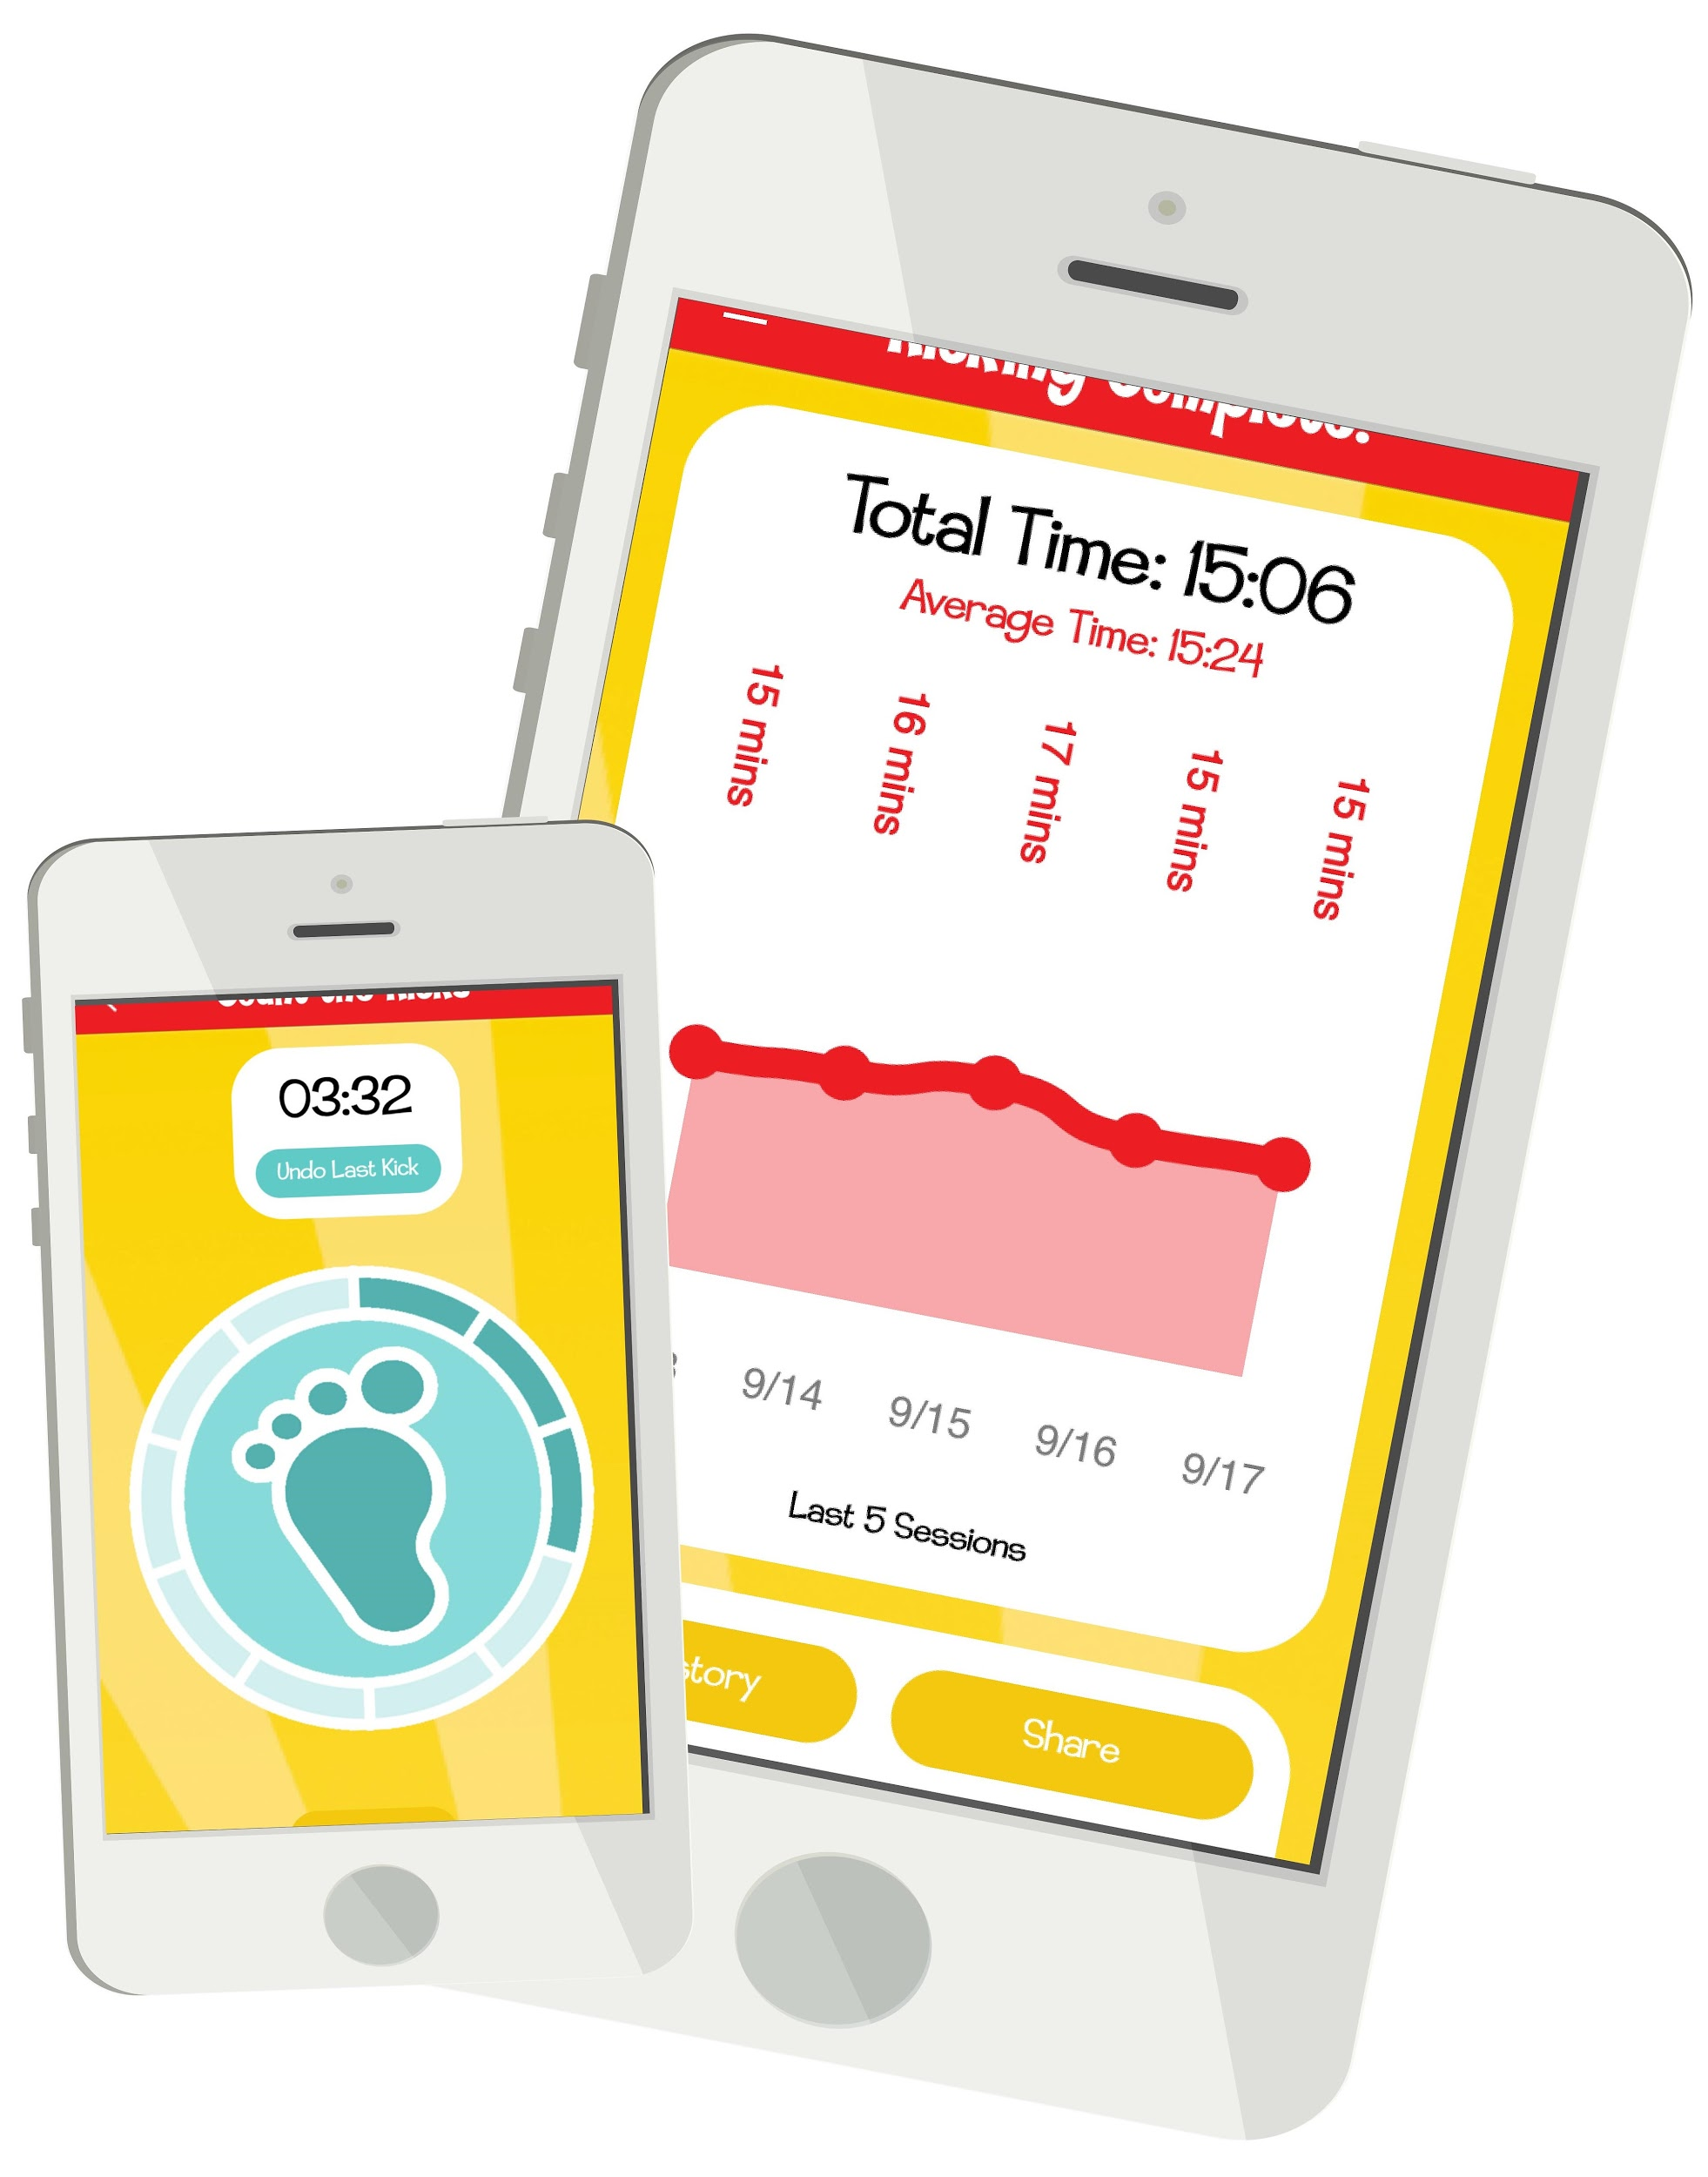
Our FREE app is evidence-based and available in 12 languages: Amharic, Arabic, Chinese, English, French, Haitian-Creole, Hindi, Marshallese, Russian, Spanish, Swahili and Vietnamese.
Available for Apple and Android products
Users can restart their session or delete a kick
Set a daily reminder to Count the Kicks
Review kick-counting history
Download history to share with their provider, family or friends via text or email
Count the Kicks with twins
Track future pregnancies on the same profile
Manage multiple devices registered to your account
Available on Apple smart watches next year!
Notes:
reads slide to go over features of app.

Slide 5

Next Steps
Download the app
Practice, Practice, Practice!
Make sure to share this information with all staff
Order material
  Tip: Designate someone in your office to oversee ordering material
  www.CountTheKicks.org
Count the Kicks contact at Florida Department of Health: Casey Omeke, Casey.Omeke@flhealth.gov

Slide 6
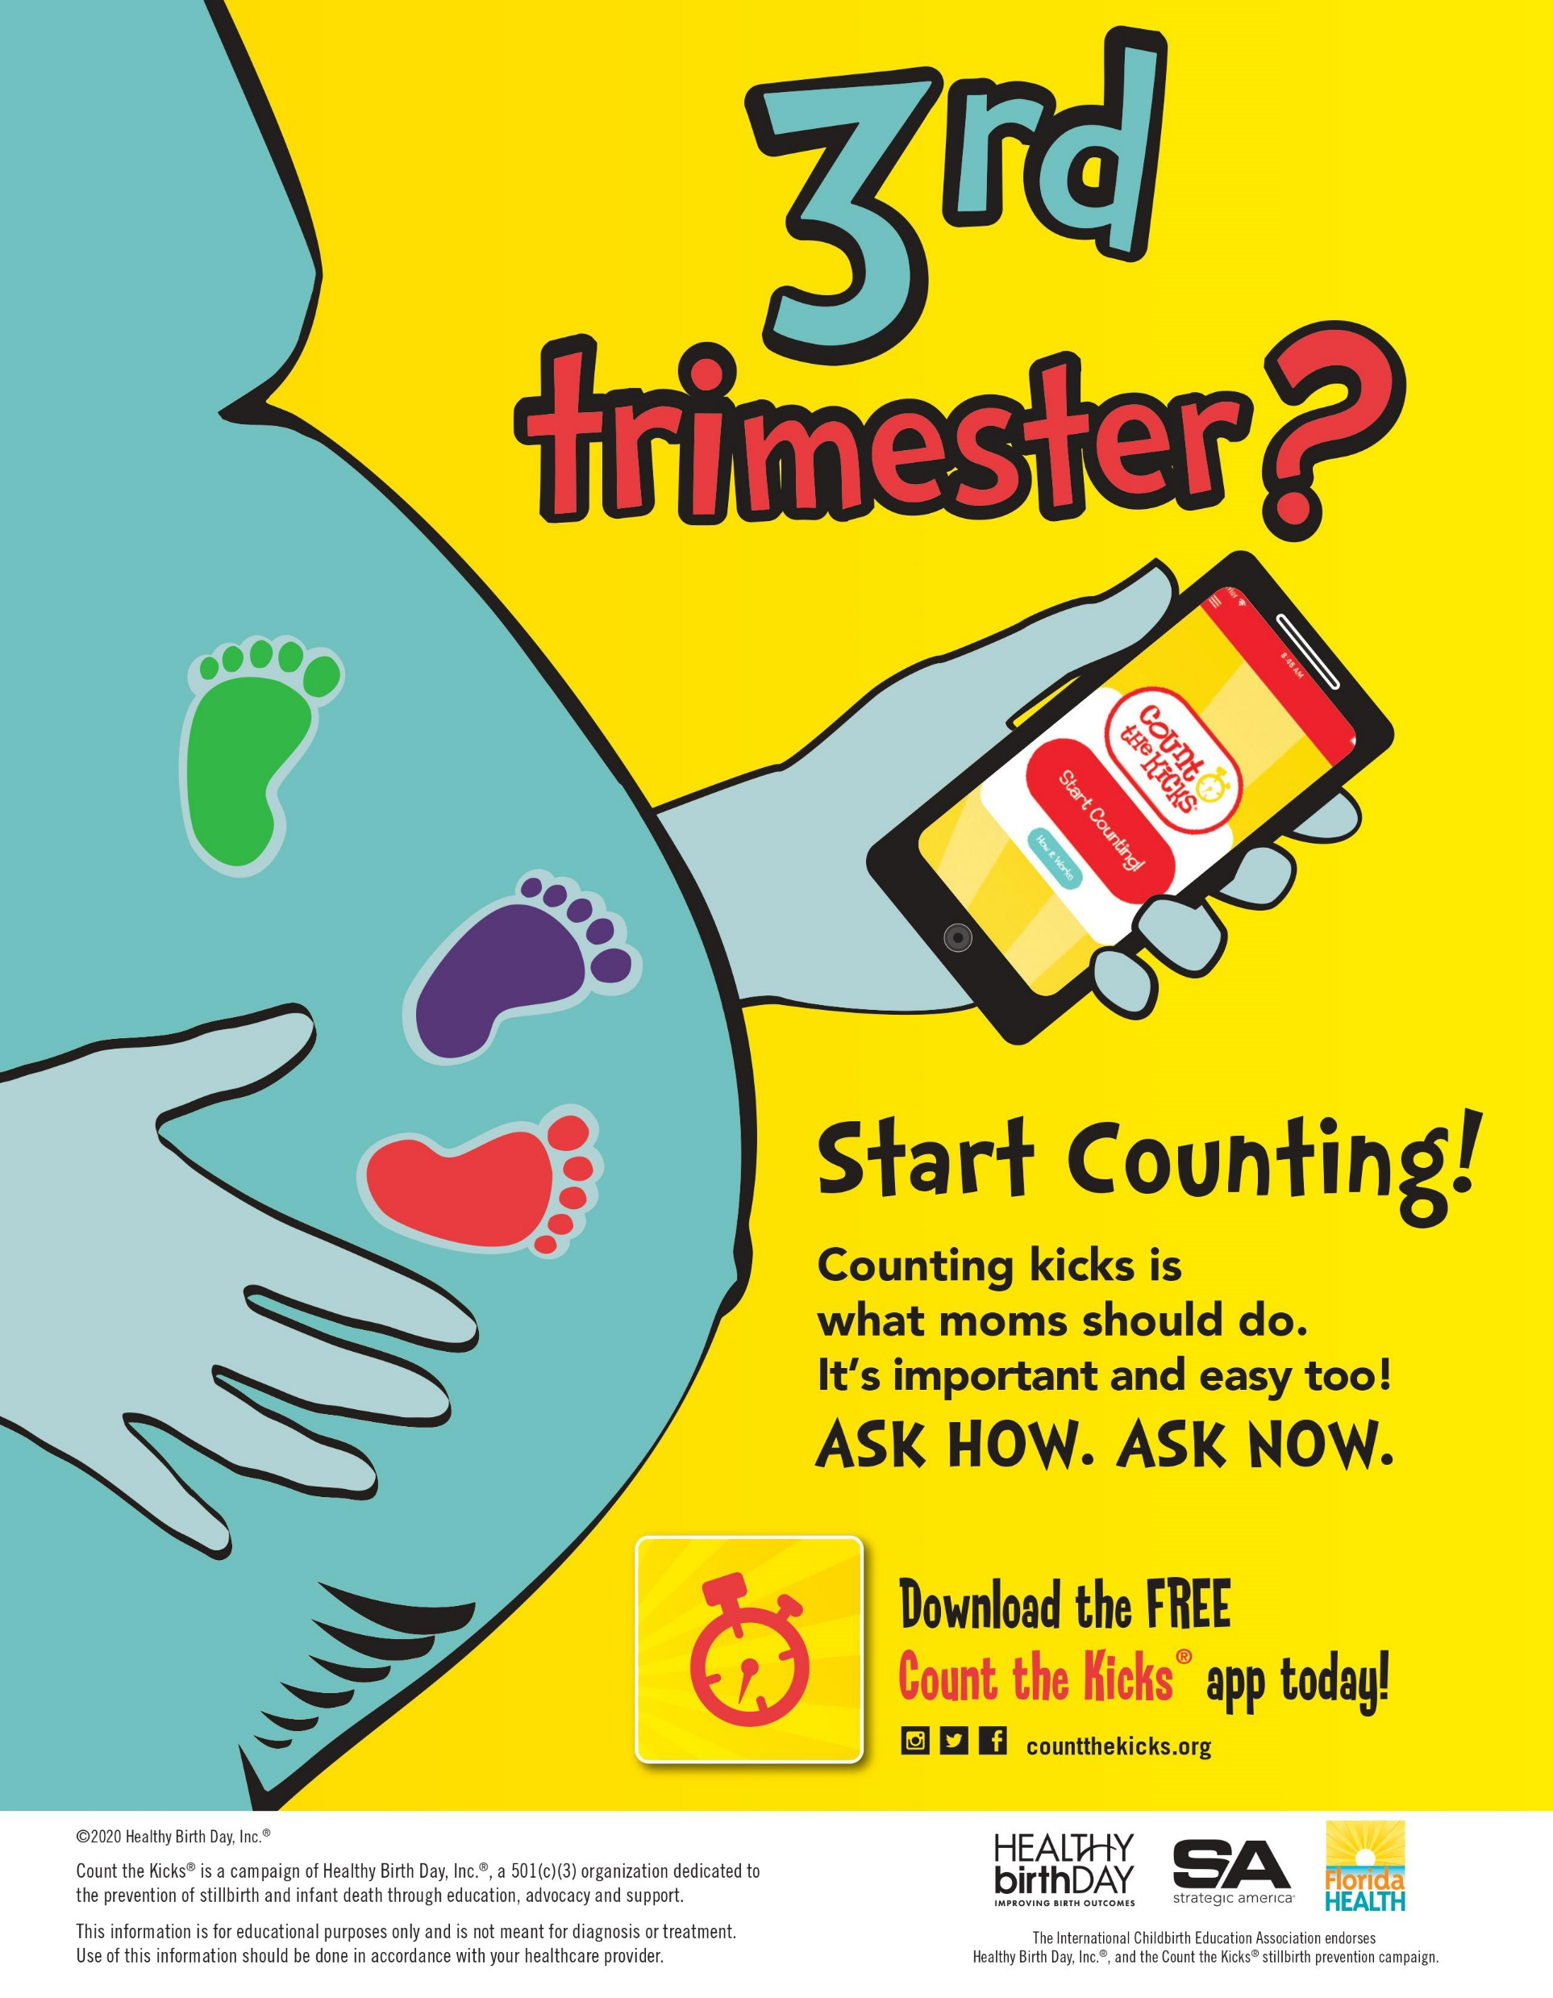
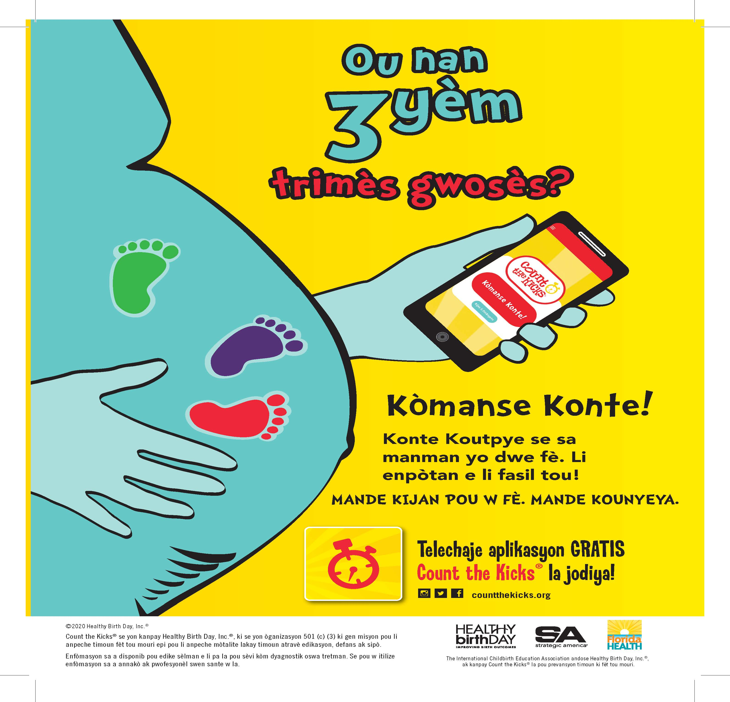
Educational Material
Promo Posters in English, Spanish, Haitian-Creole
How To Posters in English, Spanish and Haitian-Creole
App Card Reminders
Brochures
www.countthekicks.org
Notes:
So finally, now what?? Now, finish this training and go to our website and order our material. READ SLIDE

Slide 7
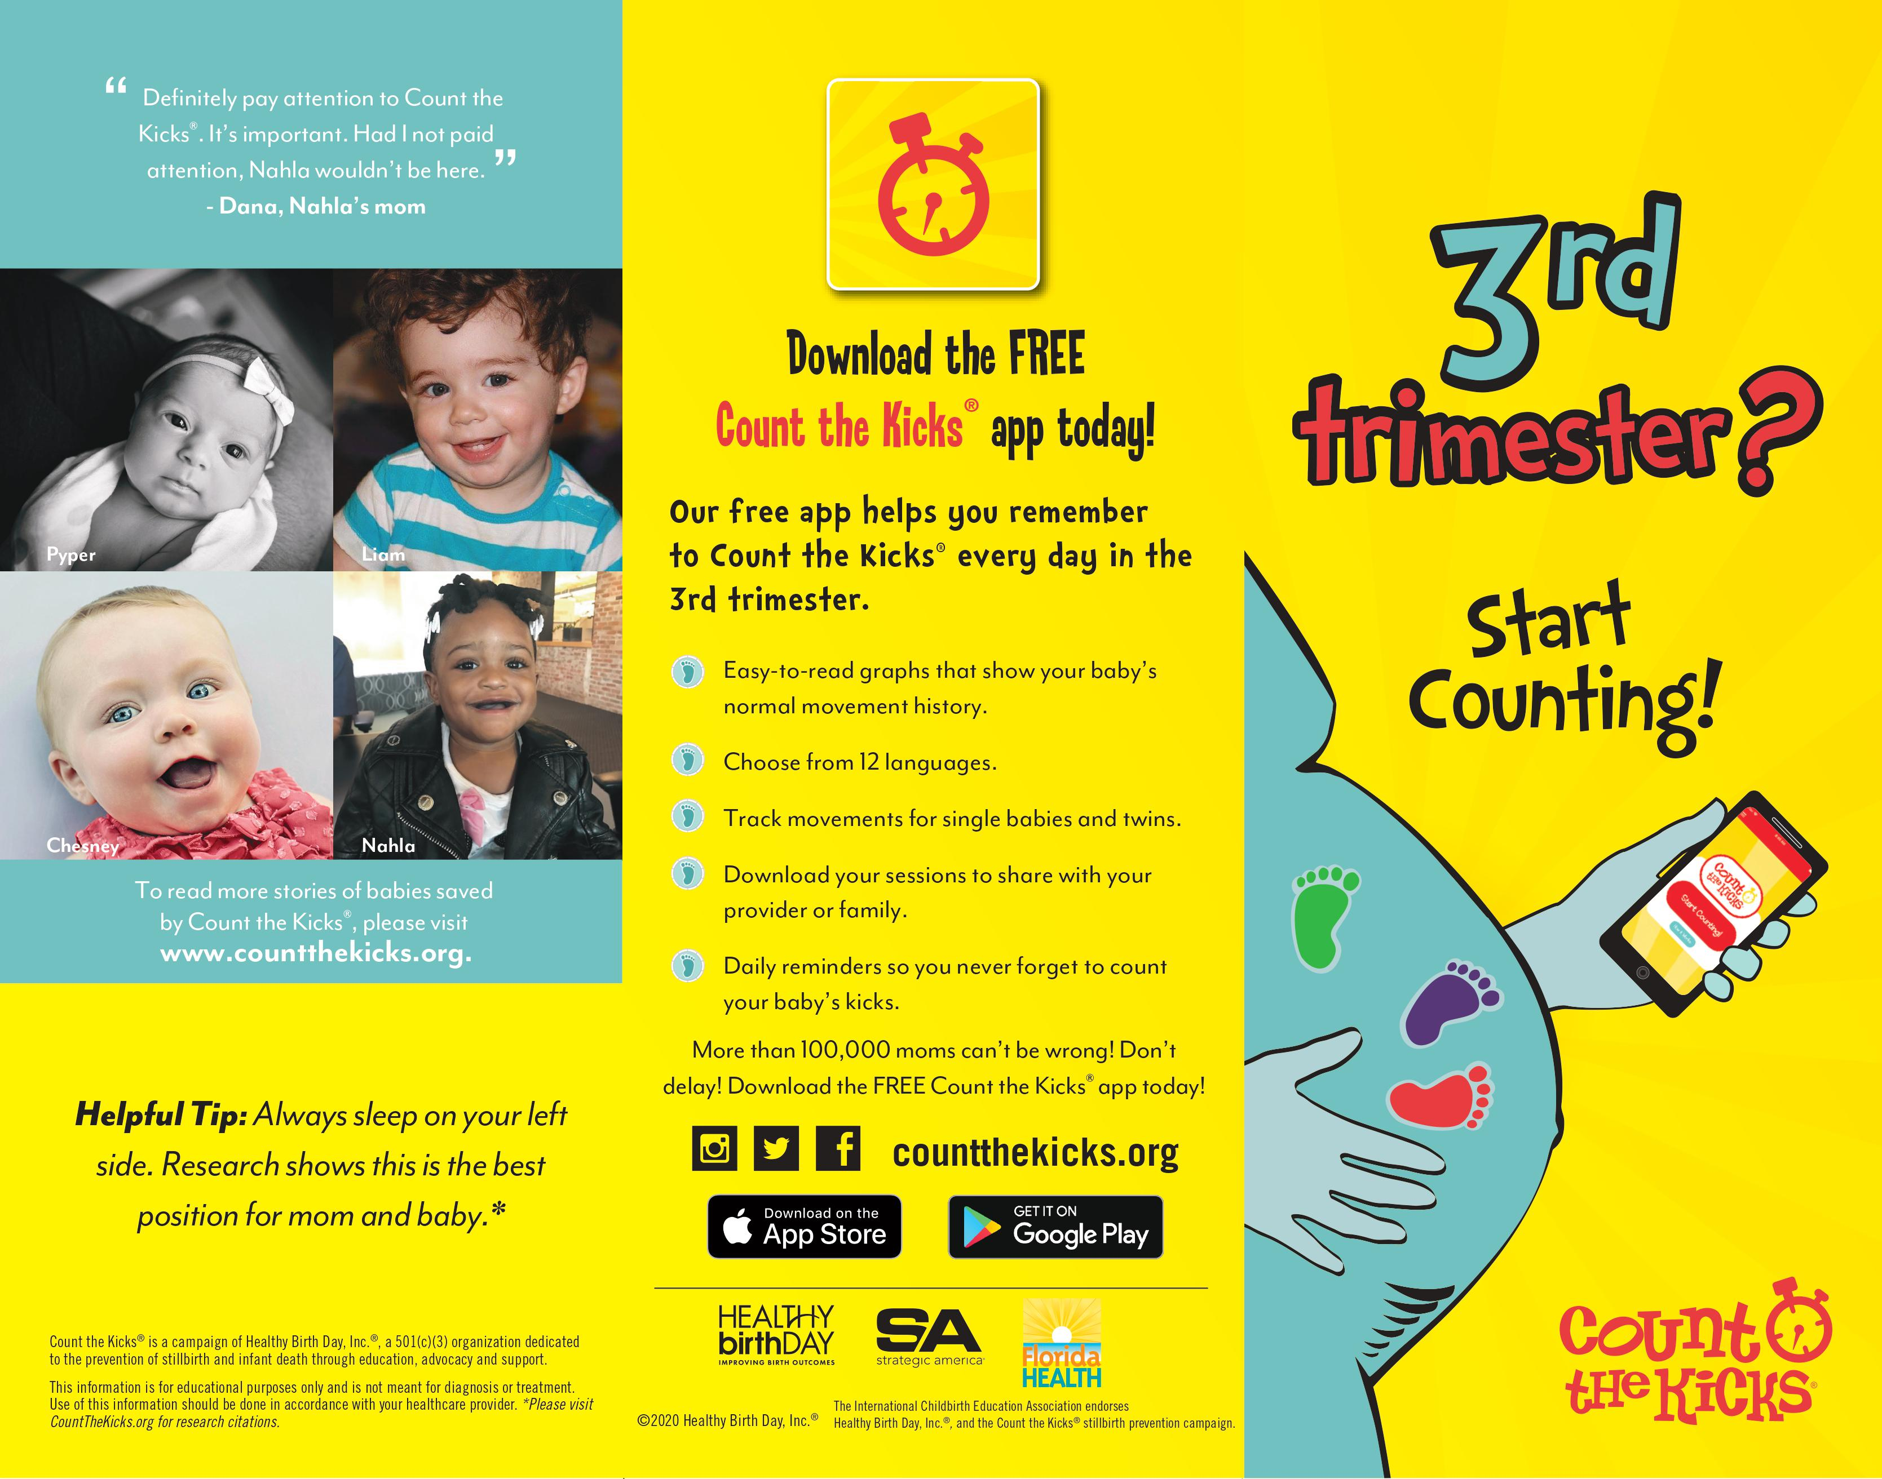
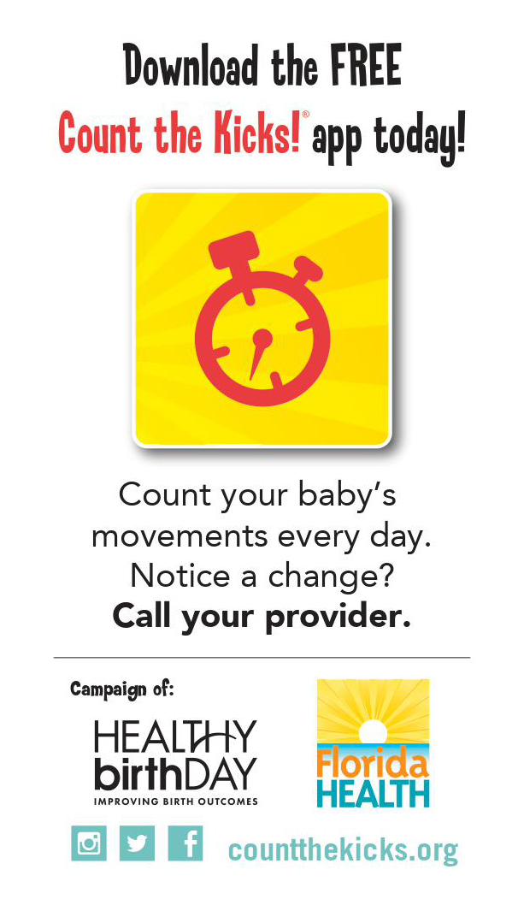
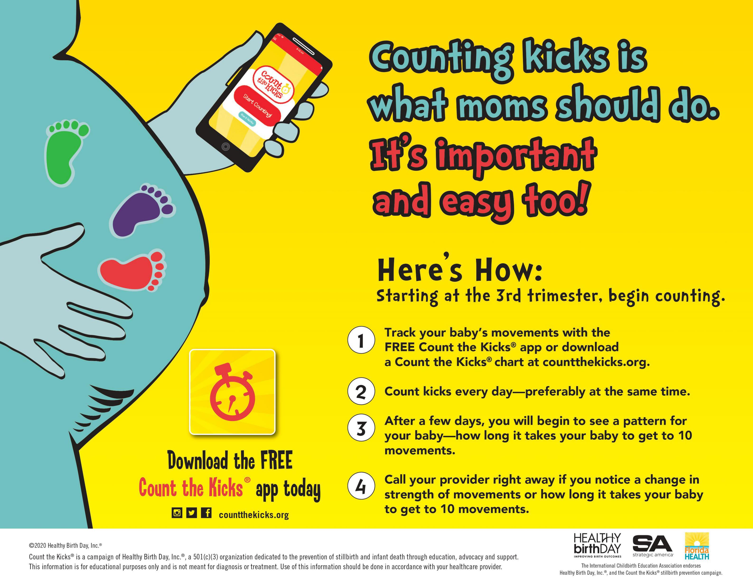
Additional Material
Visit www.CountTheKicks.org
Click on ORDER MATERIALS
Click on your state
Fill your shopping cart
Check out!
Free material for Iowa, Ohio, North Dakota, Missouri, Kansas, West Virginia, Nebraska, Florida, Illinois
Notes:
It’s so easy! READ SLIDE

Slide 8

CE Training: 1.5 CEs
The purpose of this educational activity is to train healthcare professionals how to talk to their patients about fetal monitoring and using best practices to track fetal monitoring. By using an evidence-based and non-invasive tool, providers have the ability to help prevent stillbirths.
In partnership with Florida Department of Health, the CE Training is free: use code Savebabies-FL at check out.
https://cme.dmu.edu/SaveBabies#group-tabs-node-course-default1
Notes:
Ask Anna if we should promote this.

Slide 9
March 31st: Free Webinar
Join us for a free webinar: Noon
Register:
https://us02web.zoom.us/webinar/register/WN_eMyTafXoTAKz22-QAKsyhA
We will share the link via email.

Slide 10

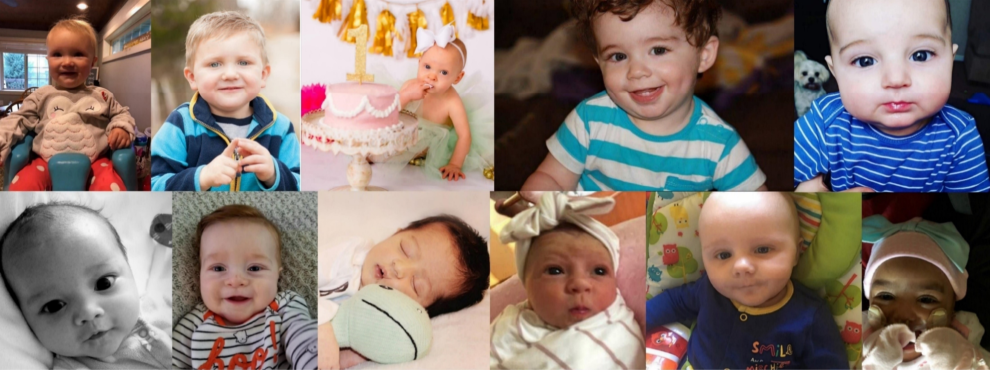
Thank you
Let’s save babies together!
Notes:
Thank you so much for taking the time to take this training, you can help save babies! Please reach out to me if you have any questions.

