Slide 1
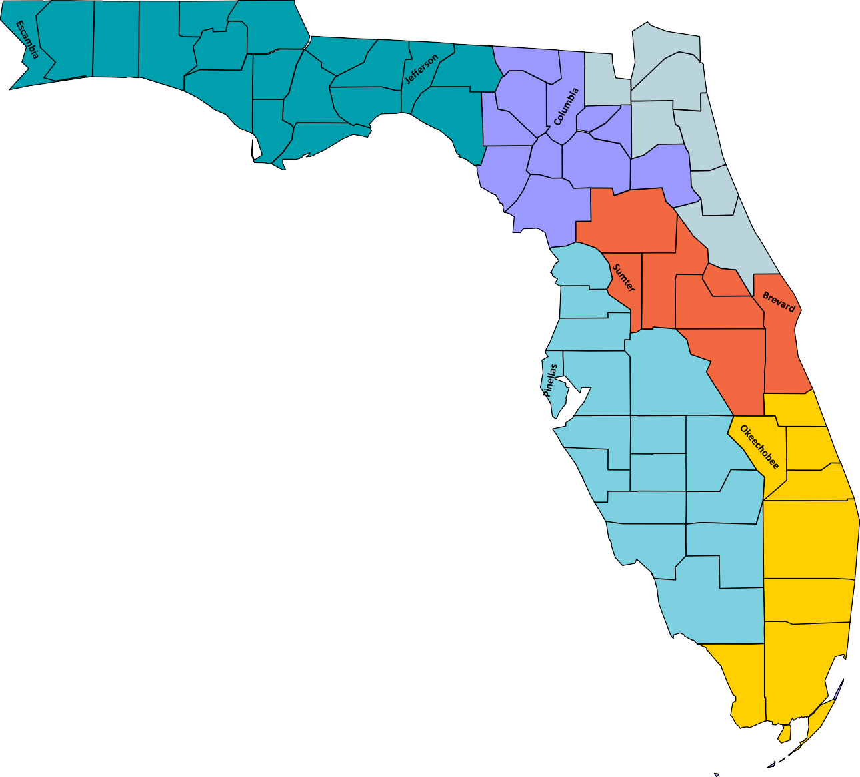
Florida Regional Cancer Control Collaboratives:
Reducing the Cancer Burden through Collaboration
Santa Rosa
Holmes
Jackson
Okaloosa
Walton
Washington
Gadsden
Nassau
Calhoun
Leon
Madison
Hamilton
Bay
Liberty
Suwannee
Baker
Duval
NORTHEAST REGION:
Health Planning Council of N.E. Florida, Inc. Coordinator: Kim Millrood Kim_millrood@hpcnef.org │(904) 448-4300 ext. 115 https://www.hpcnef.org/
Chair: Kim Millrood
NORTHWEST REGION:
University of West Florida
Coordinator: Daudet llunga Tshiswaka, PhD daudeti@uwf.edu │(850) 474-2782
PI: Justice Mbizo, DrPH NWFCCC@gmail.com │(850) 474-2194 nwfccc.org/
Chair: Sara Hobbs
Gulf
Wakulla
Taylor
Union
Bradford
Clay
Franklin
Lafayette
St.
Johns
Dixie
Gilchrist _{Alachua}
Putnam
Flagler
NORTH CENTRAL REGION:
WellFlorida Council, Inc.
Coordinator: Lindsey Redding
Levy
Marion
Volusia
LRedding@wellflorida.org │(352) 313-6500 ncfcancercontrol.org/
Chair: Laura Guyer
Citrus
Lake
Seminole
EAST CENTRAL REGION:
Health Council of East Central Florida, Inc. Coordinator: Ken Peach KPeach@hcecf.org │(866) 991-3652 centralfloridacancer.info/
Chair: Josephine Visser
Hernando
Orange
Pasco
Hillsborough
Polk
Osceola
Indian
River
Manatee
Hardee
St. Lucie
Highlands
SOUTHWEST REGION:
University of South Florida Coordinator: Natalie Erasme erasme@usf.edu
Sarasota
Desoto
Martin
Charlotte
Glades
SOUTHEAST REGION:
Health Council of South Florida, Inc. Coordinator: Tiffany Albury Talbury@ealthcouncil.org │(786) 535-4374 https://www.healthcouncil.org/sfccc
Co-Chairs: Rachelle Theodore/Paco C. Castellon
Lee
Hendry
Palm Beach
https://health.usf.edu/publichealth/prc/swfccc Chair: VACANT
Collier
Broward
Florida Department of Health
Comprehensive Cancer Control Program Manager Sandy Noel Sandy.Noel@flhealth.gov
Monroe
Dade
Florida Department of Health
Comprehensive Cancer Control Program Coordinator:
Richard Williams: Richard.Williams@flhealth.gov
Updated October 2022

