Slide 1

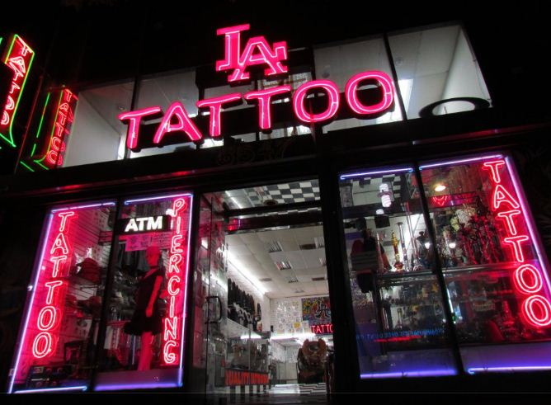
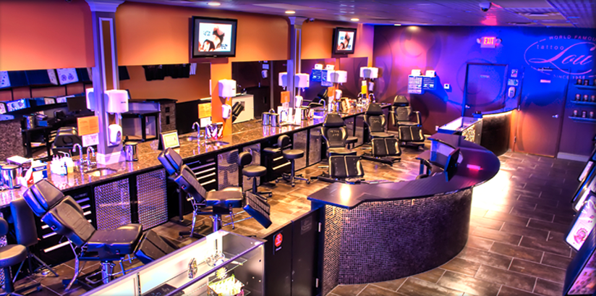
Operational Requirements for Tattoo
Establishments
Chapter 64E-28.007, Florida Administrative
Code
Notes:
Picture with background removed
(Intermediate)
To reproduce the picture effects on this slide, do the following:
On the Home tab, in the Slides group, click Layout, and then click Blank.
On the Insert tab, in the Images group, click Picture.
In the Insert Picture dialog box, select a picture and then click Insert.
Select the picture. Under Picture Tools, on the Format tab, in the Size group, click the Size and Position dialog box launcher. In the Format Picture dialog box, resize or crop the image so that the height is set to 7.5” and the width is set to 10”. To crop the picture, click Crop in the left pane, and in the right pane, under Crop position, enter values into the Height, Width, Left, and Top boxes. To resize the picture, click Size in the left pane, and in the right pane, under Size and rotate, enter values into the Height and Width boxes.
Also under Picture Tools, on the Format tab, in the Adjust group, click Color, and then under Recolor click Grayscale.
Also in the Adjust group, click Corrections, and then under Brightness and Contrast, click Brightness: -40% Contrast: +20%.
On the Home tab, in the Clipboard group, click the arrow to the right of Copy, and then click Duplicate.
Select the second picture. On the Home tab, in the Drawing group, click Arrange, point to Align, and then do the following:
Click Align to Slide.
Click Align Middle.
Click Align Center.
Under Picture Tools, on the Format tab, in the Adjust group, click Reset Picture.
Also under Picture Tools, on the Format tab, in the Size group, click the Size and Position dialog box launcher.. In the Format Picture dialog box, resize or crop the image to focus on the main subject in the picture. (Example picture is set to 3.54” height and 3.24” width). To crop the picture, click Crop in the left pane, and in the right pane, under Crop position, enter values into the Height, Width, Left, and Top boxes. To resize the picture, click Size in the left pane, and in the right pane, under Size and rotate, enter values into the Height and Width boxes.
Also under Picture Tools, on the Format tab, in the Adjust group, click Remove Background, and then do the following:
To remove additional background areas from the picture, on the Background Removal tab, in the Refine group, click Mark Areas to Remove. Select all of the additional areas to be removed.
To keep additional areas of the picture that have been removed, on the Background Removal tab, in the Refine group, click Mark Areas to Keep. Select all of the additional areas to be kept.
Click Keep Changes in the Close group when finished.
To reproduce the shape effects on this slide, do the following:
On the Home tab, in the Drawing group, select Rectangle.
On the slide, drag to draw a rectangle.
Select the rectangle. Also on the Home tab, in the Drawing group, click the Format Shape dialog box launcher.
In the Format Shape dialog box, in the Size tab, enter 7.5” into the Height box and enter 4” into the Width box.
Also in the Format Shape dialog box, in the Fill tab, select Gradient fill, and then do the following:
In the Type list, select Linear.
In the Angle box, enter 90°.
Under Gradient stops, click Add gradient stops or Remove gradient stops until three stops appear in the slider.
Also under Gradient stops, customize the gradient stops as follows:
Select the first stop from the left in the slider, and then do the following:
In the Position box, enter 0%.
Click the button next to Color, and then under Theme Colors click Black, Text 1 (first row, second option from the left).
In the Transparency box, enter 100%.
Select the second stop from the left in the slider, and then do the following:
In the Position box, enter 40%.
Click the button next to Color, click More Colors, and then in the Colors dialog box, on the Custom tab, enter values for Red: 47, Green: 91, and Blue: 77.
In the Transparency box, enter 0%.
Select the third stop from the left in the slider, and then do the following:
In the Position box, enter 100%.
Click the button next to Color, and then under Theme Colors click Black, Text 1 (first row, second option from the left).
In the Transparency box, enter 90%.
Also in the Format Shape dialog box, in the Line Color tab, select No Line.
Select the second picture. On the Home tab, in the Drawing group, click Arrange, and then click Bring to Front.
To reproduce the text effects on this slide, do the following:
On the Insert tab, in the Text group, click Text Box, and then on the slide drag to draw your text box.
Enter text in the text box, and then select the text. On the Home tab, in the Font group, do the following:
In the Font list, click Calisto MT.
In the Font Size list, click 36 pt.
Click Font Color, and then under Theme Colors click White, Background 1 (first row, first option from the left).
Position text over the least transparent part of the gradient.

Slide 2




Rule 64E-28.007(1),
Florida Administrative Code
The BASICs
Tattoo Establishments shall have walls, a floor and a ceiling.
Floor and walls in the tattooing area shall be constructed of non-absorbent easily cleanable materials.
The entire establishment shall be maintained in clean condition and good repair.

Slide 3
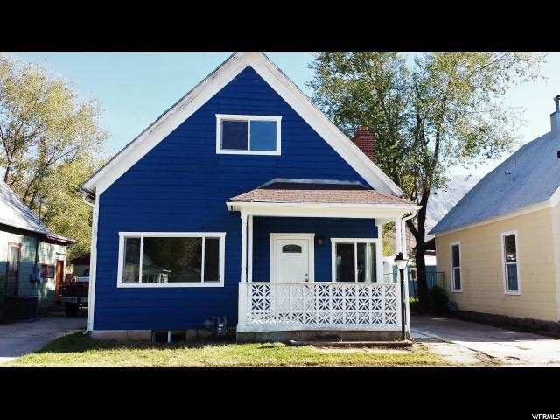
rule 64E-28.007(2),
Florida Administrative Code
May I Tattoo From home?
There will not be a direct opening between a tattoo establishment and any portion of a building used as living or sleeping quarters.
This shall be accomplished by a solid floor to ceiling wall of separation.
Most homes will be located where zoning laws will not permit the operation of a commercial business.

Slide 4

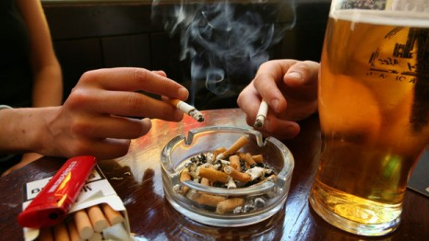
Rule 64E-28.007(3) & (4),
Florida Administrative Code
Food and Smoking
A tattoo establishment shall not be located in an area where food is prepared.
Eating and drinking, except for the purpose of administering first aid, and smoking are prohibited in areas where tattooing is performed or where instruments and supplies are cleaned and stored.

Slide 5
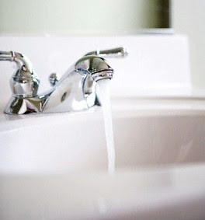

Rule 64E-28.007(5) & (6),
Florida Administrative Code
Water & Sewage
Water supplies shall comply with Chapter 64E-8 or 62-550, Florida Administrative Code.
Sewage disposal shall comply with Chapter 64E-6 or 62-200, Florida Administrative Code.

Slide 6
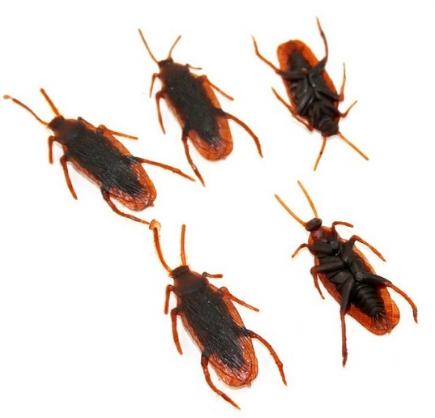

Rule 64E-28.007(7) & (8),
Florida Administrative Code
Pests & Animals
The establishment shall protect against the entrance, breeding, and presence of vermin such as insects and rodents.
Animals shall not be allowed in a tattoo establishment except for service animals for persons with disabilities.

Slide 7
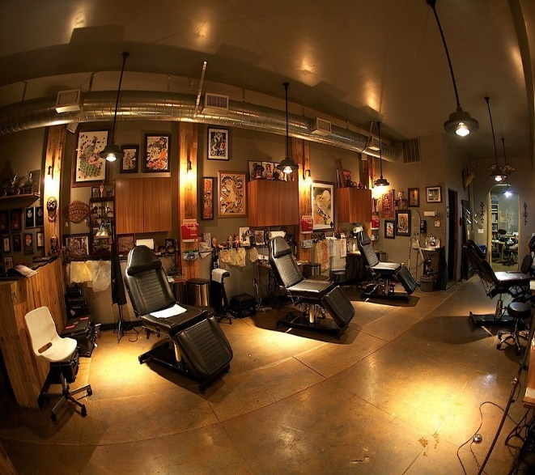
Chapter 64E-28.007(9),
Florida Administrative Code
lighting
Each tattoo establishment shall have an artificial light source equivalent to at least 100 foot candles in the tattooing area and in the area where items are cleaned and sterilized.

Slide 8
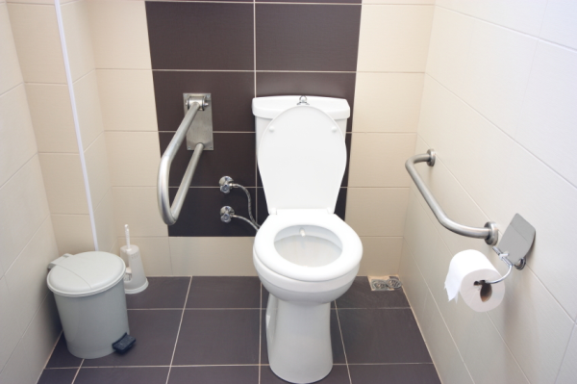
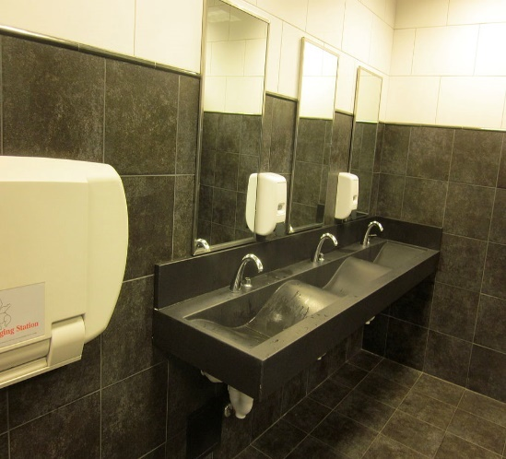
Chapter 64E-28.007(10),
Florida Administrative Code
restrooms
Restrooms shall be supplied with toilet tissue, a hand sink with running water under pressure, and liquid soap.
Restrooms shall have a dispenser with single-use paper towels, waste receptacles, and signage posted to instruct employees to thoroughly wash their hands.

Slide 9

CHapter 64E-28.007(11),
Florida Administrative Code
hANDSINKS
A handsink with unobstructed access shall be located within each tattoo area or centrally located within the overall workroom area, so that each tattoo artist has access to the handsink for handwashing.

Slide 10
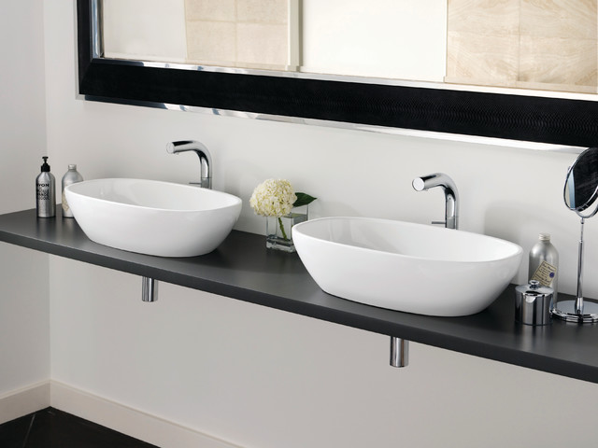
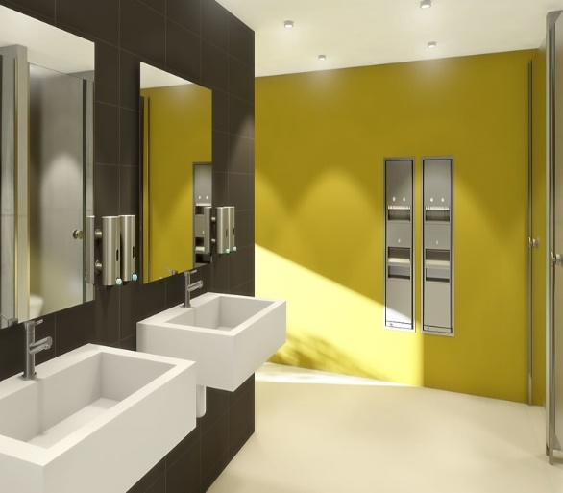
Chapter 64E-28.007(11)(a) & (b),
Florida Administrative Code
hANDSINKS (continued)
The handsink shall be supplied with running water under pressure, liquid soap, a dispenser with single-use paper towels, and a waste receptacle.
A restroom handsink may be used as the handsink provided that it meets the unobstructed access requirement and meets all handsink requirements.

Slide 11
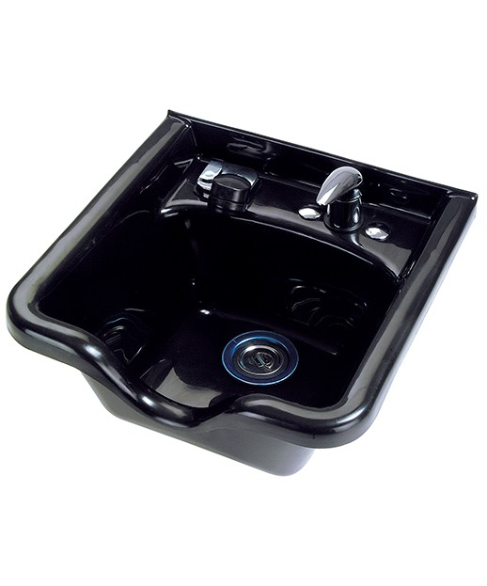
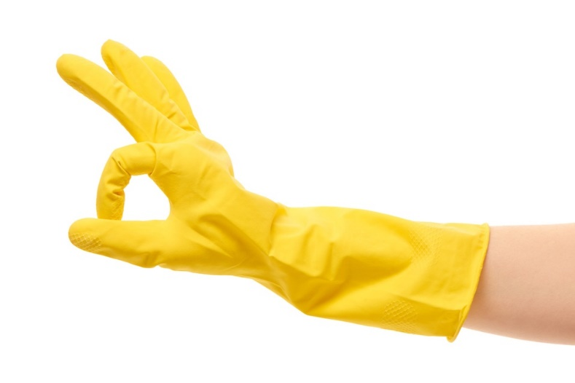
Chapter 64E-28.007(12) & (12)(a),
Florida Administrative Code
Reusable items (continued)
At a minimum, contaminated, reusable items shall be cleaned manually in a sink, separate from the handsink(s) or mechanically in an ultrasonic machine prior to sterilization.
If items are cleaned in a sink, the sink shall be deep enough to allow complete submersion of the items. Gloves shall be worn when manual cleaning is performed.

Slide 12
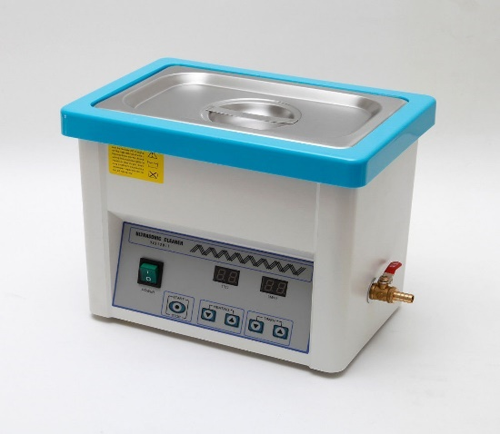
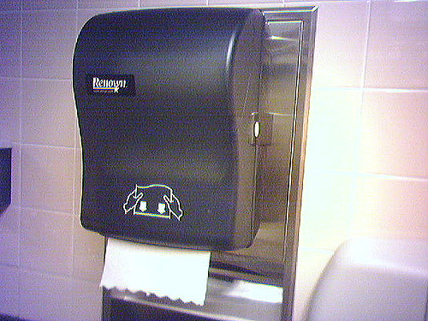
Chapter 64E-28.007(12)(b) & (12)(c),
Florida Administrative Code
Reusable items (continued)
If items are cleaned in an ultrasonic machine, the machine shall be used in accordance with the manufacturer’s instructions, which shall be available for review by the department at the time of inspection.
After cleaning, items shall be rinsed and allowed to air dry or shall be dried with single-use paper towels prior to packaging for sterilization.

Slide 13
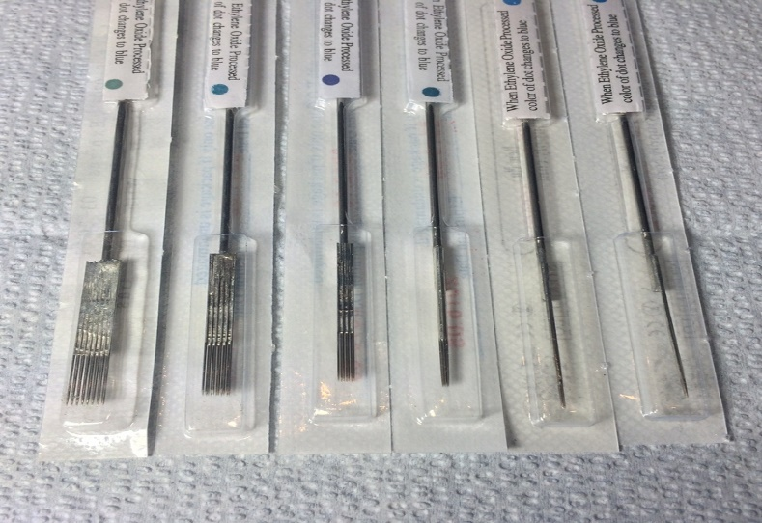
Chapter 64E-28.007(12)(d),
Florida Administrative Code
Reusable items (continued)
If only individually packaged, pre-sterilized, single-use items are used in the establishment, the cleaning sink and ultrasonic machine requirements do not apply.

Slide 14
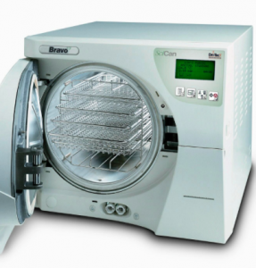
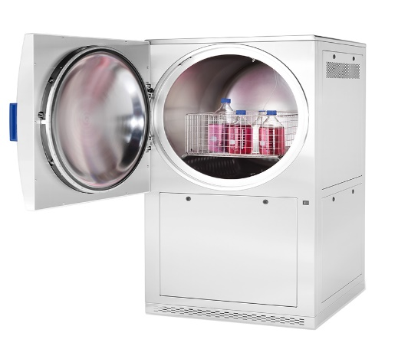
Chapter 64E-28.007(13) & 13(a) & (b),
Florida Administrative Code
AUTOCLAVES
A tattoo establishment shall have a steam autoclave for sterilizing instruments that are not single-use.
The autoclave shall be used in accordance with the manufacturer’s instructions and maintained to ensure proper operation.
There should be instructions for packaging, loading, and processing items.

Slide 15
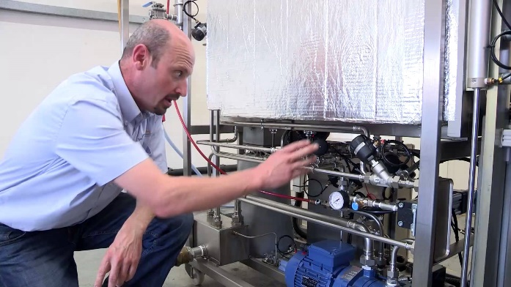
Chapter 64E-28.007(13)(b)(1),
Florida Administrative Code
AUTOCLAVES (continued)
The autoclave shall be cleaned at the frequency recommended by the manufacturer and shall be serviced at least once per year or at the frequency recommended by manufacturer.

Slide 16

Chapter 64E-28.007(13)(b)(2),
Florida Administrative Code
AUTOCLAVES (Continued)
A copy of the manufacturer’s instructions for packaging, loading, operating, cleaning, and servicing the autoclave shall be maintained at the tattoo establishment.
The instruction manual shall be available for review by the Department at the time of an inspection.

Slide 17
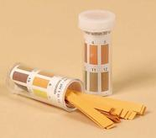
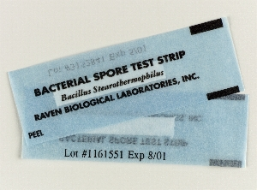
Chapter 64E-28.007(14)(a) & (b),
Florida Administrative Code
AUTOCLAVES (continued)
When using an autoclave, sterilization shall be verified through:
Chemical Indicator Strip placed inside one packet in each load to monitor sterilization procedure. The strip must indicate exposure to steam and proper operating temperature.
Test with spore strips at a minimum frequency of every 40 hours of operation of the autoclave, but not less than on a quarterly basis.

Slide 18
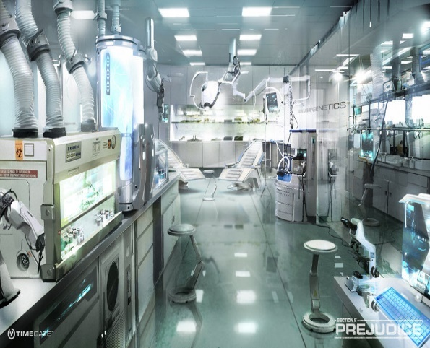
Chapter 64E-28.007(14)(b)(1) & (2),
Florida Administrative Code
AUTOCLAVES (Continued)
Test results shall be verified by an independent laboratory.
In the event of positive results, the autoclave shall be immediately taken out of service and all unused items processed in the autoclave since most recent negative test results will be considered non-sterile.

Slide 19
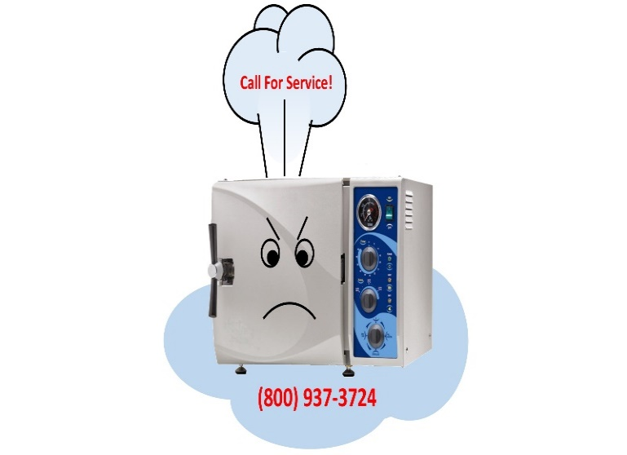
Chapter 64E-28.007(14)(B)(3) & (4),
Florida Administrative Code
AUTOCLAVES (Continued)
While the autoclave remains out of service, tattooing may continue provided either another properly functioning autoclave is placed in service in the establishment or all single-use, pre-sterilized instruments are used.
When the out of service autoclave is restored to proper function and confirmed by follow up testing, it may be placed back in service.

Slide 20
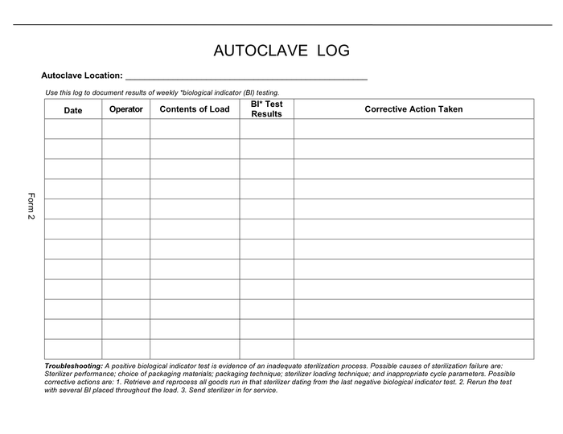
Chapter 64E-28.007(15)(a) & (b),
Florida Administrative Code
AUTOCLAVES (continued)
Each tattoo establishment shall maintain autoclave sterilization records onsite. At a minimum, the records should include an autoclave log showing cumulative run time, quantity and types of items sterilized, and the date the spore strip testing was conducted.

Slide 21
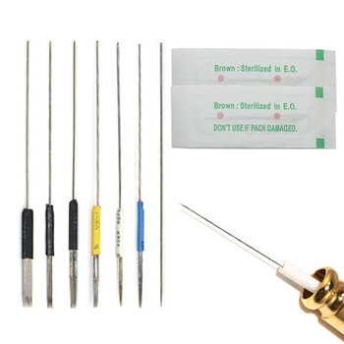
Chapter 64E-28.007(16)(a) & (b),
Florida Administrative Code
Single-use items (continued)
If only individually packaged, pre-sterilized, single-use items are used, an autoclave shall not be required nor the requirements specified in subparagraphs 12, 13, 14, and 15 of this section.

Slide 22
Chapter 64E-28.007(16)(a) & (b),
Florida Administrative Code
Single-use items (continued)
Subparagraph 12 requires items to be cleaned in a sink separate from the handsink or ultrasonic machine prior to sterilization. Subparagraph 13 requires a steam autoclave for sterilization. 14 explains how autoclave sterilization shall be verified. 15 requires the maintenance of autoclave sterilization records.

Slide 23
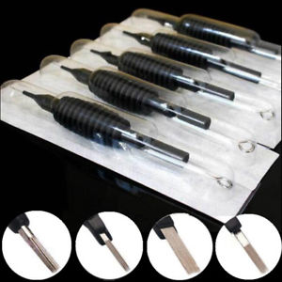
Chapter 64E-28.007(16)(a) & (b),
Florida Administrative Code
Single-use items
These pre-sterilized, single-use items shall be sterilized with ethylene gas or gamma rays and shall be labeled with the expiration date by the manufacturer. If package is compromised, contents discarded.

Slide 24
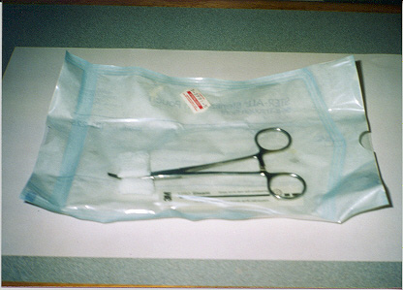
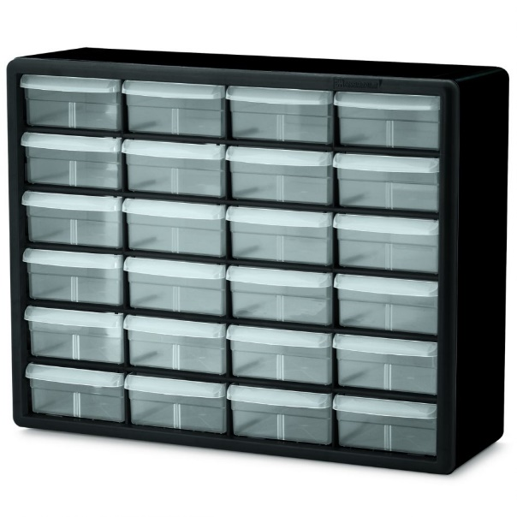
Chapter 64E-28.007(17) & (18),
Florida Administrative Code
Single-use items (continued)
Packages of sterile items, which are sterilized by the tattoo establishment, shall be labeled with the date of autoclaving. If any package has been compromised, the items shall be repackaged and re-sterilized.
All packages of sterile items shall be stored in a clean, dry, covered container or in a clean, dry cabinet until just prior to use.

Slide 25
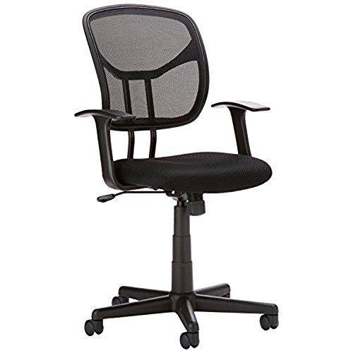
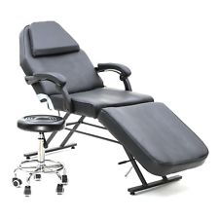
Chapter 64E-28.007(19),
Florida Administrative Code
Chairs, tables, counter tops, etc.
Work chairs, tables, stands, cabinets, and counter tops shall have a smooth, non-porous, easily cleanable surface, and shall be cleaned and disinfected after each customer.

Slide 26
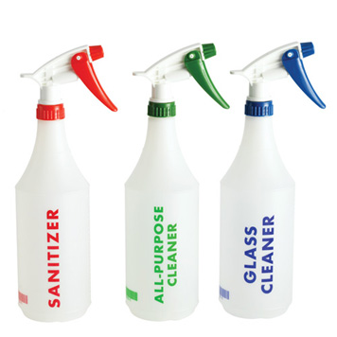
Chapter 64E-28.007(20),
Florida Administrative Code
Labeling containers
If any liquid product is not in its original container, the container into which the product has been placed shall be labeled with the name of the product.

Slide 27
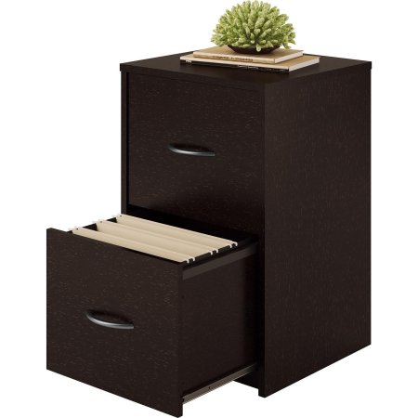
Chapter 64E-28.007(21),
Florida Administrative Code
records
Each tattoo establishment shall maintain the following records for 2 years with those for the current licensing period onsite:
Customer records, including parental consent;
Autoclave sterilization records and maintenance records;
Documentation identifying the method of sterilization utilized by the manufacturer if the information is not printed on the packaging of the item.

Slide 28
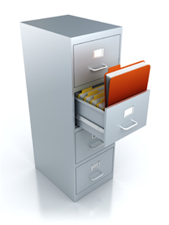
Chapter 64E-28.007(21),
Florida Administrative Code
Records (continued)
Each tattoo establishment shall maintain the following records for at least 2 years after an artist’s employment ends:
Personnel records of each tattoo artist who works in the establishment. The record shall contain the tattoo artist’s name, address, date of birth, and the license number issued by the department.

Slide 29
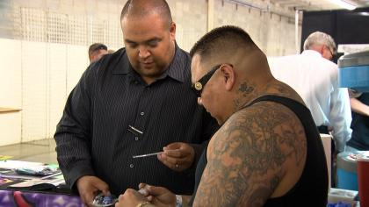
Chapter 64E-28.007(22),
Florida Administrative Code
inspections
A tattoo establishment shall allow the department to conduct, at minimum, annual inspections for the purpose of ensuring compliance with sections 381.00771-.00791, Florida Statutes, and these rules.

Slide 30
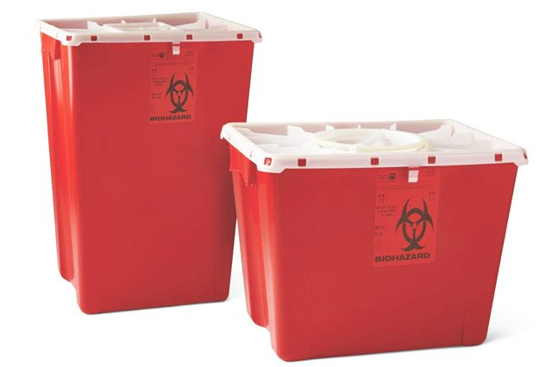

Chapter 64E-28.007(23),
Florida Administrative Code
Biomedical waste
Biomedical waste shall be managed in accordance with section 381.0098, Florida Statutes, and Chapter 64E-16, Florida Administrative Code. Regular solid waste shall be collected, stored and disposed of in a manner and at a frequency that does not create a sanitary nuisance, as defined in Chapter 386, Florida Statutes.

Slide 31
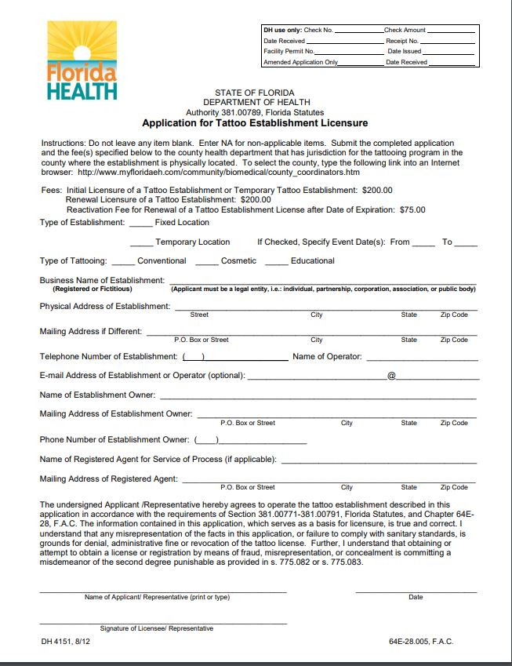
Tattoo Establishment
Licensure
Licensure of a tattoo establishment requires the following:
Contact city/county for potential need for business tax receipt and ensure location is zoned for a tattoo business.
Submit completed Application for Tattoo Establishment License. ($200)
Completed Application for Biomedical Waste Generator Permit/Exemption. ($85)
Pass inspection in compliance with sections 381.00771-381.00791, Florida Statutes, and Rule 64E-28, , Florida Administrative Code.

Slide 32
Where to submit
Application and fee
Applications, supporting documents, and fees should be submitted to the local Department of Health office having jurisdiction of the tattooing program in the county in which the business is located.

