Slide 1
Emergency Medical Service Training and Education
Disaster Preparedness and Response
EMS Education Webinar – EMS Training Outside the Box
Paul Leinas, EMS Disaster Preparedness Coordinator Florida Department of Health

Slide 2
Objectives
Review disaster preparedness and response training in current emergency medical technician (EMT) and paramedic course curriculums.
Discuss the changing environment for emergency medical service (EMS) operations.
Acknowledge some of the difficulties EMS education programs face when trying to enhance the quality and quantity of the training they offer.
Recognize some best practices to better train and prepare our responders for disaster response.
Identify some alternative training tools programs can utilize to improve the EMS training experience.

Slide 3
Emergency Medical Service
Prepared
Not so much…
EMS
Notes:
Lets take a look at these two pictures, taking them at face value, which crew would you prefer representing your program?
Which crew would you prefer to have responding to your emergency?
Not all EMS training programs are equal, programs that are motivated to provide the best training environment and opportunities can produce better responders.
EMS Training programs are the foundation to which field experience and advanced training builds on, the patch that EMS students graduate to is their license to learn.

Slide 4
Disaster Preparedness Training
Disaster preparedness and response – Disasters begin and end locally.
Disaster preparedness and response is only briefly covered during basic EMT and paramedic courses.
Once “on the job”, rank & file EMT’s and paramedics receive very minimal disaster preparedness and response training; if any at all.
“Just in Time Training” is just enough to get inexperienced responders in trouble.
There is no substitution for experience.
Notes:
Most EMS programs train their local and regional EMS work force, how we train can affect how we respond; providing bodies with patches should not be the only standard by which we measure a programs success. Progressive programs should look to local partners to support a better quality educational experience.
The subject of disaster preparedness and response in an EMT or Paramedics basic training is covered in one chapter in the students book and maybe a few random references peppered throughout other chapters. While it is unrealistic to think that we can train every student to be completely prepared for every contingency, it is possible and important to cater training to the environment they are expected to work in. As a Florida EMS instructor (in a past life) I would put more emphasis on injuries related to hurricanes, drowning and hyperthermia over lets say, avalanches, mudslides and high altitude pulmonary edema but, if I were an instructor in Colorado it would make sense to train for hazards more common to that environment.
On the job training and experience takes years to properly season responders in disaster response but it is likely that responders will experience a disaster well ahead of that point in their career. We don’t know what we don’t know and in this field that can be dangerous.
Just in time training is a lot like having just enough brains to be dangerous, there is no substitution for experience. Remember how your instructor said one day it will just be you in the back with a critical patient, bla..bla..bla, right? Remember how you felt the first time you were alone in the back with a critical patient?
Failing to prepare = preparing to fail.
Lets do a little hazard / threat analysis, fun facts:
Florida is mostly a flat peninsula situated between the Atlantic and the Gulf, it is prone to tropical weather and tropical storms and It’s low lying topography makes Florida especially vulnerable to flooding.
Florida has been hit by a hurricane 114 times since 1851 (281 for the U.S.).
Florida’s population is over 21 million and counting (3rd largest pop in the U.S.). Florida has approximately 74k licensed EMS professionals (EMT, paramedic).
Between 2005 and 2015 Florida enjoyed a decade of low activity storm seasons.
The average age for Florida EMT’s and paramedics in 2017 & 2018 is 30 – 39, next highest average is 20 – 29.
Which means the majority of our EMS work force has had minimal exposure to hurricane activity.
Secondary to experience, training is essential to our capabilities for disaster response and mitigation.
Disaster preparedness and response is not limited to hurricane season.

Slide 5
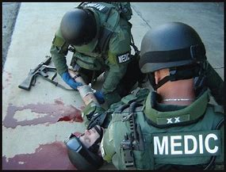
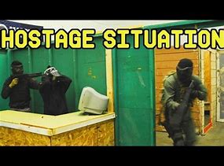
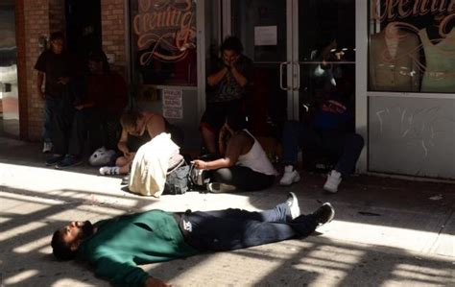
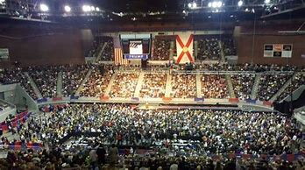
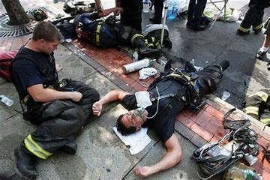
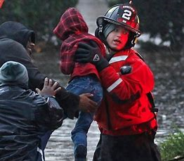
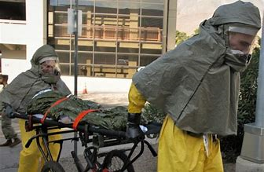
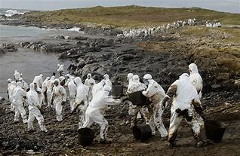
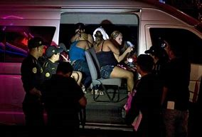
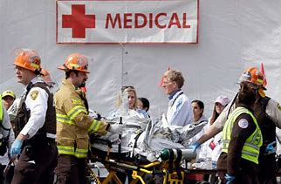
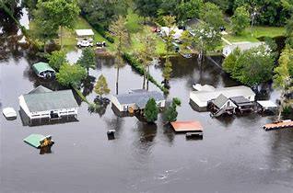
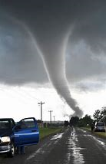
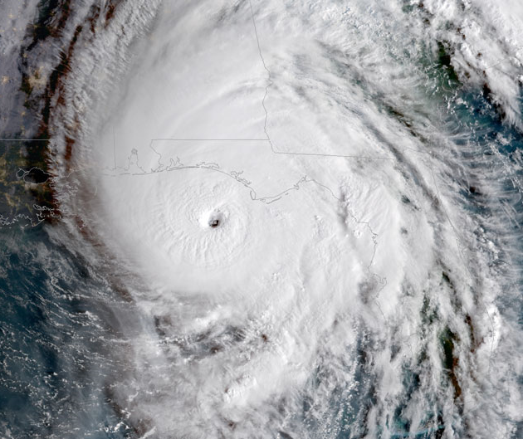
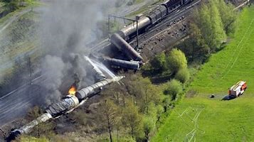
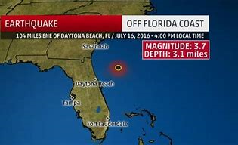
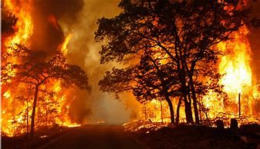
EMS Today
Today’s EMS providers face many challenges.
Multi patient incidents (MPI) (simultaneous) opioid overdoses.
Active shooters.
Hostage situations.
EMS for mass gatherings.
Natural and man – made disasters and catastrophic events.
Human trafficking.
Chemical, Biological, Radiological, Nuclear, Explosive (CBRNE) events.
Acts of terrorism
Notes:
Our best first defense in response to the multitude of hazards facing today’s EMS is to provide quality, all hazard response training.
Our best responders will be those who have received advanced training, built on a solid foundation and have survived in the industry long enough for everyone to benefit from their experience.

Slide 6
EMS Training and Education
Not enough time in the day, semester, year…our lifetime.
Ok, sure and who’s going to pay for that?
Disaster subject matter experts (SME)… Not everyone, not everywhere, not easy to schedule, not cheep.
Herding cats… Adjunct instructors and students, organized chaos.
Minimalism and naysayers.
Program changes, program development, curriculum review…
Time, support, money, “show me the money”.
Notes:
What are some of the challenges for EMS Education
Impossible task?
Provide better training and opportunities for responders to learn about disaster preparedness and response but,
no time, no money, no support, more work, no way!
If you are committed to providing quality training and enhancing the students learning experience, the results will justify the effort.
Programs that develop a good reputation in the local, regional and emergency services communities draw students, and often better quality students to their program.
Question to ask is, what do you want out of your program?
Better quality trained responders.
Solid reputation, recognition, accolades.
Improved relations with existing partners, new partnerships, sponsors.
Increased student registrations, program expansions, progressive innovations…
Bottom line is what you get out of your program is a direct reflection of what you have put into your program.

Slide 7
EMS Training and Education Disaster Preparedness and Response - Best Practices
No substitution for experience.
Better to learn in a safe and controlled environment rather than trial by fire in the field.
Realistic, scenario based training, “Train the way we fight”.
Training that engages the student’s, all of them!
Student performance driven training scenarios.
“Preparation through education is less costly than learning through tragedy” Max Mayfield, Director National Hurricane Center
Notes:
Age old question: If you don’t qualify for the job because you have no experience, but you have no experience because you don’t qualify for the job. How do you get either?
In my day you had to have a sponsor recommend you for a spot in an EMT class and so you either had to get hired as a non-cert which there were very limited opportunities, or volunteer with an agency to receive sponsorship. The combination of volunteering, which gave the student a number of advantages -mentoring, academic and practical support and experience along with the training resulted in better quality entry level responders. I remember my first job as a paid EMT and one of the first questions I was asked during my interview was, what EMT program did you graduate from? Quality makes a difference!
Florida is predominantly a paid service response system and so the volunteer option is less applicable in this market. Todays EMS student receives their experience during the initial ems training and then on the job so the more valuable experience they receive during their initial training the better prepared they are to succeed on the job.
The success of your program is a result of the success of your students and vice versa.
As educators you should all agree that it is better to learn in a safe, controlled environment where realistic training is provided and experiences that engage the students with scenarios that are performance driven is a training recipe that wins the prize.
You as EMS educators have the capabilities and responsibility to help grow the next generation of EMS providers and often your program is a grow your own program where quality means you have provided the EMS industry and your community with well trained responders who are prepared for the challenges that face today’s emergency medical services and may one day care for you or your loved ones. Quality makes a difference!
Quote: Preparation through education is less costly than learning through tragedy.

Slide 8
Disaster Preparedness and Response Training Tools and Tips
SIM LAB – Add / trade disaster related mass casualty incidents (MCI) / MPI practice scenarios.
General population (GP) & special needs medical shelters (SPNS) Scenarios, mass care prophylaxis, surge capacity / decompression.
Discuss common disaster related injury patterns and treatment modalities for physiological and psychological injuries in non disaster related chapters.
Participate in local / regional exercises.
Participate in local / regional public events.
Participate in local / regional health fair/ clinics.
Notes:
Here are a few ideas for enhancing the EMS training environment, these are just suggestions that could be easily modified to fit your programs specific needs.
There are many areas in the current EMT and paramedic curriculum where you can achieve multiple training goals simultaneously, cross walk one scenario for another many scenarios have similar expected skill sets. Spice up scenarios, build on a story, specific subject matter (such as disaster response), expected behavior and scenarios driven by responders actions.
Look to form partnerships where students can participate in real world events.

Slide 9
Disaster Preparedness and Response Training Tools and Tips
Offer information on additional training opportunities –
Until Help Arrives – Stop the Bleed, CPR, First Aid.
Federal emergency management agency (FEMA) Independent Studies (IS) online –
IS-100, 200, 700, 800 (144 different courses available)
Center for Domestic Preparedness (CDP) –
On-line courses (4)
Class trip to the CDP (free, all expenses paid)
Texas A&M (on-line) (4)
Notes:
Encourage additional learning, training and instructor opportunities.
Class trip, on-line training.
Prepare students for career success and not just test prep.

Slide 10
Summary
Reviewed disaster preparedness and response training in current emergency medical technician (EMT) and paramedic course curriculums.
Discussed the changing environment for emergency medical service (EMS) operations.
Acknowledged some of the difficulties EMS education programs face when trying to enhance the quality and quantity of the training they offer.
Recognized some best practices to better train and prepare our responders for disaster response.
Identified some alternative training tools programs can utilize to improve the EMS training experience.
Conclusion – Time, money and authority may challenge the quality of training we provide for our EMS students but, we are really only limited by our imagination and effort.

