Slide 1
Public Emergency Medical Transportation (PEMT) Supplemental Reimbursement Program
Florida Fire Chiefs’ Association Presentation
April 2019

Slide 2
Medicaid
Medicaid is a jointly funded, Federal-State health insurance program for low-income and needy people.
In Florida the federal share is 61.1%.
For every $1 spent by the state, or a local government within the state, the Federal government will reimburse the state $1.61
Cities, counties, and special purpose districts within the State of Florida provide emergency medical service care to Medicaid recipients.

Slide 3
Emergency medical Transport Cost VS. payment
Provider payment for emergency medical transportation from billing is:
Ambulance Service, Basic Life Support $136.00
Ambulance Service, Advanced Life Support $190.00
Advanced Life Support, Level 2 (ALS2) $250.00
The average cost to provide emergency medical transportation is between $800 and $1200.

Slide 4
PEMT Program
Florida Fire Chiefs Association lobbied the legislature to allow Federal Share reimbursement for local government ambulance transport costs for fee for service patients.
For Example:
Emergency medical transport costs $1,000.
State Medicaid provides payment of $190
Unreimbursed costs are $810 ($1000-$190)
Federal share is $494 (61.1% of $810)
PEMT Program was established by the Agency for Health Care Administration (AHCA)

Slide 5
PARTICIPATION LIMITS
Must be an emergency medical transport provider.
Must be enrolled as a Medicaid Provider
Must be owned or operated by an eligible governmental entity, to include the State, city, county, or fire protection district.
Only covers Fee-for-Service Transports
Does not cover recipients enrolled in a Florida Medicaid Managed Care Plan.
Does not cover Dry-Run Services (non-transports)

Slide 6
Certified Public Expenditure (CPE)
Certified Public Expenditure (CPE) is mechanism used to obtain federal funds to compensate for unreimbursed cost for emergency medical transportation provided to Medicaid recipients who are not enrolled in a Florida Medicaid Managed Care Plan.
The basis for the CPE program is found in federal regulation under 42 CFR 433.51
CPE program requires Federal Approval by the Centers for Medicare and Medicaid Services (CMS)
Florida’s State Plan Amendment 4.19-B was approved by CMS on October 20, 2016 – and made retroactive to October 1, 2015.

Slide 7
Requirements
An eligible PEMT entity must do all of the following:
Submit cost reports for the previous state fiscal year (July 1 to June 30) by November 30th using spreadsheet approved by AHCA.
Certify that the claimed expenditures are eligible for Federal Financial Participation (FFP)
Keep, maintain, and have readily retrievable any records required by AHCA or CMS for a minimum of seven years after the initial submission.

Slide 8
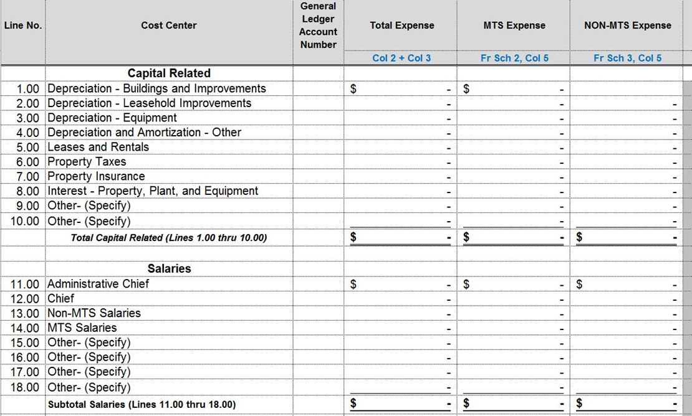
Cost Report
Must use spreadsheet approved by AHCA.
Ten “tabs” must be completed.
Example:

Slide 9
Completing the cost report
The Cost Report is very detailed and takes some time to complete the first time.
Some agencies have completed it internally using the Finance Department’s assistance.
Some agencies have contracted (6%-12%) with a third party consulting firm to help them complete the Cost Report.
McKesson Corporation
Public Consulting Group (PCG)
EMS M/C

Slide 10
Reimbursement Payments
Payment disbursement will be processed and disbursed prior to September 30th of the following state fiscal year.
For example, a PEMT entity that submits a cost report (covering SFY 2016-17) by November 30, 2017, will have a payment disbursement prior to September 30, 2018.
The target date for payment disbursement will be March 31st .

Slide 11
FY2018-19 Example Payments
West Palm Beach Fire Department - $241,769
Riviera Beach Fire Department - $122,059
Polk County Fire Rescue - $320,242
Palm Beach Gardens Fire Rescue - $57,391
Orlando Fire Department - $770,875
Miami -Dade Fire Rescue - $3,857,419
Leon County EMS - $139,518
Boynton Beach Fire Rescue - $113,283

Slide 12
FUNDING & DISBURSEMENTS
SFY 16-17 Budget Allocation of $15 million
Requests were for $19 million
Initially disbursed $15 million, then additional $4 million
SFY 17-18 Budget Allocation of $25 million, plus $10 million to retroactively cover FY16-17 costs
Requests were for $26,774,000
Disbursed $25 million
SFY 18-19 Budget Allocation of $35 million
More than $80 Million in new funding provided for public EMS providers through PEMT Program

Slide 13
FUTURE ADD PARTICIPANTS
116 Governmental licensed ALS/T agencies providing 911 (emergency) service.
64 Governmental Providers participated in FY2018-19 PEMT Program – bring 27+ million dollars back into their communities
Almost half of the eligible providers are not participating in this program.

Slide 14
FUTURE Managed care
80 percent of all Florida Medicaid recipients are enrolled in a managed care plan – currently not covered by PEMT Program.
The FFCA is seeking an expansion of the PEMT Program by an additional $250 million to include the unreimbursed costs for Medicaid Managed Care patients.
Must be done through an Intergovernmental Transfer (IGT) process.
Flat Rate of $1,445 per trip supplemental payment
Likely done incrementally (Goal for FY19-20 is $50 mil.)

Slide 15
Intergovernmental Transfers (IGT)
For services provided under the Medicaid managed care program, the ambulance provider supplies the nonfederal share through an intergovernmental transfer (IGT).
An IGT is the transfer of funds from one unit of government to another, in this case from the governmental ambulance provider to the state Medicaid agency.
Ambulance Provider transfers $1.00 to the State, and the MCO’s send back $1.61 to the ambulance provider.

Slide 16
MCO PAYMENT POTENTIAL FOR Top 20 Providers
Pinellas County $35,614,730
Jacksonville Fire $17,368,898
Miami-Dade County $15,323,015
Polk County $12,218,128
Orange County $11,515,350
City of Miami $9,355,122
Hillsborough County $8,929,410
Palm Beach County $8,554,712
Volusia County $8,219,596
Lee County EMS $7,868,647
Brevard County $7,508,022
City of Tampa $6,593,268
St Lucie County $6,581,834
Alachua $6,325,878
Leon County $5,596,713
Lake EMS $5,242,246
Manatee $4,606,316
Fort Lauderdale $4,460,307
Broward Sheriffs $4,365,313
Orlando Fire $3,759,289

Slide 17
QUESTIONS?
MORE INFORMATION CAN BE FOUND AT:
Florida Fire Chiefs Association
https://www.ffca.org/pemt-public-emergency-medical-transportation-supplemental-reimbursement-program
Agency for Healthcare Administration
http://ahca.myflorida.com/medicaid/Finance/finance/LIP-DSH/PEMT/index.shtml

