Slide 1
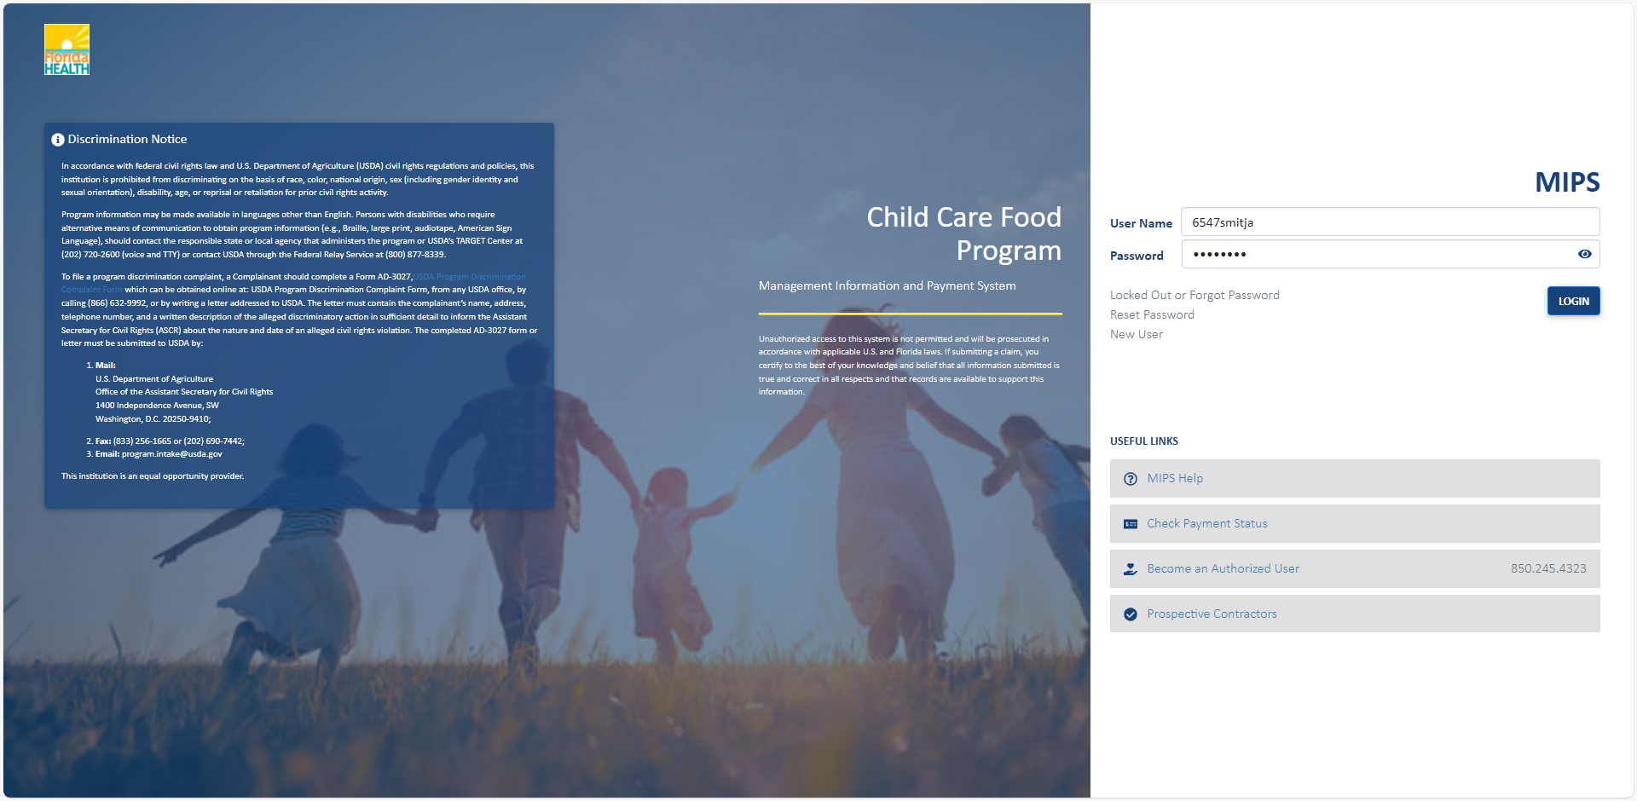
After Logging In, you will be taken to the dashboard.

Slide 2
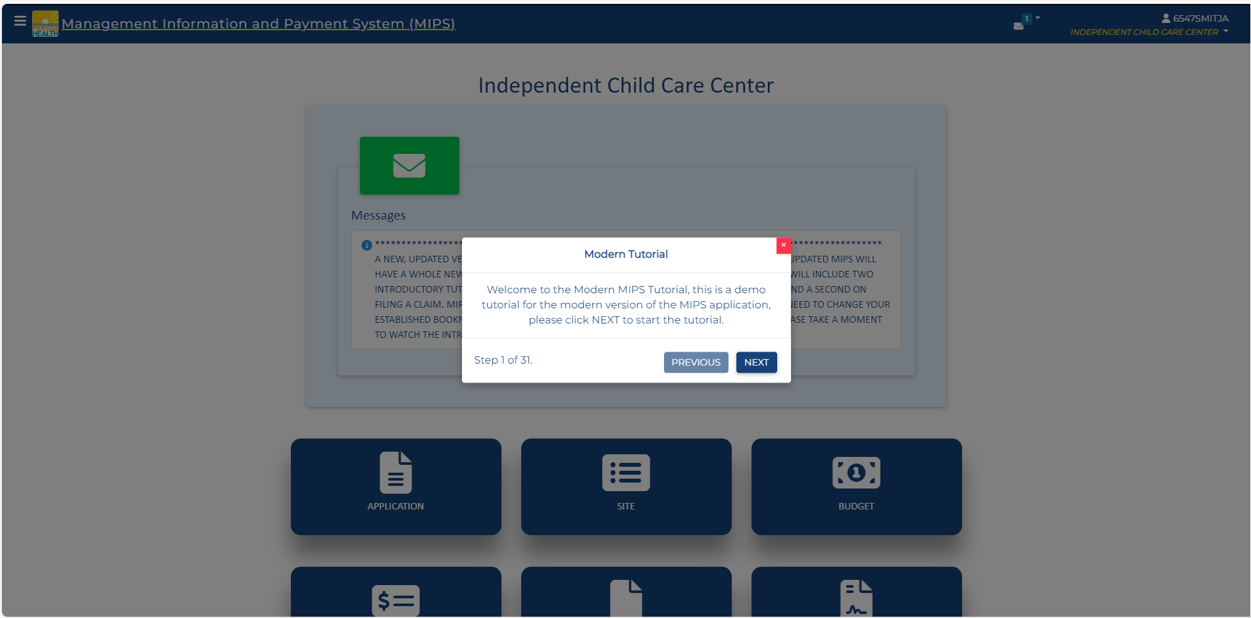
On your first log-in, you will see a tutorial on how to use the Modernized System.

Slide 3
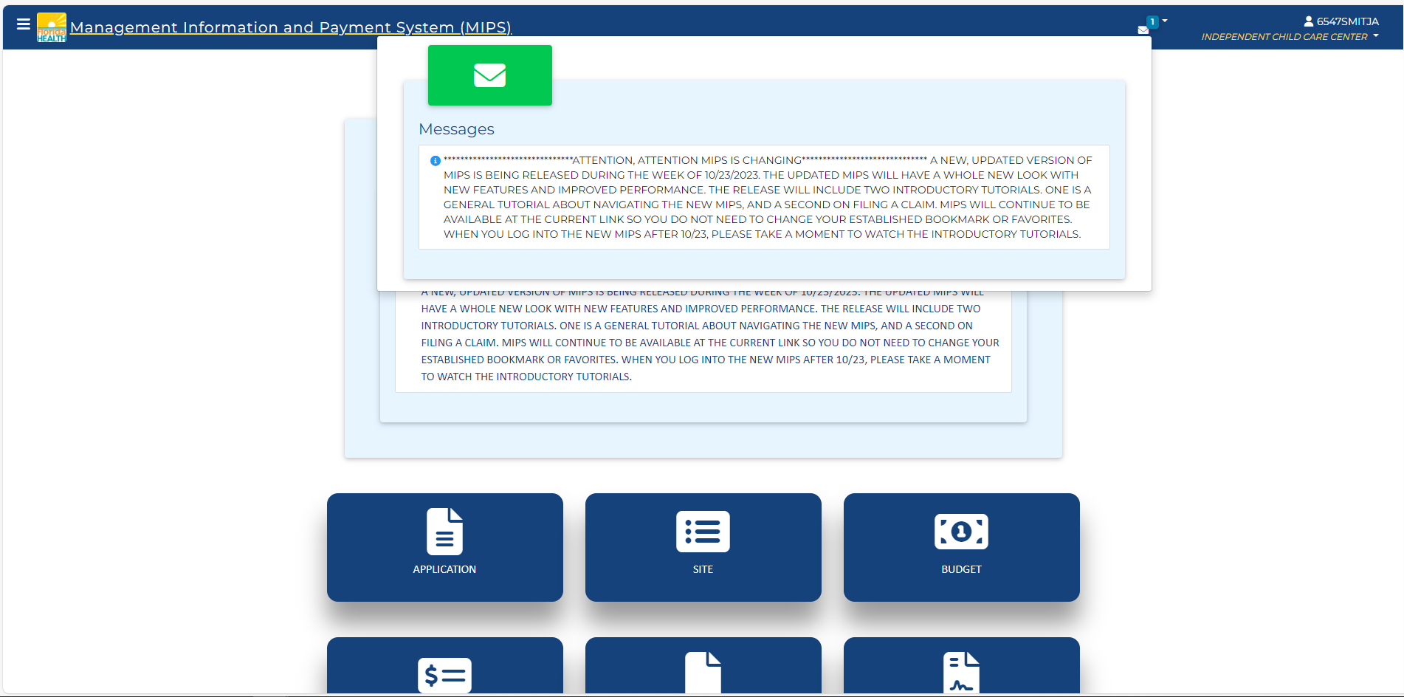
These messages will pop up like this.
They are also visible when viewing the Dashboard.

Slide 4
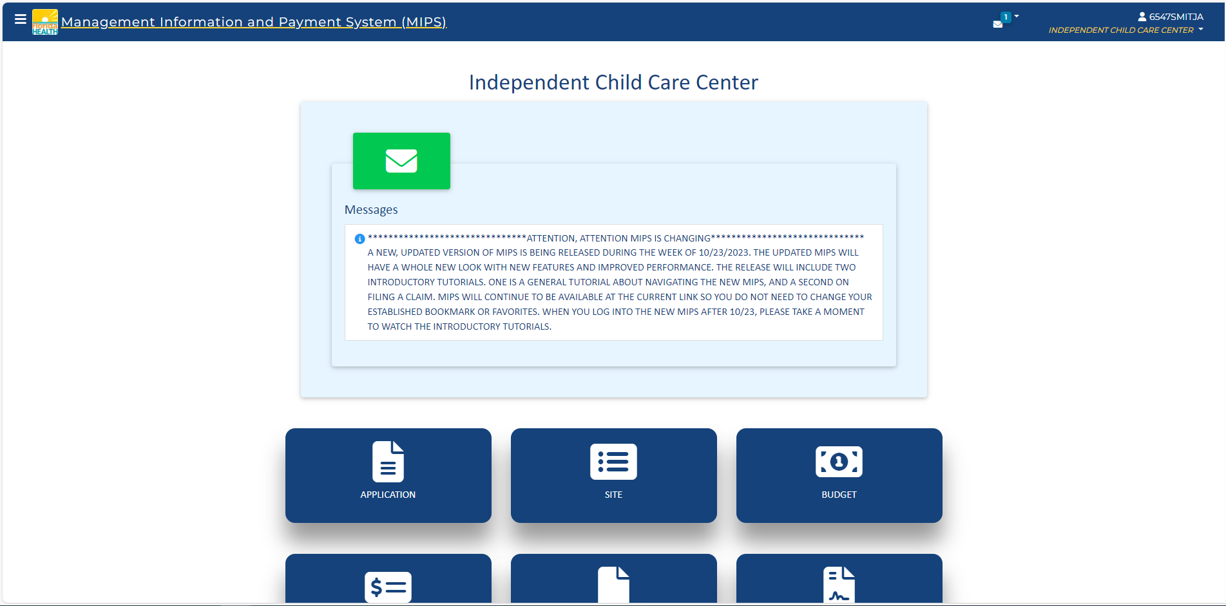
At the top of the page, you will find an icon for viewing new messages.

Slide 5
Clicking this icon will open the side menu.

Slide 6
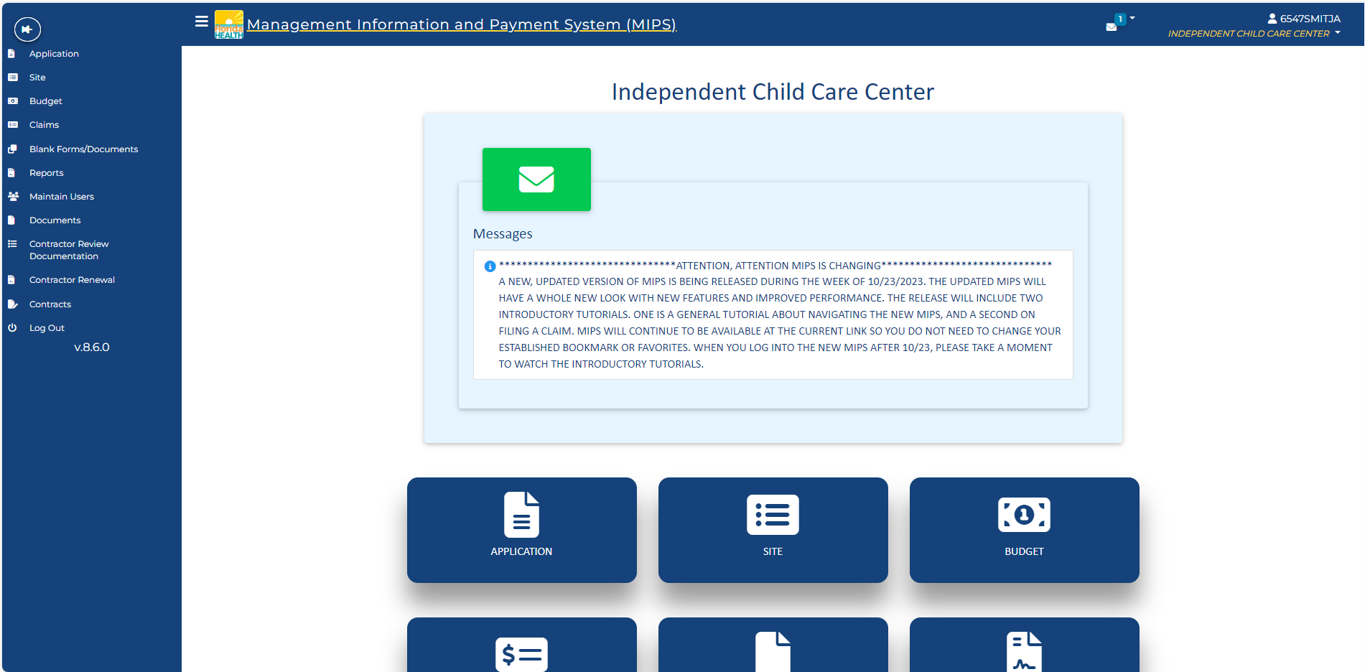
The side nav is the first of 3 ways for you to navigate the system. We will discuss this more in a bit.

Slide 7
Normally the side menu closes after you select a location. You can click this pin to keep it open.

Slide 8
Clicking it again will revert to closing it after selecting a location.

Slide 9
The MIPS icon will take you back to your dashboard from any of the pages.

Slide 10
Clicking on your username allows you to view tutorials as well as log out of the system

Slide 11
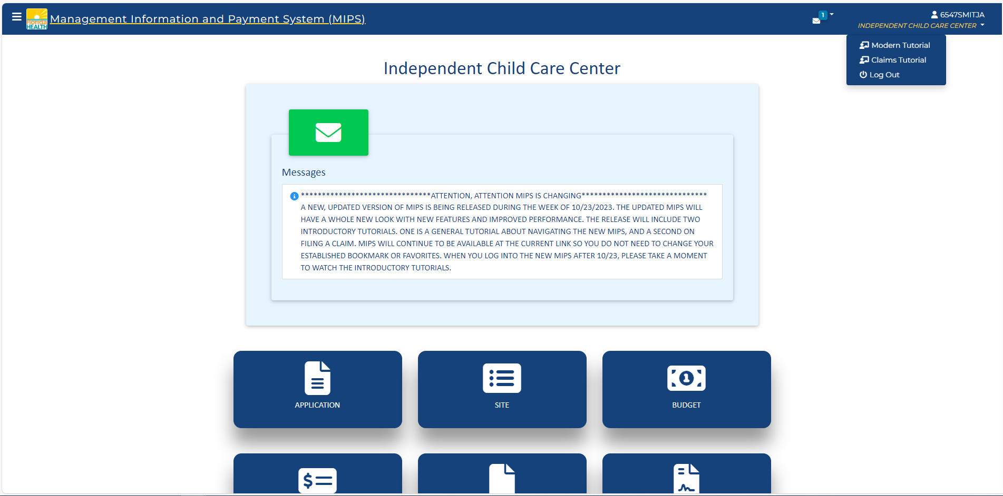
Modern Tutorial takes you back to the tutorial pop-up that displayed when we first logged in
Claims Tutorial similarly pops-up a small tutorial on how to use the Claims page

Slide 12
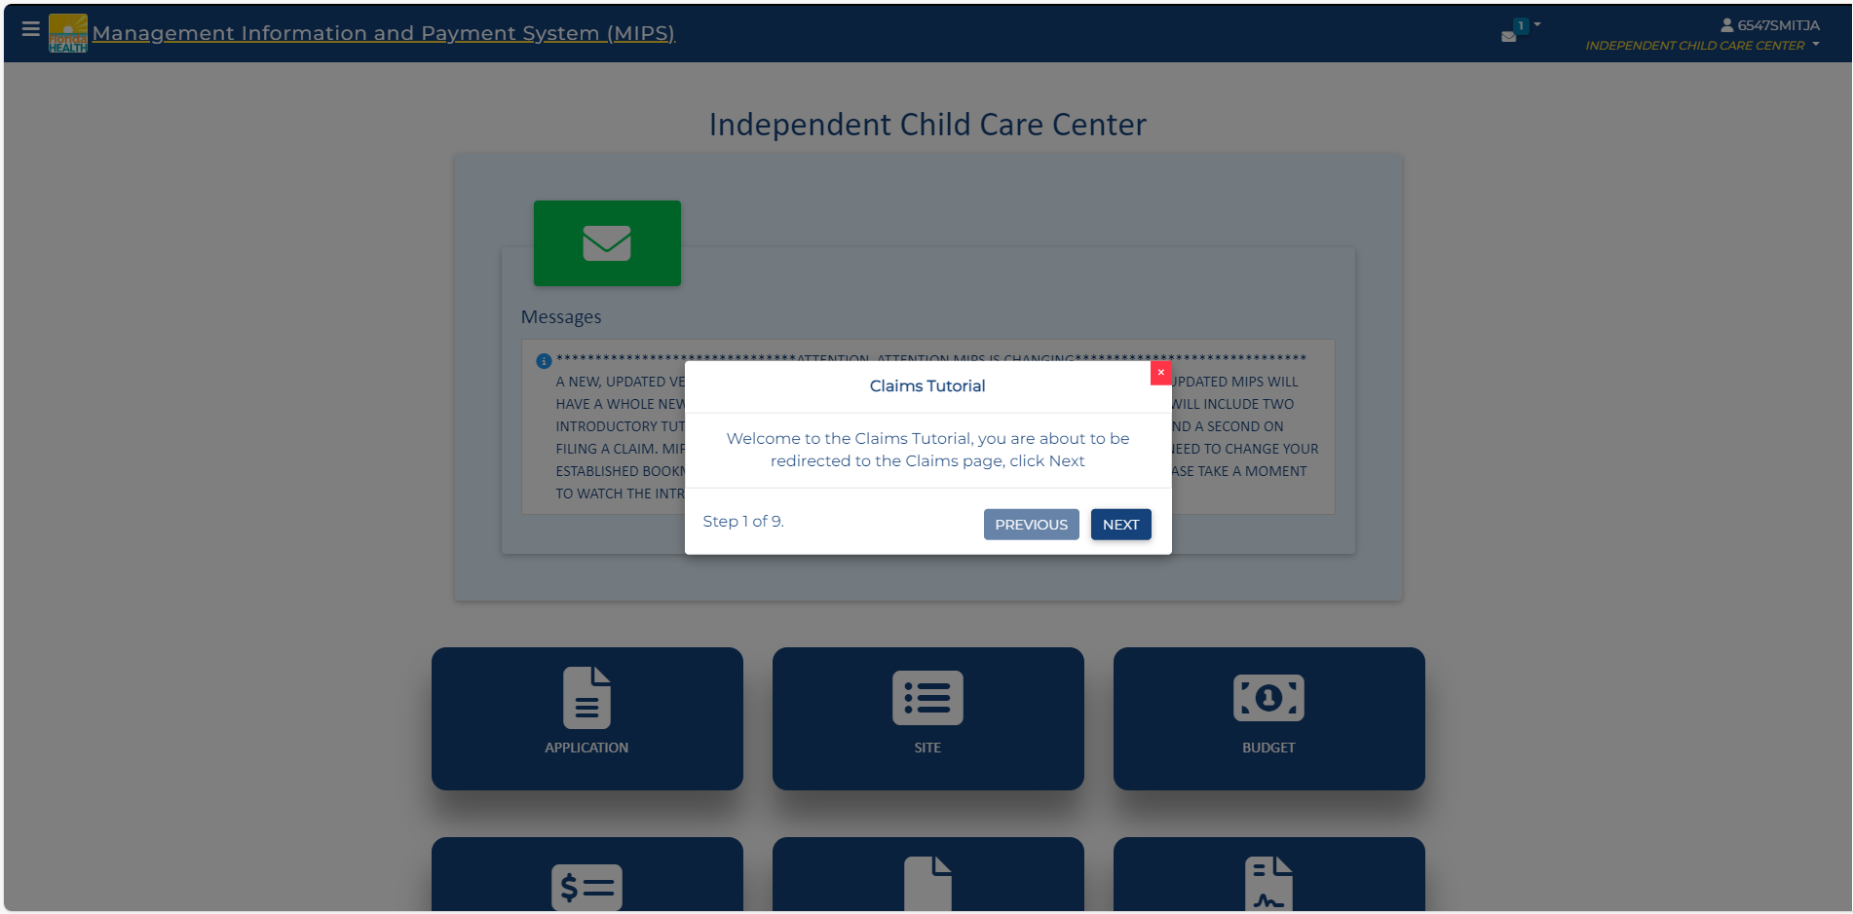
After closing this and scrolling down, we look at the Dashboard Tiles.

Slide 13
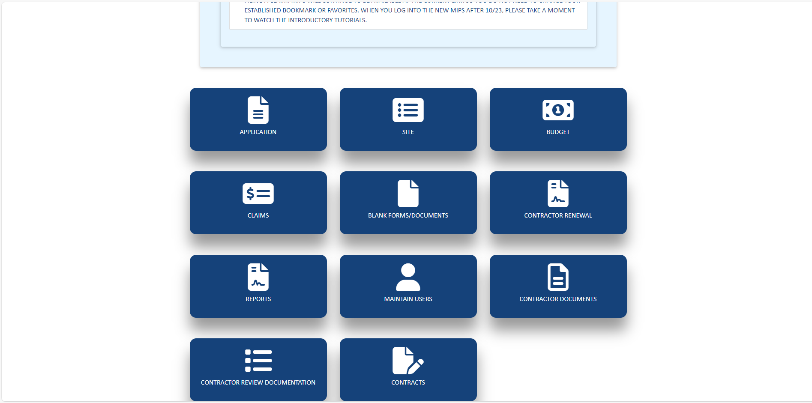
These titles are the 2nd way for you to access various components of the system.

Slide 14
The tiles shown will be based on your screen permission(s).

Slide 15
Application will take you to the Application Page where you can view and resubmit information regarding your organization.

Slide 16
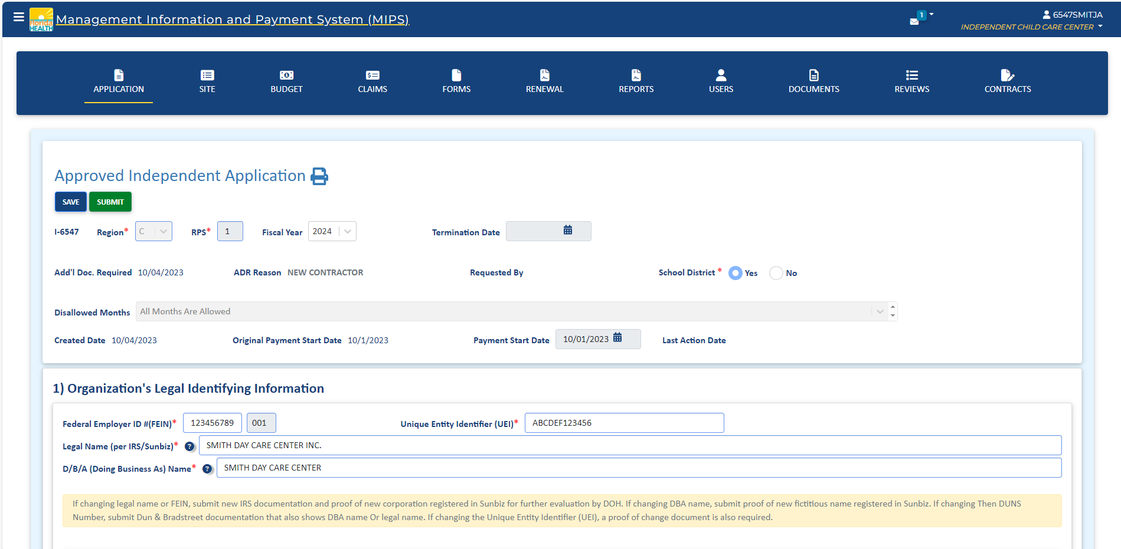
At the top of the screen is the 3rd and final way of navigating the system.

Slide 17
This banner of icons is on each of various pages.

Slide 18
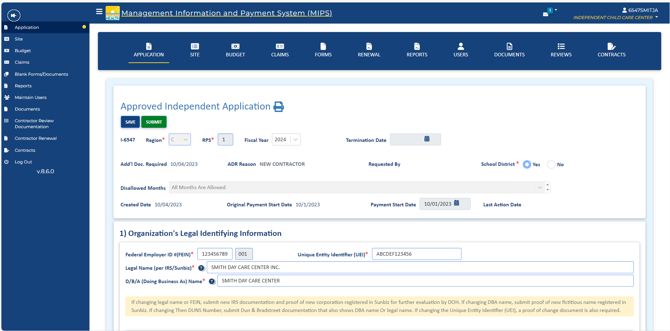
Again, you can always click up here if you want to use side menu.

Slide 19
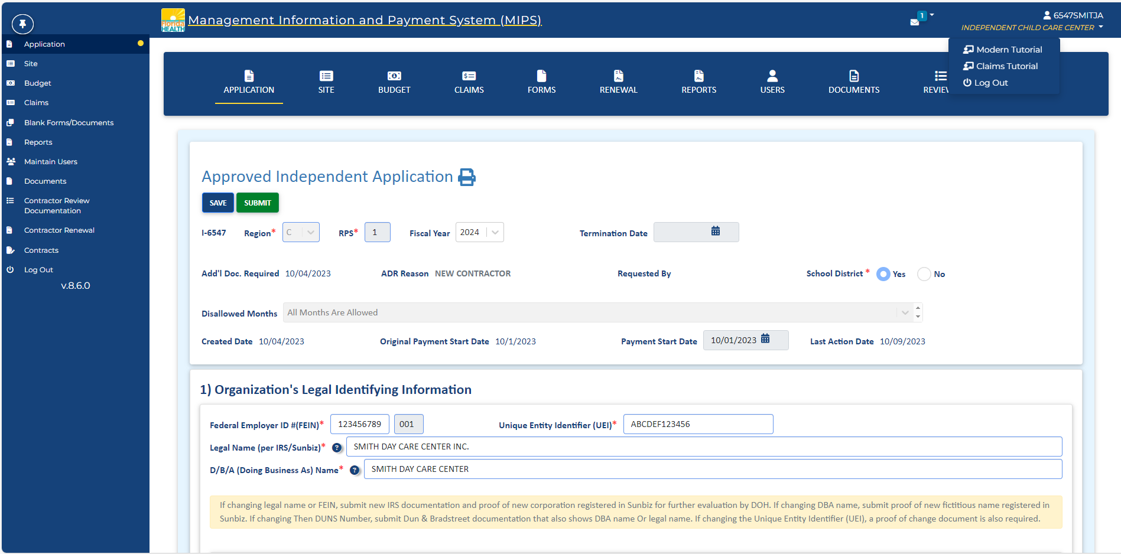
When you are done using the system, you can log out either via the side menu or by clicking on your username.

Slide 20
