Slide 1
Florida Department of Health
Children’s Medical Services
Children’s Multidisciplinary Assessment Team
Level of Care Training
December 2024

Slide 2
Program Overview
Children's Multidisciplinary Assessment Team (CMAT) collaborates with community partners to achieve several objectives:
Determining eligibility and level of care for children under the age of 21 for the following Medicaid long-term care services:
  Medical Foster Care
  Nursing Facility
  Model Waiver
Involving the parent/family/legal representative in the CMAT staffing process
Facilitating discussion on community-based resources and services available to support client needs

Slide 3
Who Needs Level of Care Training?
Level of Care (LOC) training is required for:
All CMAT and Medical Foster Care staff, including medical directors
Community partners that participate in consensus building concerning LOC recommendations
Statewide Medicaid managed care plans who have members receiving services recommended through the CMAT process

Slide 4
Important Points
At the conclusion of this training, please complete and submit the LOC Tool quiz. A certificate of completion will be sent to you.
LOC Tool Quiz
Please use the CMAT LOC for reference throughout the training:
CMAT LOC Tool

Slide 5
Course Objectives
Prepare participants to objectively determine a child’s LOC for medical foster care, nursing facility, or model waiver services
Ensure consistency in recommendations across teams across Florida
Review common difficulties encountered in determining LOC recommendations
Review child-specific clinical and psychosocial information available to help guide LOC recommendations

Slide 6
CMAT Staffing Process
CMAT staffings are led by CMAT staff from the Florida Department of Health.
All information shared at a CMAT staffing is confidential and is shared only for the purposes of determining level of care.
During the staffing, all CMAT members review the child’s medical and psychosocial information as a group.
Everyone present at the staffing is given an opportunity to provide updates or additional information.
CMAT then determines if the child has a qualifying medical condition(s) that meets the definition of medical necessity.

Slide 7
LOC Tool: Medical Foster Care
Medical necessity is the initial determination in the CMAT level of care process.
CMAT medical director indicates the stability statement, based on the qualifying medical condition(s).
Remaining four dimensions, should include co-morbid conditions (e.g., behavioral health, intellectual, or developmental conditions).
Tool should be scored without regard to any support services (e.g., private duty nursing, personal care, or prescribed pediatric extended care).

Slide 8
LOC Tool: Medical Foster Care, continued
Each dimension has categories indicated by a letter:
  Corresponding number of points
  Points added up to obtain the child’s total score
Total score determines a LOC which corresponds to the child's clinical conditions and needs
There are three levels of care: Level 1, Level 2, and Level 3:
  Level 1 has considerable care needs, Level 2 has moderate care needs, and Level 3 has extensive care needs.

Slide 9
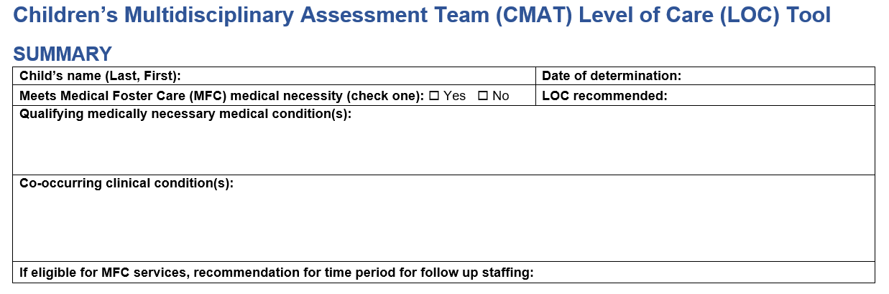
LOC Tool: Medical Foster Care, continued
The summary section includes the child’s name and date of determination, medical necessity information, including the qualifying medical condition(s) and co-occurring clinical condition(s).

Slide 10
Medical Necessity
Medical necessity for Medical Foster Care Program services should be the initial determination in the CMAT process, and determined by consensus building after the CMAT assessment is presented.
If the child meets criteria for medical necessity, with a qualifying medical condition, then the remaining tool is completed.
If medical necessity is not met, the evaluation is complete, and the child should be referred to more appropriate services.

Slide 11
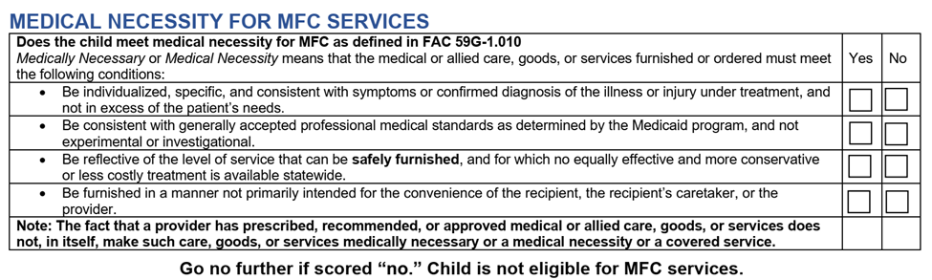
Medical Necessity Criteria

Slide 12
Medical Foster Care LOC Determination
Five Dimensions to Consider for Medical Foster Care Level of Care
Stability of the child in a home setting
Child’s tolerance to caregiver delay or error in performing tasks
Complexity and intensity of interventions
Observation, assessment, and documentation required, based on the child’s medical needs
Personal care needs and age appropriateness of those needs

Slide 13
Dimension One
1. Stability of the Child in a Home Setting
This dimension is scored by the CMAT medical director:
  CMAT medical director is the only member of the CMAT who can provide the stability statement.
Stability decision should be based only on the qualifying medical condition(s) that create the medical necessity for medical foster care.
All other conditions are co-occurring and may be considered as part of the other dimensions (2-5) but should not be considered in the determination of stability.

Slide 14
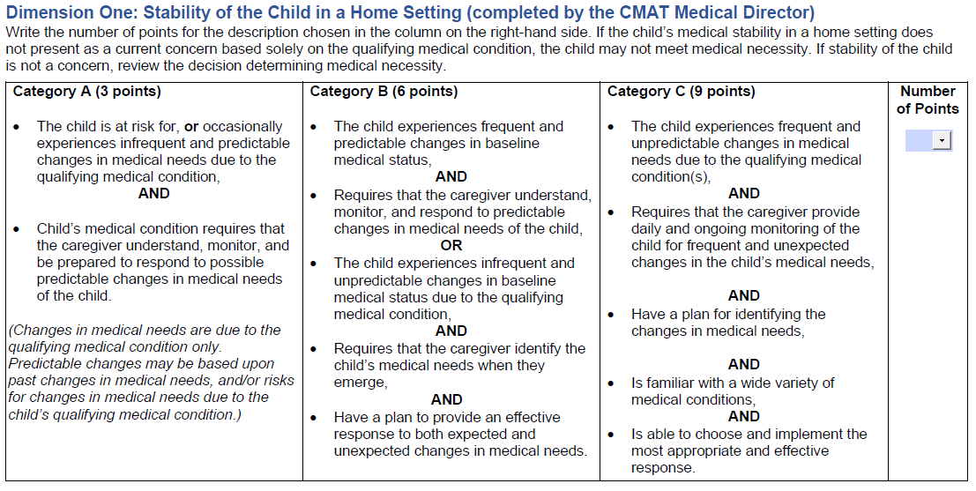
Dimension One, continued

Slide 15
Dimension Two
2. Child’s Tolerance to Caregiver Delay or Error in Performing Tasks
This dimension requires that the reviewer consider the impact of delay or task error by the caregiver in the delivery of interventions, treatments, observations, medication administration, and appointments:
 | Category A | Category B | Category C
Consequences of delay or error | Mild | Moderate | Severe
Required care | Within reasonable time frames | Structured | Stringent

Slide 16
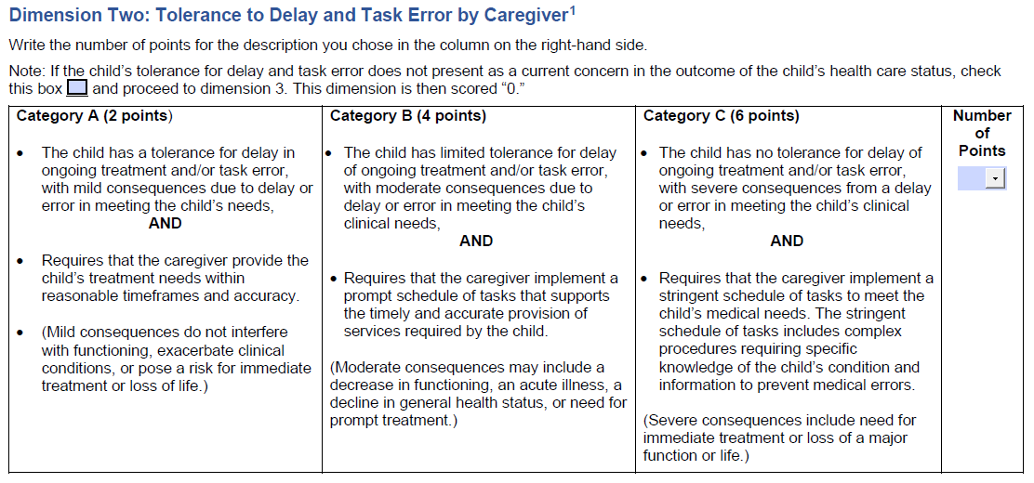
Dimension Two, continued
[1] Impact and severity of consequences of a delay or task error in the child’s medical needs.

Slide 17
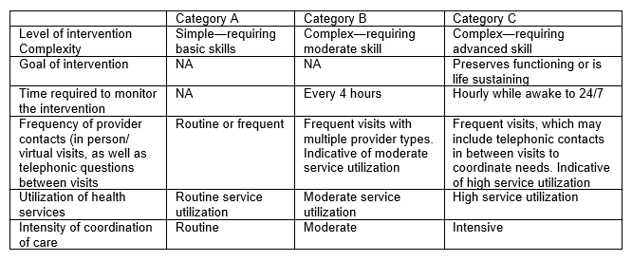
Dimension Three
3. Complexity and Intensity of Interventions
Categories for this dimension are based on:
Level of complexity of interventions, ranging from simple to complex with advanced skills.
Time and effort required for coordination of provider visits, ranging from routine medical appointments to intensive coordination with frequent visits with multiple provider types.

Slide 18
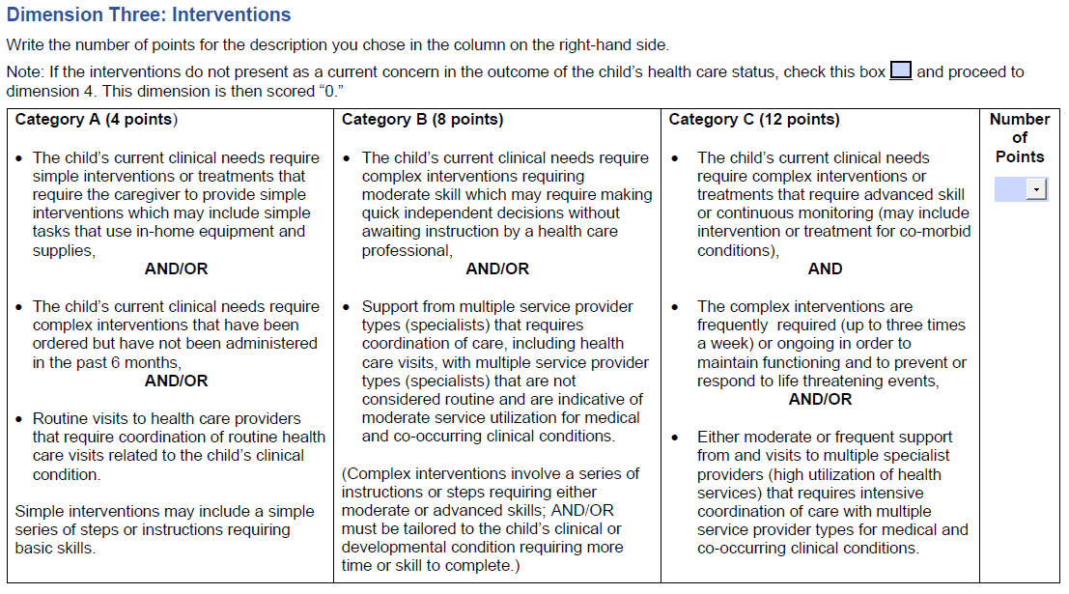
Dimension Three, continued

Slide 19
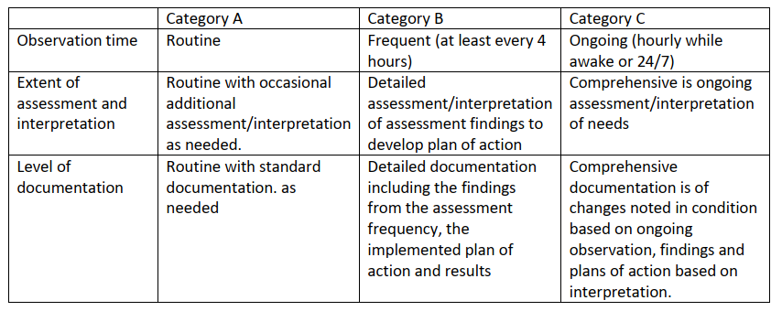
Dimension Four
4. Observation, Assessment, and Documentation
This dimension requires an evaluation of the amount of time or frequency required for observation, type of assessment, and documentation.
The team members will determine if the amount and complexity of observation, assessment, and documentation the caregiver must provide requires greater amounts of time or special skills.
  Required time for child observation may be elevated by risk factors.

Slide 20
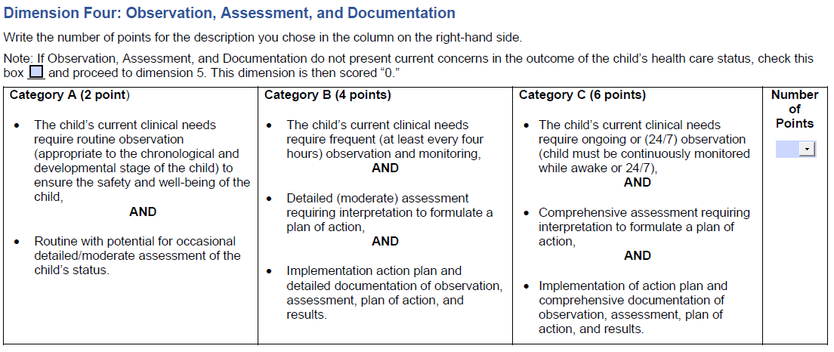
Dimension Four, continued

Slide 21
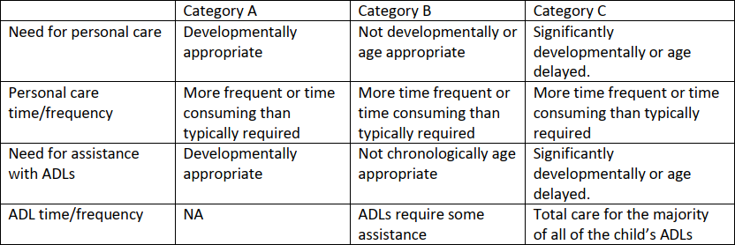
Dimension Five
5. Personal Care Needs
Personal care ratings are based on required care related to the child’s clinical conditions, including co-occurring conditions that prevent the child from functioning at an age-appropriate level for personal care needs as well as activities of daily living.
Category determination is calculated according to the extent to which the child’s personal care needs are more than that of a developmentally age-appropriate child, and not on the personal care and activities of daily living needs that are typically deemed chronologically developmentally appropriate.

Slide 22
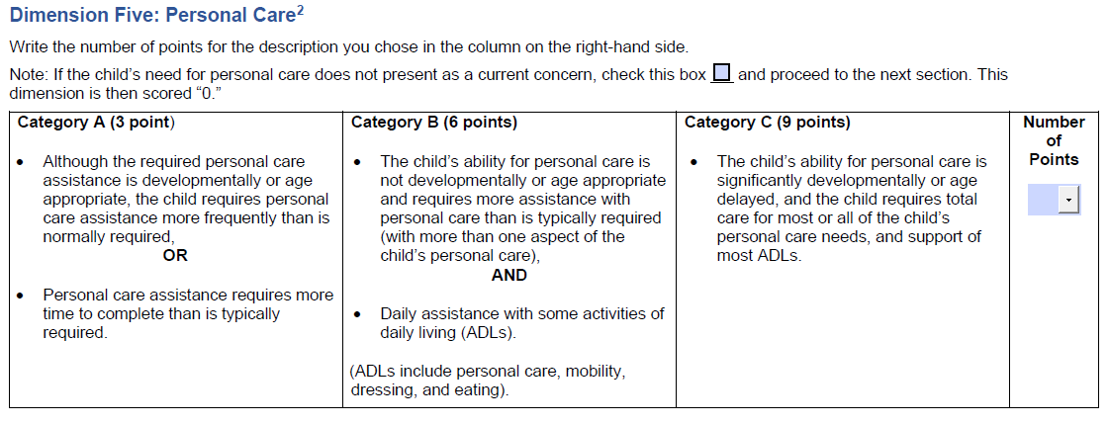
Dimension Five, continued

Slide 23
LOC Tool Scoring
After completing the tool, add the scores across each of the five dimensions. Compare the total score with the range of scores noted in this section of the tool.
Review the definitions of each of the LOCs for the child and the caregiver and compare with the LOC determination based upon the tool score.
Confirm that the corresponding definition of the resulting tool score describes the child’s clinical conditions and needs.

Slide 24
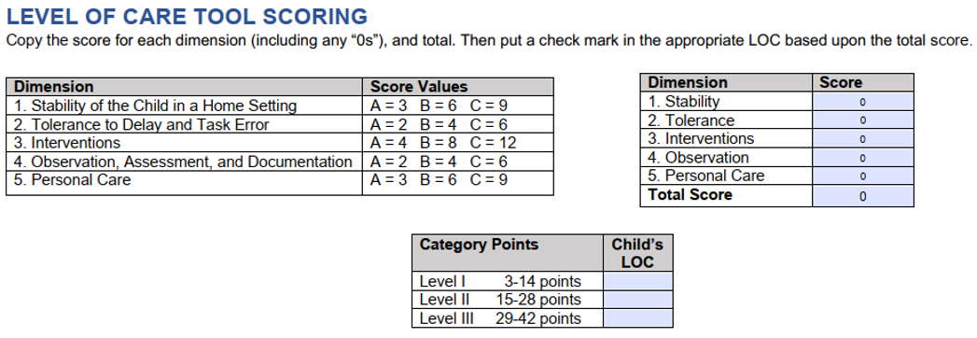
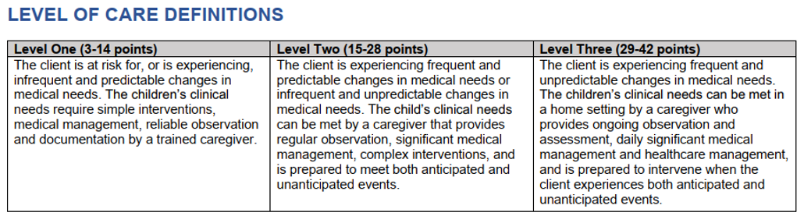
LOC Tool Scoring

Slide 25
Challenges to Determining an LOC
Quality of the medical and psychosocial assessment and the additional information provided by CMAT attendees are critical to the success of the CMAT process.
Tolerance to delay, the observation, assessment, and documentation and the personal care domains are the areas that are open to interpretation.
CMAT members may disagree from time to time on scoring.
Each child and situation must be considered individually.
Stability is the sole responsibility of the CMAT medical director.

Slide 26
Medical Foster Care
LOC Case Studies

Slide 27
Medical Foster Care Case Study #1
Jimmy Jones is a six-year-old with diabetes mellitus that was just diagnosed two years ago. He gets routine insulin twice a day and as-needed doses depending on his blood sugar. He must have his blood sugar checked before meals and at bedtime routinely.
He has lots of highs and lows and does not always eat what he is supposed to at school. He has been hospitalized twice in the past six months for diabetic ketoacidosis, but not since going into foster care. He also has exercise-induced asthma and uses his inhaler before playing outside.
He is independent in his activities of daily living other than needing occasional reminders to brush his teeth or take a shower. He is in the first grade and doing well in school. He has three visits per week with his parents, with the goal of reunification. He is often very hyperactive and upset when he returns from family visits.
How would you score this child?

Slide 28
Medical Foster Care Case Study #1 Results
Stability: Child has had two hospital admits in the past six months, but none while in foster care. He is reported to have lots of highs and lows of blood sugar. | B – 6 points
Tolerance to Delay: Failure to monitor blood sugar or administer insulin could cause loss of functioning or life. Failure to use inhaler could result in loss of functioning. | C – 6 points
Interventions: Insulin-dependent diabetic, not controlled for six months. Also, ongoing observation to prevent loss of life. | C – 12 points
Observations: Must check blood sugar and formulate a plan regarding insulin administration and implement that plan. Needs ongoing observation. | C – 6 points
Personal Care: Age appropriate. | 0 points
Total: 30 points = LOC 3

Slide 29
Medical Foster Care Case Study #2
Susie Loo is a 12-year-old with second-degree burns on her arms, cheek, and perineal area caused by her parent throwing scalding water on her. She has been released from the burn center. She has twice-per-day dressing changes to the burn areas, as well as application of burn garments. She complains of pain with the dressing changes and requires pain medication.
She needs assistance with bathing, dressing, and eating because of the dressings. She is going to physical therapy and occupational therapy three times per week. She is having frequent nightmares about her injuries and is seeing a therapist one time per week.
She is currently on hospital homebound. Her mother is incarcerated and there is no visitation with her mother.
How would you score this child?

Slide 30
Medical Foster Care Case Study #2 Results
Stability: Child is experiencing frequent and predictable changes in needs. | B – 6 points
Tolerance to Delay: While burn care dressing is important; it is not dependent on a specific time of day. | A – 2 points
Interventions: Frequent visits to providers out of home. Burn care that requires pre-medication. Because the burn care is a higher level of complexity, you would score Interventions as a C – 12 points. | C – 12 points
Observations: Burn areas need to be observed twice a day and level of pain must be assessed. A plan of action must be formulated. | B – 4 points
Personal Care: Twelve-year-old who needs assistance with activities of daily living. Also not sleeping well, with nightmares. | B – 6 points
Total: 32 points = LOC 3 The personal care needs increased the level, not the interventions.

Slide 31
Medical Foster Care Case Study #3
Penny Loafer is a newborn infant who was born at 26 weeks gestation. She has been in the neonatal intensive care unit for four months. She has weaned off the ventilator but is on continuous oxygen through nasal cannula and is going home on an apnea monitor.
She has occasional alarms for low heart rate. She gets albuterol nebulizer every four hours and is on Diuril, which is considered a complex medication. She is also a slow by-mouth feeder, and each feeding can take up to an hour, with a specific feeding program. Her weight is low, so she is fed every three hours, through the night as well. Because of her weight, she must go to her primary care physician for weekly weight checks.
There is a referral for Early Steps. She also must be seen by cardiology, pulmonology, ophthalmology, and gastroenterology.
How would you score this child?

Slide 32
Medical Foster Care Case Study #3 Results
Stability: Baby is on apnea monitor with occasional low heart rate alarms. Also, on oxygen. | C – 9 points
Tolerance to Delay: If the baby has low heart rate and there is no response, or oxygen comes out of nose and is not replaced, this could result in loss of functioning or life. | C – 6 points
Interventions: Continuous oxygen administration, complex medications, special feeding techniques. There is a C-level intervention, so that level will be the score. | C – 12 points
Observations: Oxygen and apnea monitor are 24-hours per day. Must be able to assess and formulate a plan. | B – 4 points
Personal Care: Every three-hour feedings for an infant is not uncommon. However, because of size and prematurity, feeding may require more time. | A – 3 points
Total: 36 points = LOC 3 As the baby grows and gets stronger, it is possible that the apnea monitor, and oxygen may be discontinued when the next staffing occurs. These changes could potentially decrease the level of care, which would require a notice of the right to appeal.

Slide 33
Nursing Facility and Model Waiver Services
Nursing Facility LOC
CMAT members determine if the child meets the definition of medical necessity.
CMAT medical director determines the appropriate stability statement.
CMAT members independently determine the appropriate LOC according to defined criteria and necessary interventions.
Chosen category description is reviewed to ensure it aligns with the child’s clinical condition and medical needs.
Model Waiver LOC
Nursing Facility LOC Guidelines Tool is used (as they must meet nursing facility eligibility criteria and some additional requirements) for model waiver services.
There is no formal training on the Nursing Facility LOC Guidelines Tool.

Slide 34
Right to Appeal a CMAT Recommendation
When consensus cannot be reached by the CMAT, the Medicaid Managed Medical Assistance Plan is authorized to make a final decision.
Biological parent or legal guardian has a right to appeal the CMAT recommendation to deny, decrease, stop, or change a service.
Managed Medical Assistance Plan must notify the biological parent or legal guardian of the appeal process.
Medical foster parents and medical providers do not have the right to appeal a recommendation.
The result of a timely appeal is a Medicaid Fair Hearing, where the decision is binding on all parties.

Slide 35
Attendance and Confidentiality Statement
Each person attending a CMAT staffing will have their name, address, and phone number recorded on the CMAT attendance sheet.
The confidentiality statement will be read before each child is staffed so there is full understanding of the purpose of the staffing and the information shared.
CMAT nurse or social worker will keep a copy of all attendance sheets, LOC scoring, and assessments in the child’s electronic health record.
Notes:
Confidentiality Statement: "All information discussed at the CMAT staffing is considered confidential. Recording devices such as traditional audio and video recorders or cellular telephones will not be permitted to record the staffing. Please maintain the confidentiality of the information and not discuss the information without written permission from the parent or legal guardian in accordance with HIPAA and other federal laws".

Slide 36
Completion of CMAT Training
To receive a certificate of completion for this training, please complete the LOC tool quiz. A score of 80% or greater is needed to pass.
Email zzzzFeedbackCMSCMAT@FLhealth.gov when you have completed the quiz.
Your quiz will be scored, and you will receive your certificate of completion to be shared with your local CMAT staff members.

Slide 37
Questions
Please email zzzzFeedbackCMSCMAT@FLhealth.gov
or contact your local CMAT staff members.

