Slide 1
Health Partner Ordering Portal (HPOP) Registration and Inventory Training
Florida Department of Health

Slide 2
Department of Health
Stephanie Anspaugh-Naples, MPH
COVID-19 Therapeutics Team
Florida Department of Health
COVID.Therapeutics@flhealth.gov

Slide 3
HPOP Registration and Inventory Training
Agenda
Background information (PPT)
Live demonstration in HPOP
Question and answer session
Questions will be answered after the live demo
They can be entered in the chat box, or you can use the “raise your hand” feature in Teams
Please mute your microphone if you are not speaking

Slide 4
HPOP Registration and Inventory Training
The Federal partners are changing the system for how the State orders therapeutics for your site
Starting Monday, February 14, all sotrovimab allocations will be completed by the state in HPOP, along with all allocations for Evusheld, Paxlovid, and molnupiravir
The C19 portal will be closed
This requires that each site has an HPOP account to receive therapeutics

Slide 5
Overview
HPOP = Health Partner Ordering Portal
Today’s training
Initial access
Account setup
Inventory reporting and transfers

Slide 6
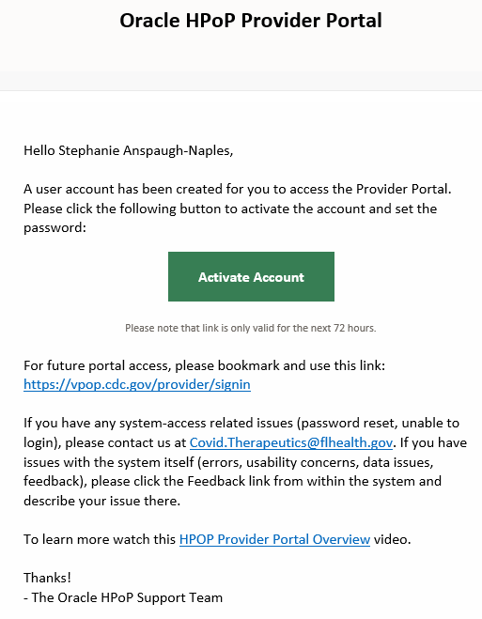
Account setup
User account is created
Name
Address
Email address
Phone number
System sends the user an email

Slide 7
Two-factor authentication
The first time a user logs into the system, a password and two-factor authentication must be set up
Two-factor authentication options
Microsoft Authenticator
Google Authenticator
Email

Slide 8
Initial account setup
Tasks that must be completed before a site is eligible to receive an allocation
Enter license number and expiration date
Enter or review receiving site address and hours
Formally verify this information

Slide 9
Recurring tasks in HPOP
Review orders that have been placed on behalf of the site
Enter courses administered and courses available counts for Evusheld, Paxlovid, and/or molnupiravir
Documenting transfers of therapeutics in HPOP

Slide 10
Inventory reporting

Slide 11
Inventory reporting
 | Sotrovimab | Evusheld, Paxlovid, and/or molnupiravir
How do I create an order? | You cannot currently create an order for sotrovimab | You cannot currently create an order for these products
How do I request doses? | Using the same ReadyOp link you’ve been using | Doses cannot be requested at this time
What do I have to report? | Inventory and utilization data for all mAbs in the order request link (bam-ete, regen-cov, and sotrovimab) | Courses administered and courses available
When and where do I have to report? | Weekly (up to 2x per week) By midnight every Wednesday in HHS Protect or TeleTracking By 5:00pm on Fridays in ReadyOp link | Daily in HPOP
Please note: Until the therapeutics supply stabilizes there will be no direct orders from providers

Slide 12
Live demonstration
(Please bear with me as I switch programs)

